Slide 1

Intro to Qiskit

Slide 2
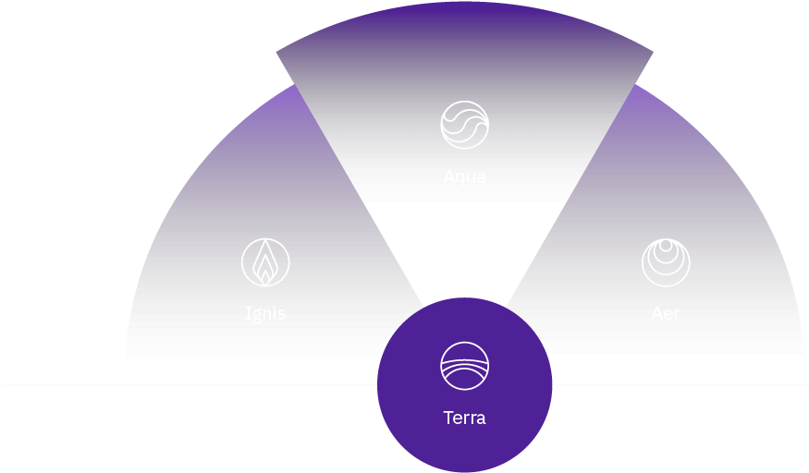
Qiskit = IBM QC Dev Platform
Terra: Composing programs
using circuits and pulses
Aqua: Building algorithms and applications
Aer: Simulators, emulators, and debuggers
Ignis: Addressing errors and noise

Slide 3
Qiskit Terra
Build
  Create circuit out of registers, gates
Compile
  Translate to QASM, then to backend instructions
Execute
  Backends = simulators (Aer), hardware

Slide 4
Building a Circuit
QuantumRegister
  Collection of qubits
  Indexed to reference individual qubit: q[0]
ClassicalRegister
  Collection of bits
  Used as the receiver of measurements on qubits
QuantumCircuit
  Starts with set of registers
  Add gates specifying registers/qubits as arguments

Slide 5
from qiskit import QuantumRegister, ClassicalRegister, QuantumCircuit
qreg = QuantumRegister(3) # a 3-qubit register
creg = ClassicalRegister(3) # a 3-bit classical register
qc = QuantumCircuit(qreg,creg) # create a circuit
qc.measure(qreg,creg) # measure all qubits in qr, put results in cr

Slide 6
Basic Gates
Quantum Gate | ...on qubits | ...on register
X (NOT) | qc.x(qreg[0]) | qc.x(qreg)
Hadamard | qc.h(qreg[0]) | qc.h(qreg)
CNOT | qc.cx(qreg[0],qreq[1]) | --
Toffoli | qc.ccx(qreg[0], qreg[1], qreg[2]) | --
Phase shift | qc.u1(angle,qreq[0]) | qc.u1(angle,qreg)
Swap | qc.swap(qreg[0],qreg[1]) | --
Measure (not a gate) | qc.measure(qreg[0],creg[0]) | qc.measure(qreg)
Reset (not a gate) | qc.reset(qreg[0]) | qc.reset(qreg)
summary_of_quantum_operations.ipynb

Slide 7
Other Circuit Operations
Operation | Description
qc.barrier() | Completes operations before proceeding. Can specify registers, qubits.
qc.add(regs) | Add register(s) to circuit.
qc.combine(circuit) | Appends circuit (if compatible). Creates new circuit (qc + circuit) and returns it.
qc.extend(circuit) | Appends circuit (if compatible). Modifies qc.
qc.qasm() | Returns a string containing the QASM representation of circuit.

Slide 8
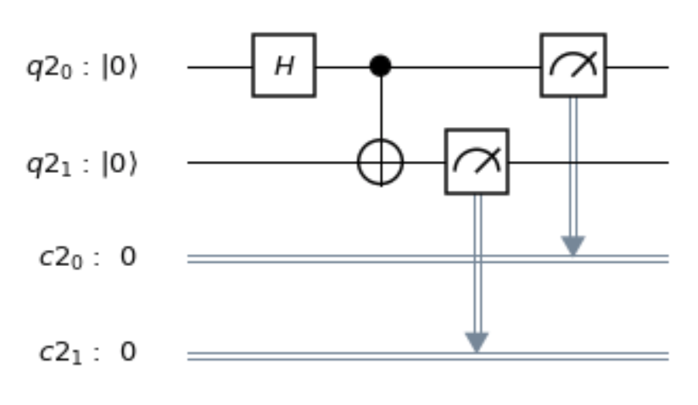
from qiskit import QuantumRegister, ClassicalRegister, QuantumCircuit
q = QuantumRegister(2)
c = ClassicalRegister(2)
qc = QuantumCircuit(q, c)
qc.h(q[0]) # Hadamard on first qubit
qc.cx(q[0],q[1]) # CNOT to entangle
# creates a Bell state
qc.measure(q,c)

Slide 9
Compiling and Running
Provider
  Facilitates access to a selection of backends
  Aer Provider
    simulators, running locally on your machine
  IBM Q Provider
    hardware, remote simulator
Backend
  Runs a compiled program (Qobj) and reports result
Job
  The result of an execution
  Asynchronous -- query job to see status
  Get result when complete

Slide 10
Backends
To compile/execute a circuit, must specify a backend.
Simulators:
  Local (Aer):
  qasm_simulator -- emulates a machine with/without noise, multi-shot
  statevector_simulator -- single shot, returns state vector
  unitary_simulator -- returns unitary matrix represented by circuit
  IBMQ: ibm_qasm_simulator
Hardware:
  IBMQ provider -- to be discussed later

Slide 11
Job Operations
Operation | Description
job.status() | Returns current status.
job.done() | Returns True if done, False if not.
job.id() | Identifier (remote provider only)
job.result() | Results from completed job.
job.result().get_counts() | Instances of various measured states, e.g. {'111': 512, '000': 512}
job_monitor(job) | Loop that waits for job to complete, periodically printing the job status.

Slide 12
Example One: Entaglement / Bell Pair
Write Qiskit program to
create Bell State
Jupyter notebook example

Slide 13
from qiskit import QuantumRegister, ClassicalRegister, QuantumCircuit
from qiskit import Aer, execute
from qiskit.tools.visualization import plot_histogram
# ... deleted circuit building commands...
qc.measure(q,c)
backend = Aer.get_backend('qasm_simulator')
job = execute(qc, backend, shots=512) # shots default = 1024
result = job.result()
print(result.get_counts())
plot_histogram(result.get_counts())

Slide 14
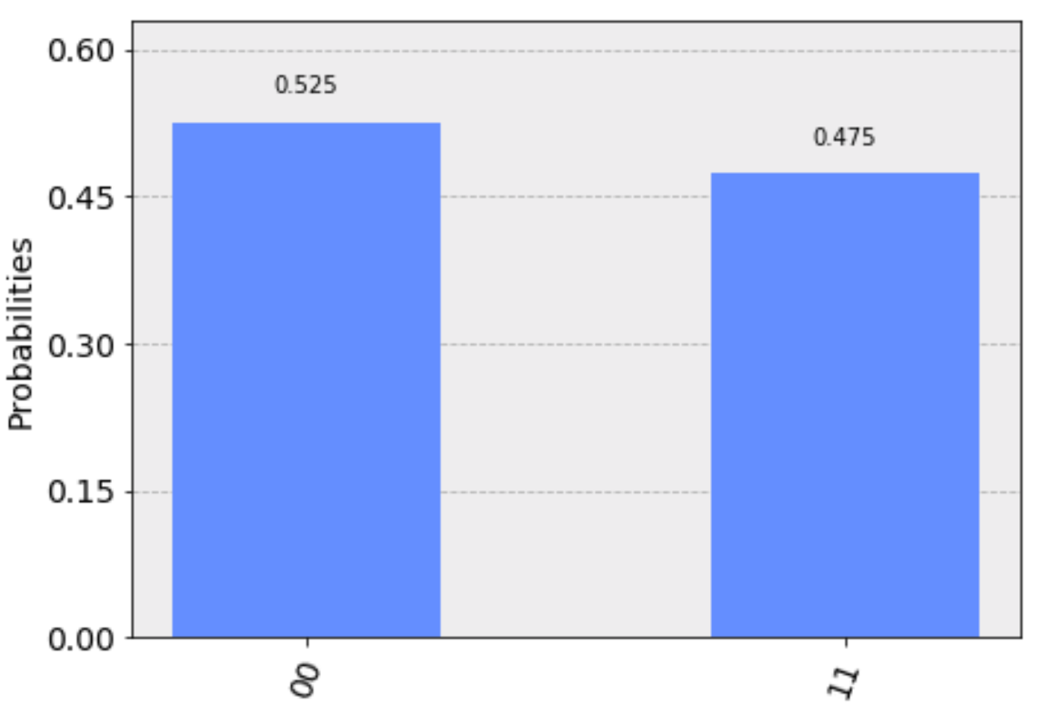
from qiskit import QuantumRegister, ClassicalRegister, QuantumCircuit
from qiskit import Aer, execute
from qiskit.tools.visualization import plot_histogram
# ... deleted circuit building commands...
qc.measure(q,c)
backend = Aer.get_backend('qasm_simulator')
job = execute(qc, backend, shots=512) # shots default = 1024
result = job.result()
print(result.get_counts())
plot_histogram(result.get_counts())
{'00': 269, '11': 243}

Slide 15
Example 2
What is the result of this measurement?
After the Toffoli gate, are the qubits entangled?

Slide 16
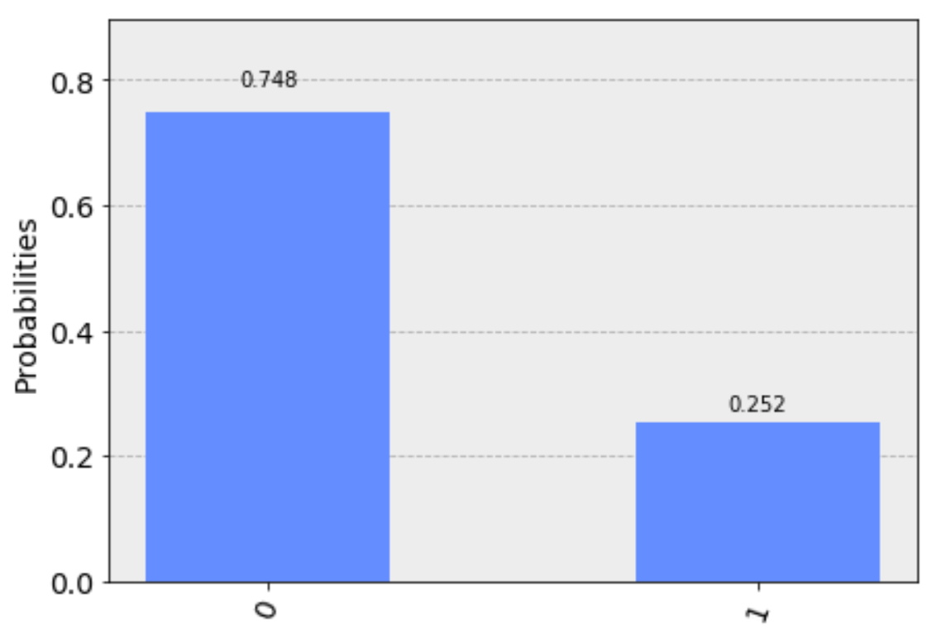
Example 2
What is the result of this measurement?
After the Toffoli gate, are the qubits entangled?

Slide 17
Example 3
Implement a quantum circuit that checks whether two qubits are equal (in the computational basis).
Use qiskit to demonstrate that your circuit works.
Would this circuit work to test whether two qubits in arbitrary states are equal?

Slide 18
Qiskit Summary
Create quantum and classical registers.
Create quantum circuit, adding registers.
Add gates and measurements to circuits.
Choose backend from provider.
Execute circuit -- compiles circuit to match specifics of backend.
Get results from job.

Slide 19
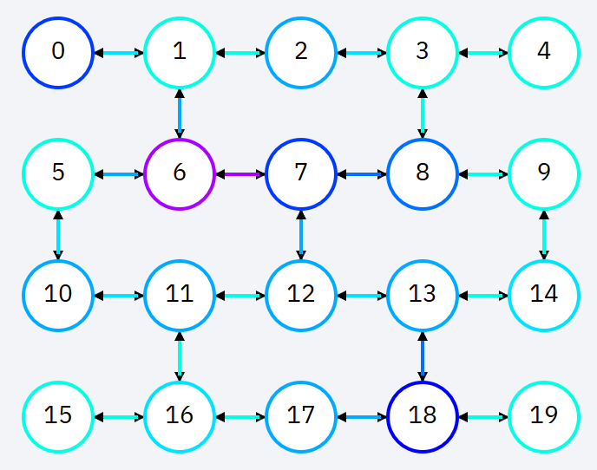
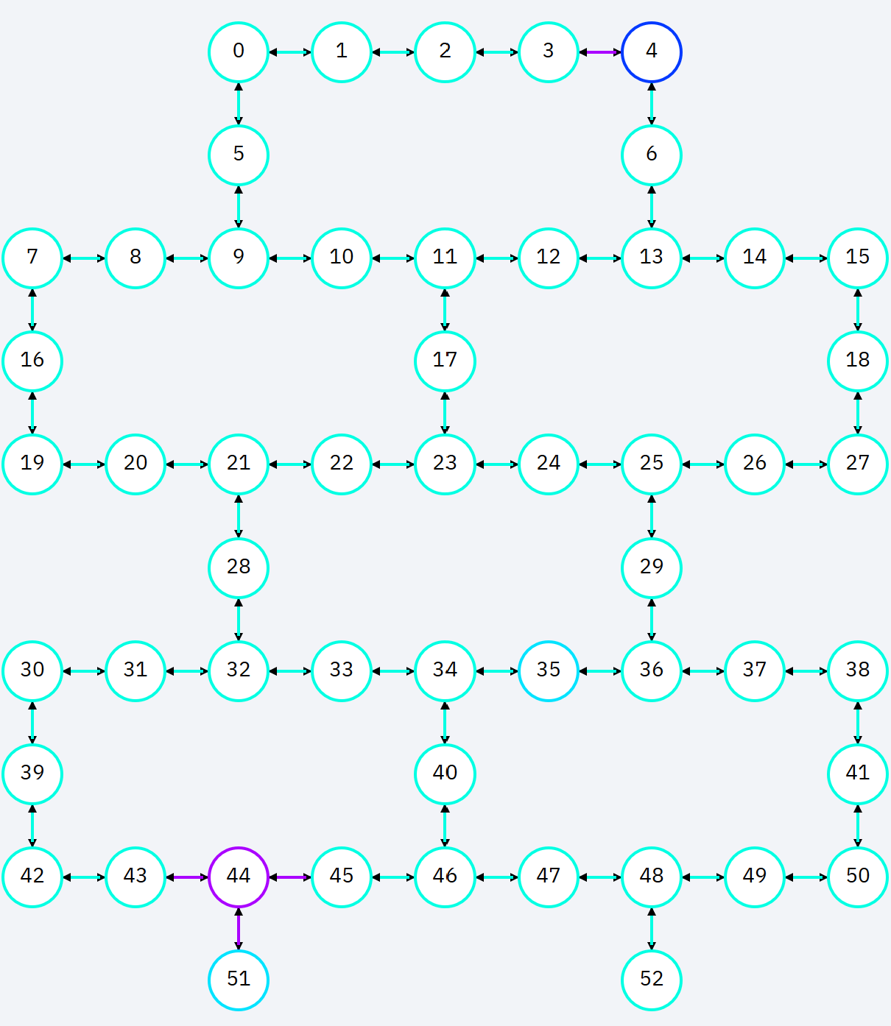
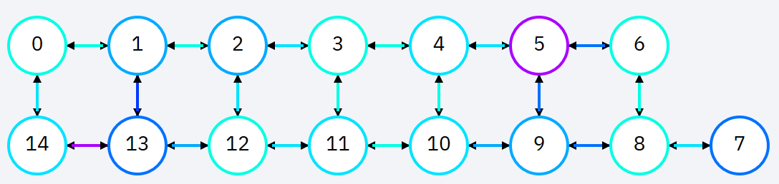
Limited Connectivity
IBM Q systems

