Slide 1
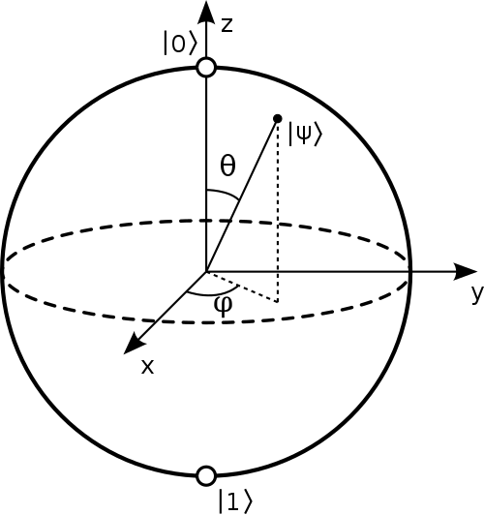
Quantum Gates,
Circuits, and Algorithms
(Part 2)
Qunatum Computing– Fall 2020

Slide 2
Next Steps
Efficient quantum implementations of classical functions
  Create reversible classical circuits
  Convert to quantum
  Undo entanglement
Quantum algorithms

Slide 3
Classical (Boolean) Circuits
In general, classical circuits are not reversible. Consider this circuit for a 4-way AND.
By using (classical) Toffoli gate, we can construct a reversible circuit. Requires one additional bit per AND gate, and of course a Toffoli gate is more complex than an AND gate.

Slide 4
Reusing Temporary Bits
These bits are no longer zero, and can’t be reused if this feeds into additional computation. Can’t just “reset” them, because that’s not reversible. Need to uncompute to reclaim them.
Tradeoff: Uncomputing requires extra gates, so
when is it better to reclaim vs. retain for potential later use?

Slide 5
General Scheme
Assume a classical circuit C can be decomposed into subcircuits C_{i}, convert each to reversible R_{i}.

Slide 6
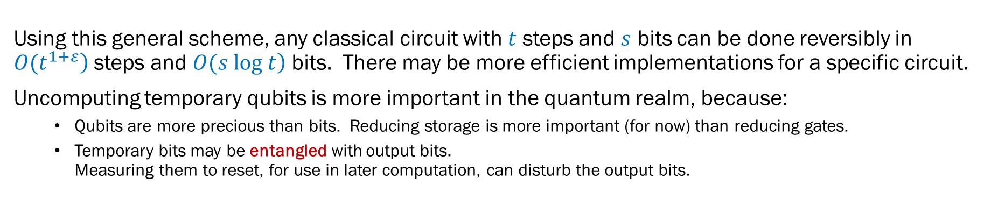
General Scheme
Using this general scheme, any classical circuit with $t$ steps and $s$ bits can be done reversibly in $\left.O(t^{1+ε}\right)$ steps and $\left.O(s log t\right)$ bits. There may be more efficient implementations for a specific circuit.
Uncomputing temporary qubits is more important in the quantum realm, because:
  Qubits are more precious than bits. Reducing storage is more important (for now) than reducing gates.
  Temporary bits may be entangled with output bits.
  Measuring them to reset, for use in later computation, can disturb the output bits.

Slide 7
Summary
Any computation with an efficient
classical circuit has an equivalent
efficient quantum circuit.
Use reverse computation to unentangle and reuse tmp qubits.
Further reading:
  John Preskill notes, Chapter 6
  Vedral, Barenco, and Ekert, Quantum Networks for Elementary Arithmetic Operations, Physical Review A, 54(1):147-153, 1996.
  Barenco, et al., Elementary Gates for Quantum Computation, Physical Review A, 52(5):3457-3467, 1995.

Slide 8
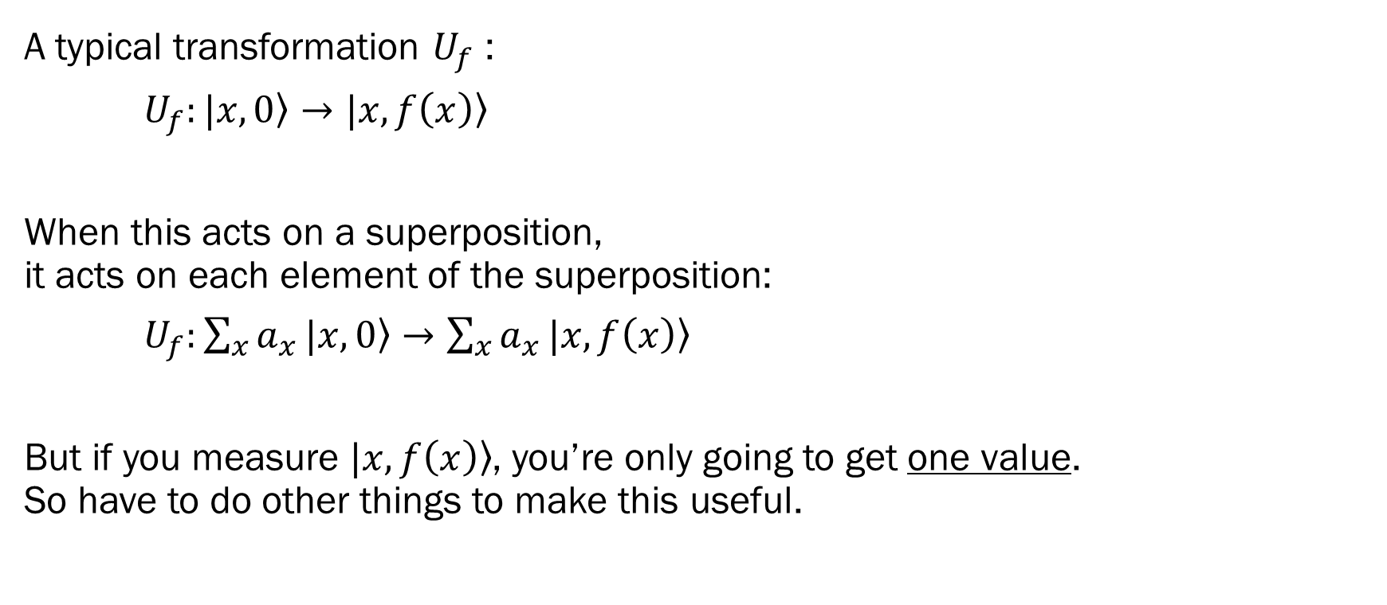
Quantum Parallelism
A typical transformation $U_{f}$ :
$U_{f}:|x,0〉→|x,f\left(x\right)〉$
When this acts on a superposition,
it acts on each element of the superposition:
$U_{f}:\sum_{x}{a_{x}}|x,0〉→\sum_{x}{a_{x}}|x,f\left(x\right)〉$
But if you measure $|x,f\left(x\right)〉$, you’re only going to get one value.
So have to do other things to make this useful.
So have to do other things to make it useful.

Slide 9
Quantum Algorithm Strategies
Create superposition of states (quantum parallelism)
Apply transforms that amplify desirable values and diminish unwanted values
Measure to get desired value with high probability.
  Typically, execute many times (“shots”) to identify high-probability value(s).
Repeat calculation to learn about relationships among values.
Measurements can yield information about the properties of values

Slide 10
Simple Quantum Algorithms
Deutsch
Phase Change for a Subset of Basis Vectors
Deutsch-Josza
Simon

Slide 11
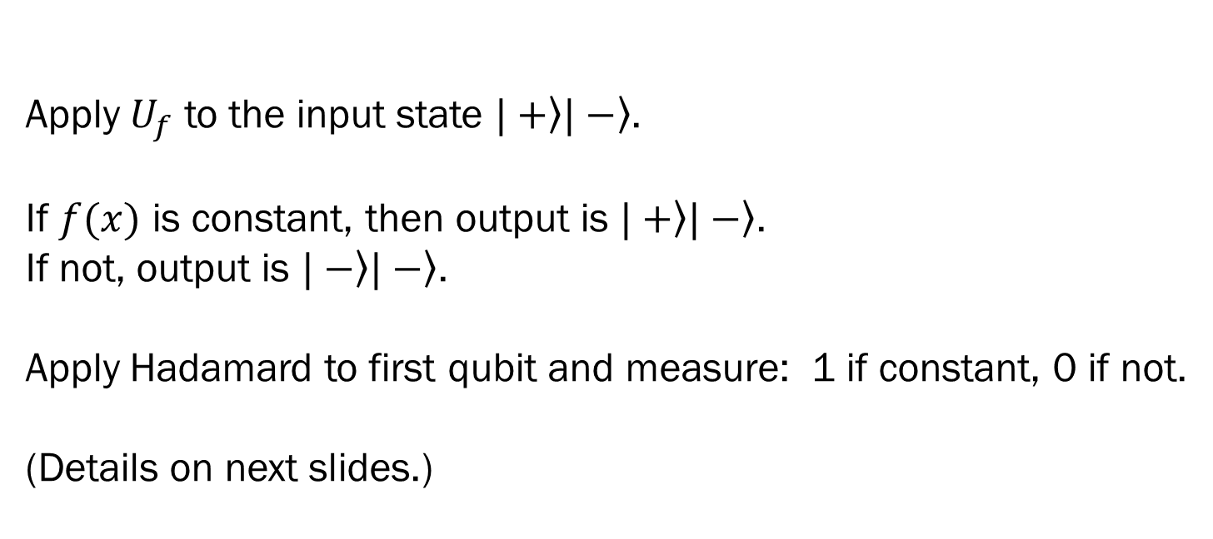
Deutsch Algorithm
Problem: Given a Boolean function $f:ℤ_{2}→ℤ_{2}$, determine whether $f$ is constant.
Apply $U_{f}$ to the input state $|+〉|−〉$.
If $f(x)$ is constant, then output is $|+〉|−〉$.
If not, output is $|−〉|−〉$.
Apply Hadamard to first qubit and measure: 1 if constant, 0 if not.
(Details on next slides.)
0
1
Requires only a single call to black box $U_{f}$, while classical algorithm requires two calls.

Slide 12
⊕ Denotes addition modulo 2 without carrying (same as bit-wise XOR), i.e.
f(x): |x>|y> → |x>|y ⊕ f(x)>

Slide 14
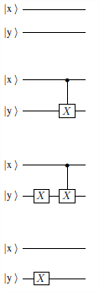
Deutsch’s Problem (V2)
 | x=0 | x=1
f₀ | 0 | 0
f₁ | 0 | 1
f₂ | 1 | 0
f₃ | 1 | 1
Consider f(x): Z₂ → Z₂ options: 2 constant, 2 not
Assume unitary U_{f} exist s.t. U_{f}(|x>|y>)=|x>|y⊕f(x)>
Could construct 4 different circuits
Could run U_{f} on |0>|0> and |1>|0> → same cost as classical
Instead, create superposition to test “both states” at once:
  U_{f}(H⊗|1>)(|0>0>)= 1/√2|0>|f(0)> + 1/√2|1>|f(1)>
But we need a single U_{f}: So try NOT, then Hadamard on both regs:
(H⊗H)(X⊗X)(|0>|0>)=(H⊗H)(|1>|1>)
= (1/√2|0> − 1/√2|1>)(1/√2|0> − 1/√2|1>)
= 1/2(|0>||0> − |0>|1> − |1>|0> + |1>|1>)

Slide 15
Deutsch’s Problem (V2)
 | x=0 | x=1
f₀ | 0 | 0
f₁ | 0 | 1
f₂ | 1 | 0
f₃ | 1 | 1
We have: (H⊗H)(X⊗X)(|0>|0>)=
1/2(|0>||0> − |1>|0> − |0>|1> + |1>|1>)
Applied to U_{f}, by linearity, we get:
1/2(U_{f} |0>||0> − U_{f} |1>|0> − U_{f} |0>|1> + U_{f} |1>|1>) =
1/2(|0>|f(0)> − |1>|f(1)> − |0>|f’(0)> + |1>|f’(1)>)
since U_{f}(|x>|y>)=|x>|y⊕f(x)>, where f’(x)=1⊕f(x)
constant f(0)=f(1): 1/2(|0> − |1>)(|f(0)> − |f’(0)>)
  Apply H to input→ |1>1/√2(|f(0)> − |f’(0)>)
not const f(0)≠f(1): 1/2(|0> + |1>)(|f(0)> − |f’(0)>) since f(1)=f’(0),f(0)=f’(1)
  Apply H to input→ |0>1/√2(|f(0)> − |f’(0)>)

Slide 16
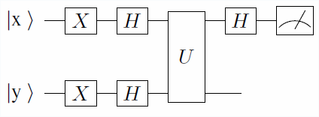
Deutsch’s Problem (V2)
 | x=0 | x=1
f₀ | 0 | 0
f₁ | 0 | 1
f₂ | 1 | 0
f₃ | 1 | 1
constant f(0)=f(1): 1/2(|0> − |1>)(|f(0)> − |f’(0)>)
  Apply H to input→ |1>1/√2(|f(0)> − |f’(0)>)
not const f(0)≠f(1): 1/2(|0> + |1>)(|f(0)> − |f’(0)>) since f(1)=f’(0),f(0=f’(1)
  Apply H to input→ |0>1/√2(|f(0)> − |f’(0)>)
So (H⊗|1>)U_{f}(H⊗H)(X⊗X)(|0>|0>)=
|1>1/√2(|f(0)> − |f’(0)>) if f(0)=f(1)
|0>1/√2(|f(0)> − |f’(0)>) if f(0)≠f(1)
This means measure input register to get |1> or |0> in this circuit:

Slide 17
Deutsch’s Problem (V3)
 | x=0 | x=1
f₀ | 0 | 0
f₁ | 0 | 1
f₂ | 1 | 0
f₃ | 1 | 1
Consider f(x): Z₂ → Z₂ options: 2 constant, 2 not
Assume unitary U_{f} exist s.t. U_{f}(|x>|y>)=|x>|y⊕f(x)>
(1) Start w/ f_{i},i=0..3 →

Slide 18

Deutsch’s Problem (V3)
 | x=0 | x=1
f₀ | 0 | 0
f₁ | 0 | 1
f₂ | 1 | 0
f₃ | 1 | 1
Consider f(x): Z₂ → Z₂ options: 2 constant, 2 not
Assume unitary U_{f} exist s.t. U_{f}(|x>|y>)=|x>|y⊕f(x)>
(1) Start w/ f_{i},i=0..3 →
(2) apply H before+after U_{f} →

Slide 19
Deutsch’s Problem (V3)
 | x=0 | x=1
f₀ | 0 | 0
f₁ | 0 | 1
f₂ | 1 | 0
f₃ | 1 | 1
Consider f(x): Z₂ → Z₂ options: 2 constant, 2 not
Assume unitary U_{f} exist s.t. U_{f}(|x>|y>)=|x>|y⊕f(x)>
(1) Start w/ f_{i},i=0..3 →
(2) apply H before+after U_{f} →
should be
same result

Slide 20
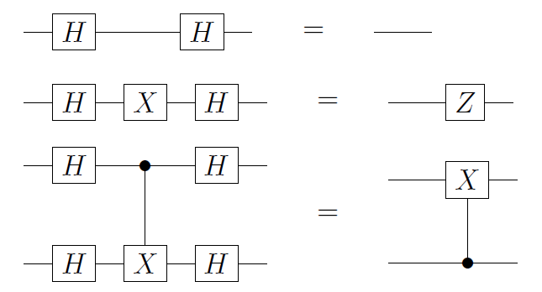
Deutsch’s Problem (V3)
 | x=0 | x=1
f₀ | 0 | 0
f₁ | 0 | 1
f₂ | 1 | 0
f₃ | 1 | 1
Consider f(x): Z₂ → Z₂ options: 2 constant, 2 not
Assume unitary U_{f} exist s.t. U_{f}(|x>|y>)=|x>|y⊕f(x)>
(1) Start w/ f_{i},i=0..3 →
(2) apply H before+after U_{f} →
(3) use equivalences→
should be
same result

Slide 21
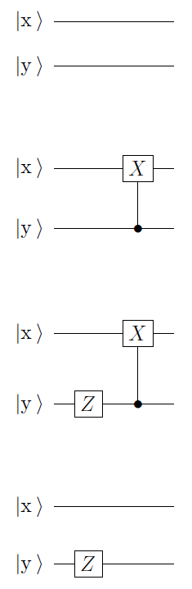
Deutsch’s Problem (V3)
 | x=0 | x=1
f₀ | 0 | 0
f₁ | 0 | 1
f₂ | 1 | 0
f₃ | 1 | 1
Consider f(x): Z₂ → Z₂ options: 2 constant, 2 not
Assume unitary U_{f} exist s.t. U_{f}(|x>|y>)=|x>|y⊕f(x)>
(1) Start w/ f_{i},i=0..3 → (4) H-Uf-H=equiv=result f(0) f(1)
(2) apply H before+after U_{f} → = 0 0
(3) use equivalences→
0 1
should be
same result 1 0
1 1
If input y=1, then output x=input x iff f=f₀ or f₃
If input y=1, then output x=¬input x iff f=f₁ or f₂

Slide 22
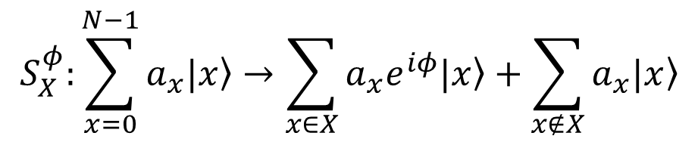
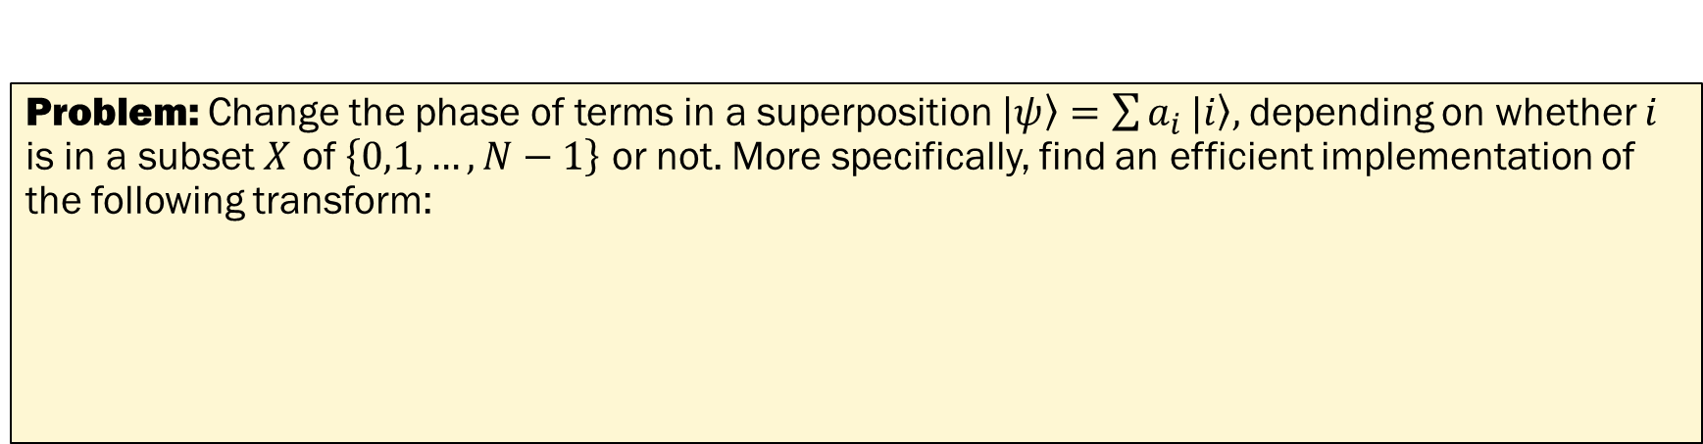

Selective Phase Change
Problem: Change the phase of terms in a superposition $|ψ〉=\sum{a_{i}}|i〉,$depending on whether $i$ is in a subset $X$ of $\left\{0,1,…,N−1\right\}$ or not. More specifically, find an efficient implementation of the following transform:
$$S_{X}^{φ}:\sum_{x=0}^{N−1}{a_{x}|x〉}→\sum_{x∈X}{a_{x}e^{iφ}|x〉}+\sum_{x∉X}{a_{x}|x〉}$$
Requires an efficient implementation of $U_{f}$ for the function $f\left(x\right)$ that tests for membership in $X$:

Slide 23
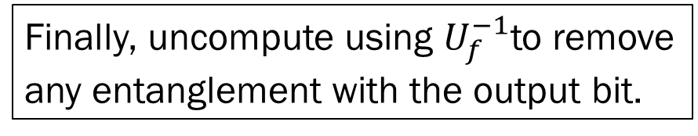
Finally, uncompute using $U_{f}^{−1}$to remove
any entanglement with the output bit.

Slide 24
Special case of π:

Slide 25
Qiskit Example
Create a circuit that generates an equal superposition of two qubits,
except the sign (phase) is flipped when the two qubits are equal.
  Sign flip is phase change of π.
  Use the "equal" circuit from Example 3.
How do you see the phase shift in qiskit?
More details leading up to phase change (after the exercise):
https://qiskit.org/textbook/ch-gates/phase-kickback.html

Slide 26
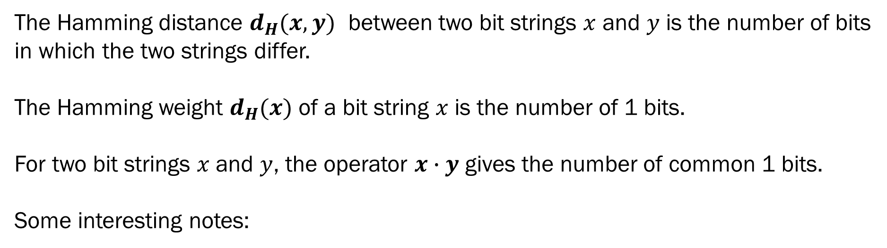
Background: Hamming Distance
The Hamming distance $d_{H}(x,y)$ between two bit strings $x$ and $y$ is the number of bits
in which the two strings differ.
The Hamming weight $d_{H}(x)$ of a bit string $x$ is the number of 1 bits.
For two bit strings $x$ and $y$, the operator $x∙y$ gives the number of common 1 bits.
Some interesting notes:

Slide 27
More on Walsh-Hadamard
where N=2^{n}

Slide 28
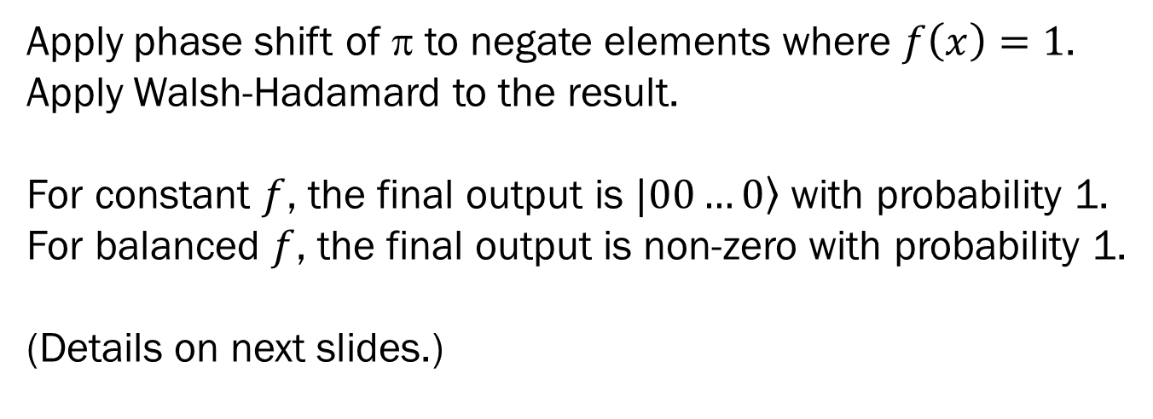
Deutsch-Josza Algorithm
Problem: Given an n-bit Boolean function (mapping n bits to 1) that is known to be either constant or balanced, determine whether it is balanced or constant. A function is “balanced” if an equal number of input values return 0 and 1.
Requires only a single call to black box $U_{f}$, while classical algorithm requires at least $2^{n−1}+1$ calls.

Slide 30
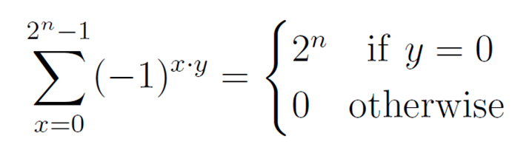
and since
we get Σ(-1^{)i•0=}N
, which means amplitudes are 0 for non-zero |j>.
So all we are left with is |0> with amplitude 1 and an optional global phase (which is ignored).

Slide 32
Qiskit Example
Use the previous example (phase shift) to demonstrate
Deutsch-Josza algorithm.
  isEqual is a balanced function
Further details: https://qiskit.org/textbook/ch-algorithms/deutsch-josza.html

Slide 33
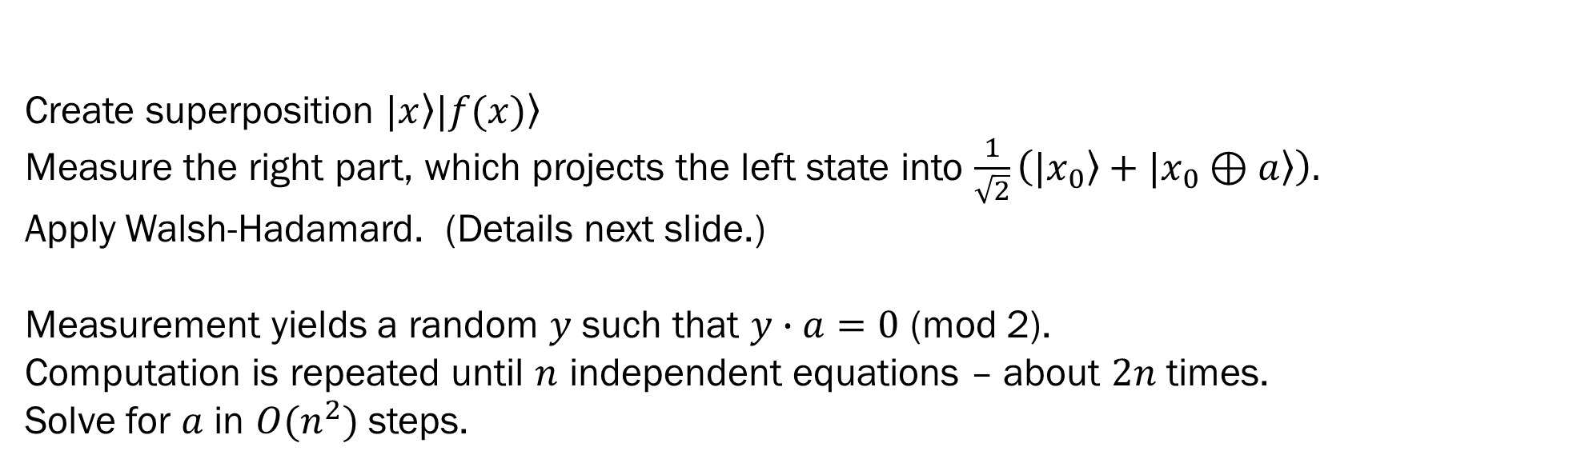
Simon’s Algorithm
Problem: Given a 2-to-1 function $f$, such that $f\left(x\right)=f(x⊕a)$, find the hidden string $a$.
Create superposition $|x〉|f(x)〉$
Measure the right part, which projects the left state into $\frac{1}{\sqrt{2}}\left(|x_{0}〉+|x_{0}⊕a〉\right).$
Apply Walsh-Hadamard. (Details next slide.)
Measurement yields a random $y$ such that $y∙a=0$ (mod 2).
Computation is repeated until $n$ independent equations – about $2n$ times.
Solve for $a$ in $O(n^{2})$ steps.
Requires $O\left(n\right)$ calls to $U_{f}$, followed by $O(n^{2})$ steps to solve for $a$.
Classical approach requires $O(2^{n/2})$ calls to $f$.

Slide 36
Summary
Any efficient reversible classical circuit can be
efficiently implemented as a quantum circuit.
  Use inverse function to reduce space and unentangle temporary bits.
For quantum advantage, add some non-classical operations.
  E.g, phase change.
Are these algorithms really useful?
  Perhaps not directly, but they illustrate ways in which quantum computing may have an advantage over classical computing.

