Slide 1


Compiler Techniques to Fight Bias and Correlated Errors on NISQ Hardware
Swamit Tannu
APQC 2019
Estes Park, Colorado
Notes:
Good Afternoon, Thanks for being here, Today I will talk about how we can use simple software techniques to fight bias and correlated errors. So my background is computer architecture and systems, similar to previous speaker.

Slide 2
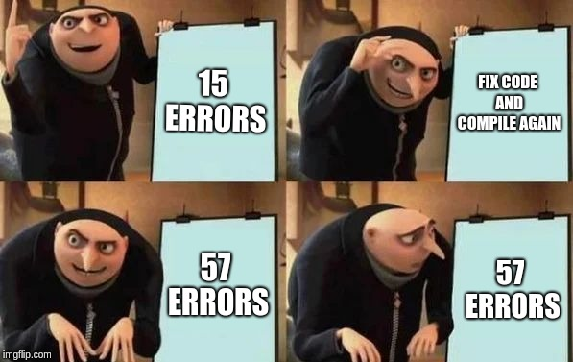
Compiler: Program Transformation
Notes:
For Classical programs, problem of program transformation, where you have a program P and it is transformed into program P’ such that

Slide 3
Classical Program Transformation
P is any classical program
Program Transformation
P
P’
time to execute P > time to execute P’ (lower is better)
Caveat:
P , P’ are semantically equivalent programs
have access to identical instruction set
Notes:
For Classical programs, problem of program transformation, where you have a program P and it is transformed into program P’ such that

Slide 4

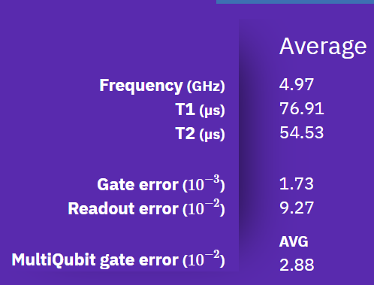
Error Rates on Existing Quantum Computers
Program Transformation
Q
Q’
Caveat:
Semantically equivalent programs
have access to identical instruction set
Can we design program transformations to improve resilience?
Notes:
Error-rates are

Slide 5
“NISQ” Programming Model
Input Program
(Like Bernstein-Vazirani )
Due to probabilistic measurements and qubit errors, program is executed multiple times.
For every execution trial the output is logged
Compile
Error free outcome
Erroneous outcome
q-executable
N Trials
Execute
Execute
Output String
Output String
PST = 0.3
Repeat for N Trials
Probability of Successful Trial (PST) is a key metric

Slide 6

Inferring Correct Answer with NISQ Model
Quantum
Computer
Input Program
30%
Frequency
20%
20%
15%
10%
5%
S1
S2
S3
S4
S5
S6
Output Strings
Inference: Pick output with highest frequency of occurrence

Slide 7
OUTLINE
Background
Variability-Aware Qubit Allocation [ASPLOS-2019]
Ensemble of Diverse Mappings: Spreading Correlated Errors [MICRO-2019]
Flip and Measure: Diversifying Measurement Risk [MICRO-2019]

Slide 8
Qubit Allocation Problem
Compute Pairwise Distance Table assuming Uniform SWAP cost
Partition the program into layers
Find SWAPs to minimize the A-Star
cnot
A
Program Variable DAG
Physical Qubit Connectivity
cnot A,B
cnot C,D
cnot A,C
cnot A,D
B
D
1
2
3
B
C
A
C
6
5
4
Input Program
D
Program to Devices Map
(P2D ) Map
Circuit Representation
of program
Map program on the physical qubits

Slide 9


The Problem of Limited Connectivity
A
B
Not Possible no link between
A and B
C
CNOT A,B
Q1
Q2
Q3
SWAP B,C
link between
A and B, CNOT can be performed
Q6
Q5
Q4
CNOT A,B
SWAP facilitate data movement
Compiler insert SWAPs → SWAPs are extra instructions which can also fail

Slide 10
NISQ Compiler Policies
[1] Zulehner+, (DATE’18)
[2] Siraichi+, (CGO’18)
[3] Li+, (ASPLOS’19)
Compiler responsible for qubit allocation and movement
A
SWAPs = 4
SWAPs = 2
1
2
3
A
1
2
3
B
B
6
5
4
6
5
4
Qubit movement policy minimizing SWAPs
Existing compiler policies solely focus on minimizing SWAPs
Notes:
In fact, this is an active area of research, several papers focus on SWAP minimization for NISQ.
On a NISQ machine compiler is responsible for qubit allocation and movement, for example we require four SWAPs to entangle and B on
For example on the right we have the SWAPs that use shortest route.
Existing compiler policies solely focus on minimizing SWAPs.

Slide 11
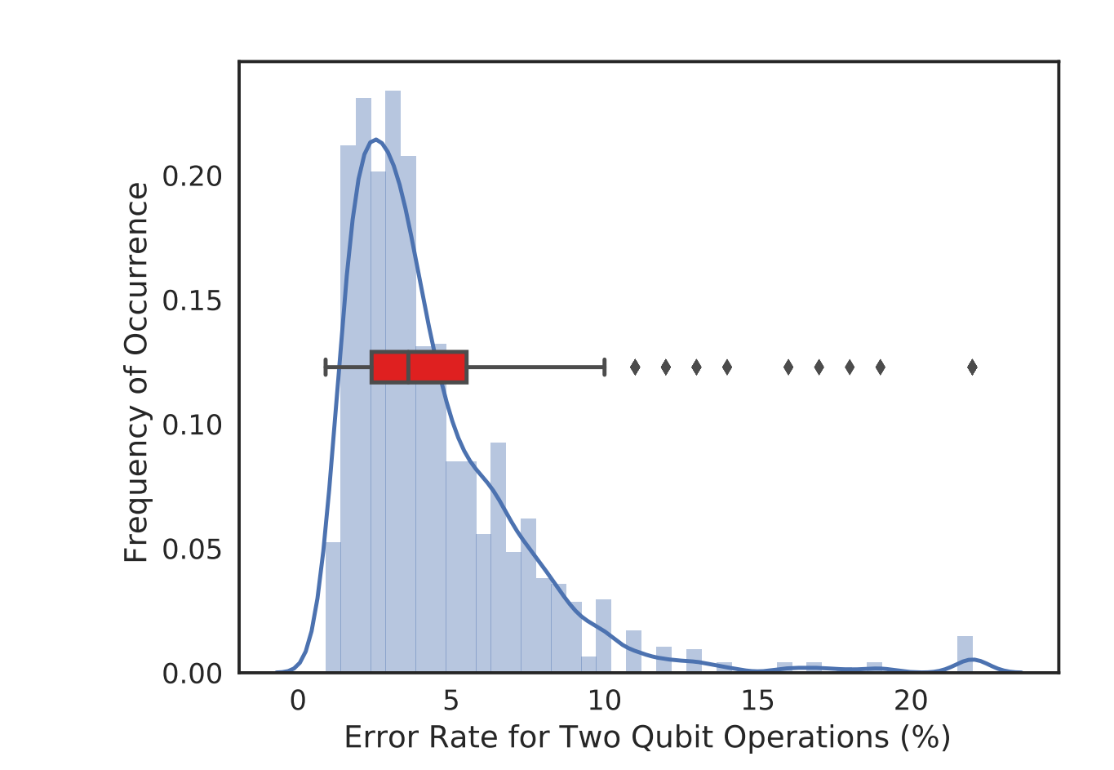
CNOT Errors on IBMQ-20
Average error rate 4%
Note: data collected in Feb-April 2018
from IBMQ20 (IBM Tokyo) reports
90th Percentile: Link Error 10%
Two qubit error rate is high and show significant variability

Slide 12
Not All Qubits Are Created Equal
Tannu et. al, “Not All Qubits are Created Equal” (ASPLOS - 2019)
Variability: Some qubits and links fail with higher probability than others
Avoiding certain links can improve reliability significantly
Best SWAP
6% probability of Failure
Worst SWAP 40% Chance of Failure
Q1
Q2
Q1
Q2
Q3
Q3
Q6
Q6
Q6
Q5
Q4
Q4
Goal: Exploit variation in error rates to improve reliability
(assign more operations on reliable qubits/links)
Notes:
In our paper, we observe that not links have the same reliability, some links and qubits are much more vulnurable to errors than others.
For example, on IBM machines one of the links has SWAP error rate of 40% and the other link has error rate of 6%
To improve the reliability, we want to avoid SWAP on the red link and use the green link.
The goal of our paper is to develope compiler policies that exploit variation in error rates to improve reliability.
To enable this let’s look at the characterization of errors

Slide 13
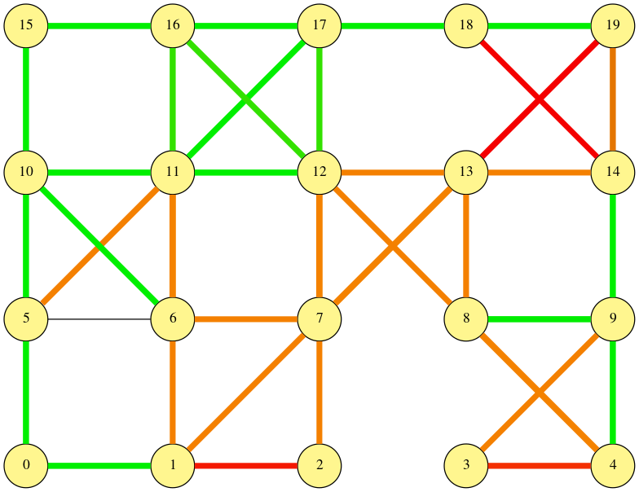
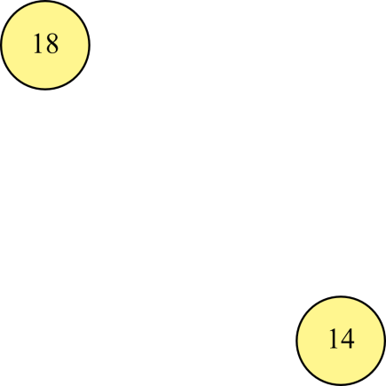

Variation in Two Qubit Gate Errors
Worst link:
15% cnot error
Link Error Rate > 7%
3% < Link Error Rate < 7%
Link Error Rate < 3%
Average link error rate for 76 links in IBM-Tokyo machine
Best Link:
2% cnot error
Some links are consistently more error prone than others
Notes:
Next we show the spatial variation in the link error rate. This diagram represents the network for IBMQ20 systems.
Link error rates are color coded,
links in red have error rate more than 7%
Links in orange have error rate between 3% and 7%
Whereas links in green have error rate less than 3%
The worst case link has 15% error rate , whereas the best link has 2% error rate,
Some links are consistently more error prone than others
We can use this information to avoid bad links and use good links that’s our proposal

Slide 14

Variation-aware Qubit Movement (VQM)
A
Movement Path | Probability of Success
1-6-5 | 40%
1-2-3 | 50%
1-2-5 | 60%
0.9
0.9
1
2
3
0.95
0.95
0.95
6
5
4
0.8
0.95
B
cnot A, B
Chose a sequence of swaps that maximizes the reliability
Notes:
If we expose variability to the compiler than we can choose a path that maximizes the reliability,
In the figure, the number above the link shows probability of Success, for example link between D-C is the best link with 90% success rate
If we wan to entangle A and B there are three possible paths with just tw SWAP operations, for instance
1-6 –5 that will have 45% success rate
1-2-3 that will have 40% success rate
1-2-5 that will have 60% success rate
While trying to keep the SWAP count to minimimum
We can extend tyhis while allocating the qubits

Slide 15


Variation Aware Qubit Allocation (VQA)
cnot A,B
cnot B,C
cnot C,D
A
A
B
B
0.9
0.9
0.9
0.9
1
2
3
1
2
3
0.95
0.95
0.85
0.95
0.85
0.95
6
5
6
5
4
4
0.8
0.8
0.95
0.95
D
C
D
C
SWAPs = 0
PST = 0.61
SWAPs = 0
PST = 0.77
Choose qubits that maximizes the reliability
Notes:
For example if we want to use four qubits on six qubit machine to run the example program where
A,B,C,D are entangled with adjacent qubits
We can either choose four qubit devices on the right or left, bot will have identical SWAP cost, but the allocation on the right has the higher reliability as it uses the best possible links on the machine

Slide 16
Variation-Aware Policy
Input Program
Variation-aware Qubit Allocation (VQA)
Variation-aware
Compiler
Connectivity Map
Variation-aware Qubit Movement (VQM)
Noise Characteristics
We propose variation-aware policy , to generate initial assignment and operation schedule that maximize the reliability, not just SWAP count
Notes:
We use the characterization data to generate initial assignment and SWAP schedule that maximizes the reliability by accounting the variation in the link error rates not just minimizing the swap count

Slide 17
Evaluations on ibmqx4
90%
Variation unaware baseline
Relative PST
BV3 – Bernstein Vazirani with 3 bits
BV4 -- Bernstein Vazirani with 3 bits
Tri-SWAP – 3 SWAPs
On IBM-Q5, VQA+VQM improves the reliability up to 1.9x
Notes:
We test proposed policies on the five qubit IBM quantum computer.
This graph shows four benchmarks that we run on IBMQ5. The y axis is the ratio of PST for the proposed policies over PST of baseline that is variation unaware

Slide 18
Variability-aware Compilation for NISQ
Not All Qubits Are Created Equal by Tannu et. al (2018) [Georgia Tech]
Noise-adaptive compiler mappings by Murli et. al (2019) [Princeton]
Extracting Success from IBM's 20-Qubit Machines by Nishio et. al (2019) [Keio]
Near-optimal routing of noisy quantum states by Sadlier et. al. (2019) [Oak Ridge]
Quantum Circuit Compilation by Venturelli et. al (2019) [NASA]
QURE: Qubit Re-allocation in NISQ by Ash- Saki et. al (2019) [Penn State]
And many more …….
IBM QISkit now offers Variability Aware Mapping

Slide 19
Variability-aware Compilation for NISQ
Input Program
Variation-aware
Compiler
One Best Mapping
Connectivity Map
Noise Characteristics
Should we use one best mapping for all our trials?

Slide 20
OUTLINE
Background
Variability-Aware Qubit Allocation
Ensemble of Diverse Mappings: Spreading Errors
Flip and Measure: Diversifying Measurements to Fight Bias

Slide 21
NISQ with Correlated Errors
Input Program
Error free outcome
Erroneous outcome
Expectation
Compile
q-executable
Repeat for N Trials
Execute
Reality
Output Log
30%
30%
15%
15%
10%
High Probability of Successful Trial (PST) doesn’t guarantee correct inference
Notes:
Use quantum error correction to mitigate errors. But quantum error correction is expensive. We need 20 to 50 qubits to build one fault-tolerant qubit. We can not afford this given our machines have 10s of qubits.
A new paradigm has emerged called Noisy Intermediate Scale Quantum (NISQ) Computing where the workload is run without any error correction. We run the workload again and again for N trials. For each trial we log the output.
By analyzing the log we can infer the correct answer if the correct answer appears with the reasonable probability
The key figure of merit for NISQ is the probability of successful trial or PST

Slide 22
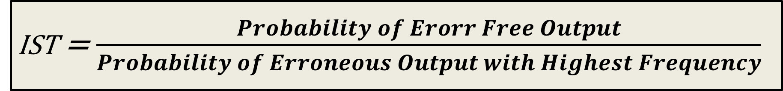


Figure of Merit: Inference Strength (IST)
IST = $\frac{Probability of Erorr Free Output}{Probability of Erroneous Output with Highest Frequency}$
IST = $\frac{0.35}{0.40}$ = 0.87
40%
IST = $\frac{0.3}{0.25}$ = 1.25
35%
30%
25%
25%
10%
20%
5%
A
B
C
D
A
B
C
D
IST captures quality of inference. IST > 1 ensures correct answer is strongest
Notes:
Use who wants to be millioniar

Slide 23
Goal
Software can significantly affect the ability to infer the right answer on NISQ
Goal: Develop software transformation for NISQ programs to reduce the impact of hardware errors

Slide 24
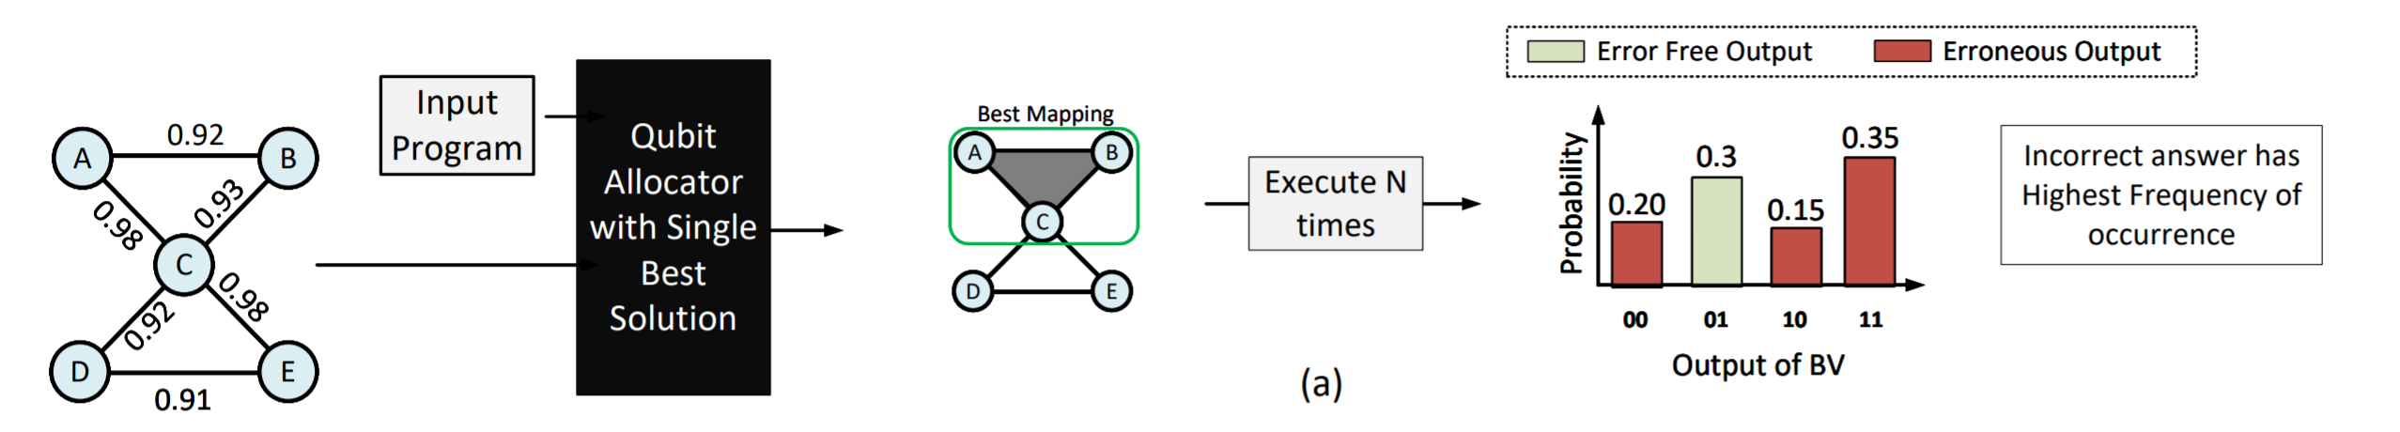
One Mapping For All Trials
Prior work searches for best qubit mapping and uses it for all N trials
Notes:
Change the figure have an

Slide 25
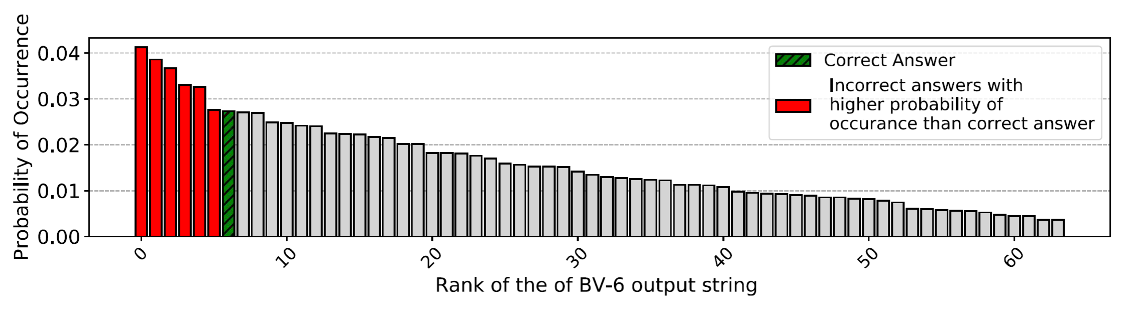
Running Bernstein Vazirani (BV) on IBMQ-14
Experiment with 8192 shots → Batch
BV-6 → Bernstein Vazirani Algorithm with 6-bit Key

Slide 26
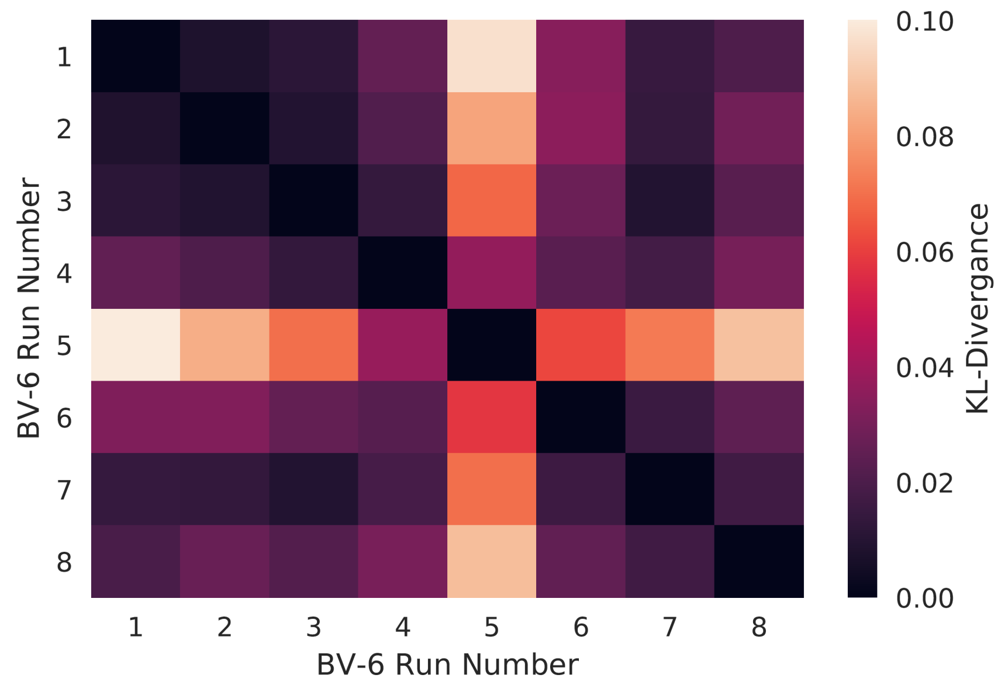
Impact of Running Identical Program for All Trials
KL-Divergence →
Similarity between Probability Distributions
KL(Batch-1, Batch-8) = 0.035
Running a program with identical mapping produces similar output distributions
Notes:
What is this heat map
Kullback-Leibler divergence

Slide 27
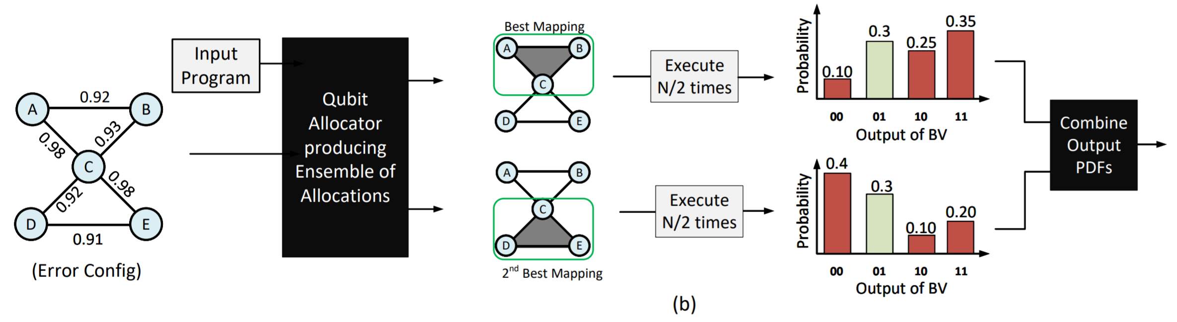
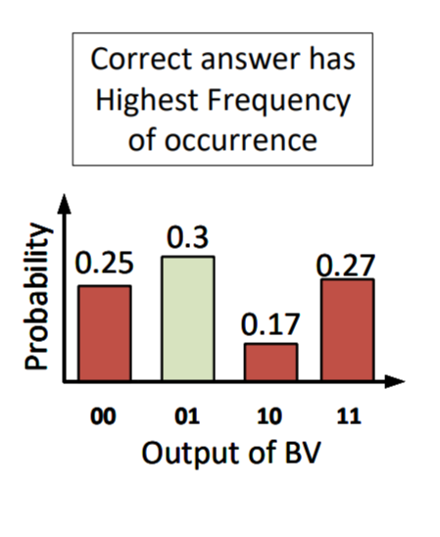
Can We Suppress Incorrect Answers with Diversity?

Slide 28
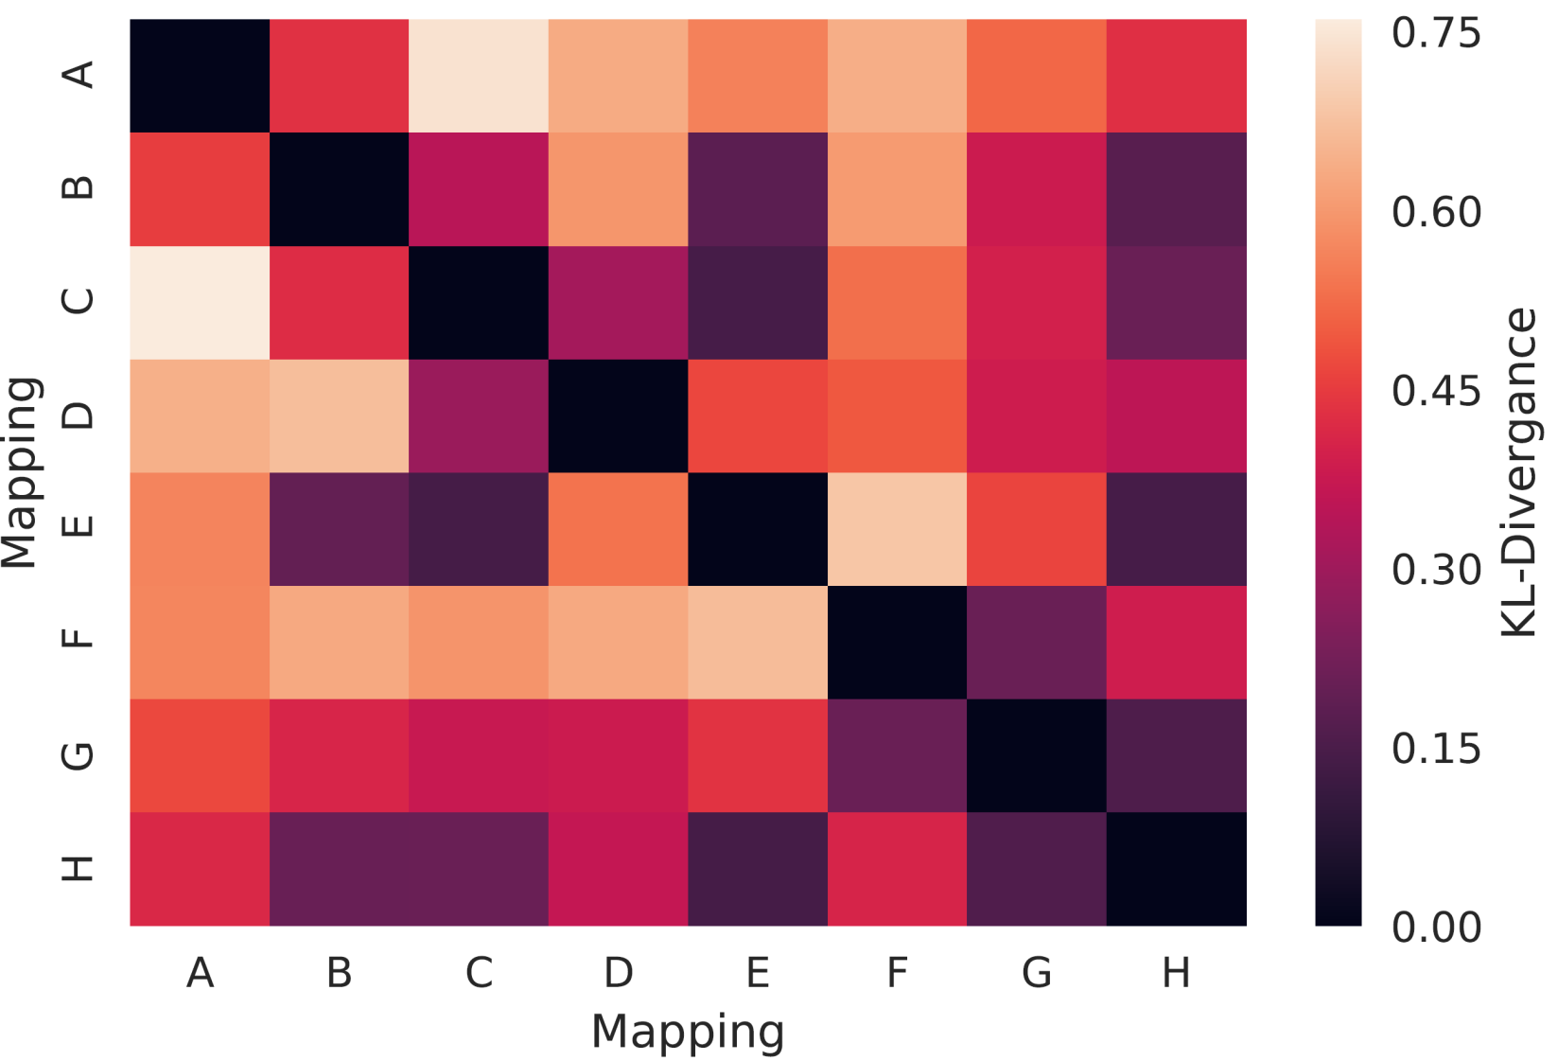
Running Program with Diverse Mappings on IBMQ
Diversity in qubit mapping produces dissimilar output distributions

Slide 29
Ensemble of Diverse Mapping: Design
M 1
E 1
O 1
Variation Aware
Qubit Mapper
Sub-graph
Search
E 2
O 2
M 2
Q
Assembler
Execute on NISQ
Merge
PDFs
MAP
best
M 3
E 3
O 3
M 4
E 4
O 4
Qubit Mappings
Quantum Executables
Output PDF
Notes:
Make this figure better

Slide 30
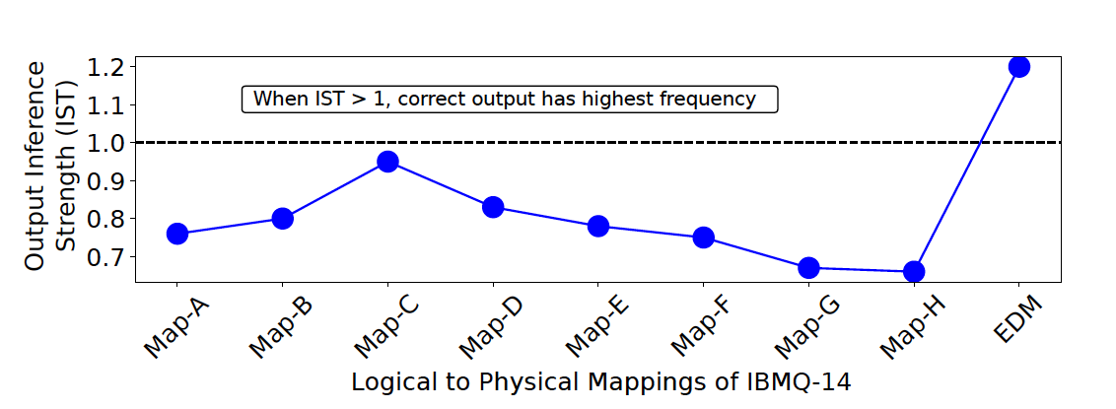
Ensemble of Diverse Mappings
EDM creates four copies of the program using mappings A, B, C, and D
With diverse set of mappings we can orchestrate dissimilar mistakes

Slide 31
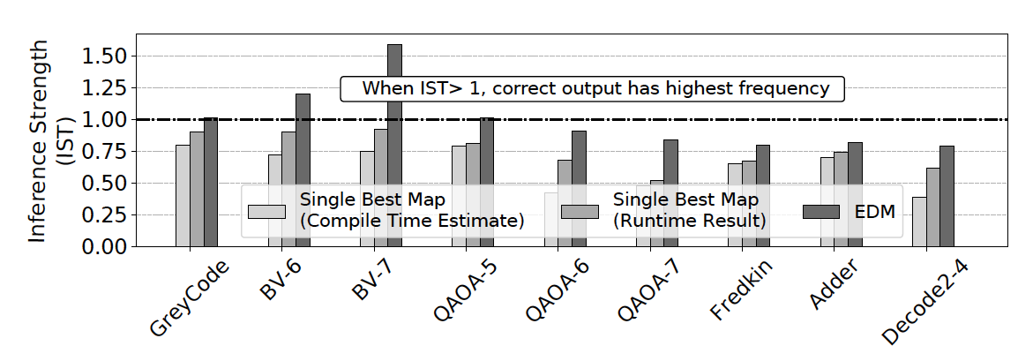
Evaluations on IBM-Q14 system
For current quantum kernels, EDM improves the IST by up to 1.5x

Slide 32
OUTLINE
Background
Variability-Aware Qubit Allocation
Ensemble of Diverse Mappings: Spreading Correlated Errors
Flip and Measure: Diversifying Measurement Risk

Slide 33

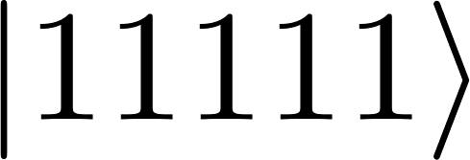
Data Dependent Bias in Measurement
Correct Answer
84%
Qubit Measurement
(N trials)
Probability
Incorrect Answers
16%
Correct Answer
Qubit Measurement
(N trials)
Probability
Incorrect Answers
62%
38%
On IBM-Q5, measurement errors have directional bias
Notes:
Megan Lily from Oak Ridge

Slide 34
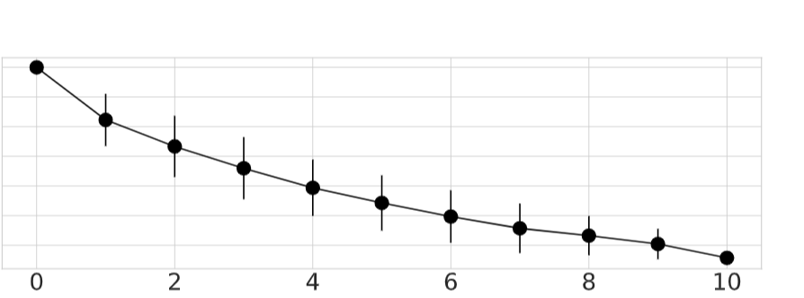

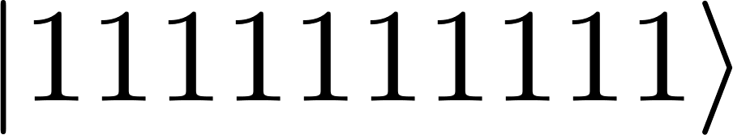
Measurement Bias on IBMQ-14
1.0
0.9
0.8
0.7
0.6
0.5
0.4
Measurement
Strength
0
2
4
6
8
10
Hamming weight of basis state
Measurement Strength is negatively corelated to Hamming weight of data

Slide 35
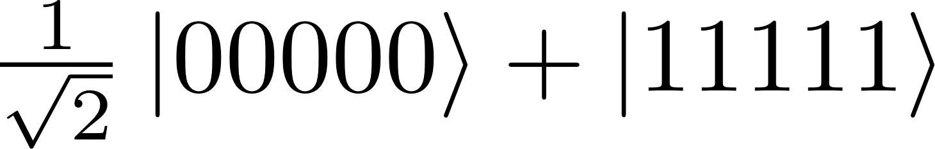
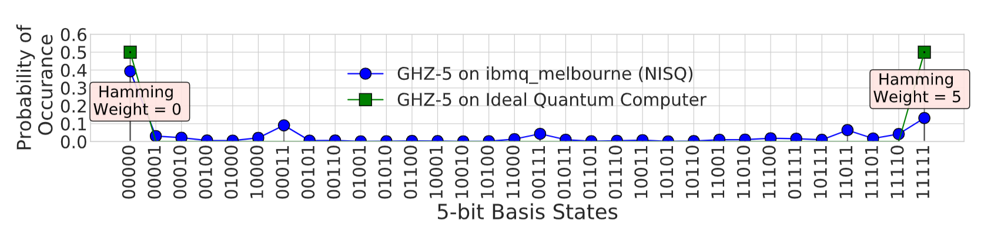
Measurement Bias for GHZ-5 State
GHZ-5 state →
Notes:
40 mins --

Slide 36
Insight – Leveraging Measurement Bias
Not all states are created equal: Some basis states are more vulnerable to measurement errors than others
Avoiding such weak states can improve reliability significantly
Goal: Exploit state-dependent bias in measurement error to improve reliability (transform weak states to strong states)
Notes:
In our paper, we observe that not links have the same reliability, some links and qubits are much more vulnurable to errors than others.
For example, on IBM machines one of the links has SWAP error rate of 40% and the other link has error rate of 6%
To improve the reliability, we want to avoid SWAP on the red link and use the green link.
The goal of our paper is to develope compiler policies that exploit variation in error rates to improve reliability.
To enable this let’s look at the characterization of errors

Slide 37
Invert and Measure on ibmqx4
Correct Answer
Qubit Measurement
(N trials)
Probability
Incorrect Answers
62%
38%
Correct Answer
Probability
X gate
Qubit Measurement
(N trials)
78%
Incorrect Answers
5
22%
Inverting a weak state (11..1) to produce strong state (00..0)
Notes:
Keep both

Slide 38
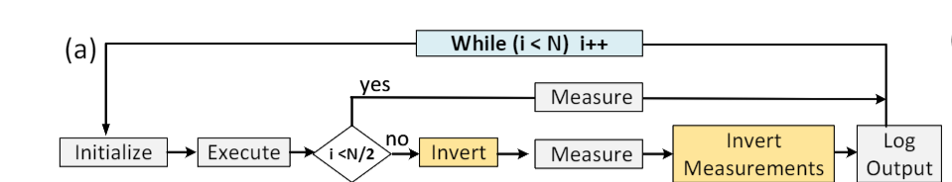
Invert and Measure: Design
Create two copies of program: one with inverted measurement and other with standard measurement

Slide 39
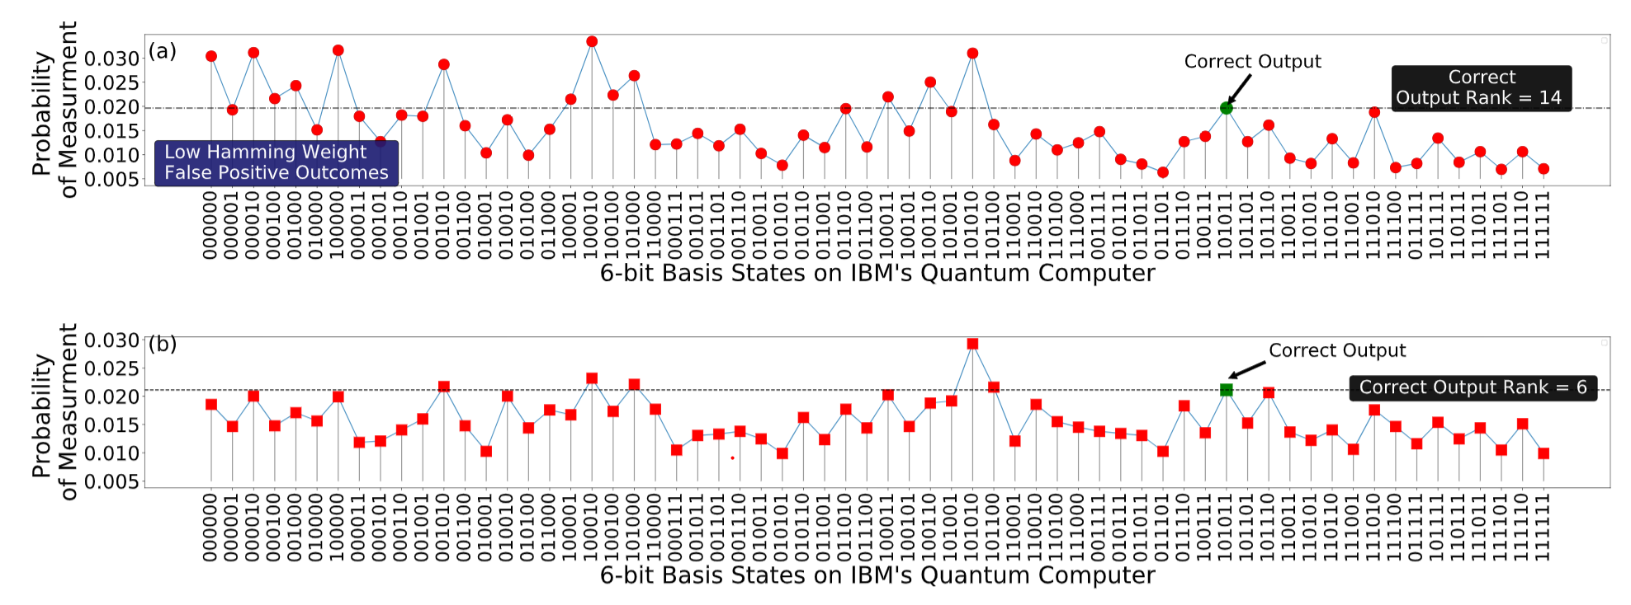
Invert and Measure on IBMQ
Baseline
Invert and Measure

Slide 40
Summary
Correlation in qubit errors and bias in measurements degrade the inference strength (ability to infer right answer) on NISQ machines
Executing Identical program that uses single best mapping for all trials produces correlated errors
Proposed Ensemble of Diverse Mapping (EDM) and Flip and Measure (FNM), creates multiple copies of the program to mitigate correlated errors and bias

Slide 41
Transformation: The Key to Computation
Problem
Problem
(Conv. Hard, Quantum Easy)
Algorithms
Algorithms
Language/Compilers
Q-Software
Architecture
Hardware Architecture
Integrated Circuits
Characterization(QCVV)
Devices/Technology
Qubit Devices
Electrons
Photons/Ions/Electrons
Notes:
quantum characterization, verification, and validation

Slide 42
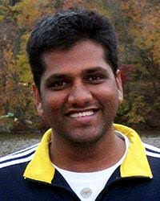

Thank you
Moin Qureshi
Professor, moin@gatech.edu
Swamit Tannu
Ph.D. Candidate swamit@gatech.edu

Slide 43
Backup Slides -- ASPLOS

Slide 44
Implementation Example
Compute Pairwise Distance Table assuming Uniform SWAP cost
Partition the program into layers
Find SWAPs to minimize the A-Star
cnot
A
Logical Qubit DAG
Physical Qubit Connectivity
cnot A,B
cnot C,D
cnot A,C
cnot A,D
B
D
1
2
B
C
A
C
4
3
D
Input Program
L2P Map
Circuit Representation
of program
Map program on the physical qubits to maximize reliability

Slide 45
Variation-Aware Movement Design
L1
L2
L3
0.9
1
2
A
0.9
0.8
4
3
B
0.95
Form Layers
C
A
B
D
C
A
B
A
B
A
B
D
1
2
1
2
1
2
L2P
Map for
Layer
M1
M2
M3
4
3
4
3
4
3
C
D
C
D
D
C
Partition circuit in Layers (L_{i}) & Find L2P Map (M_{i})

Slide 46
Variation-Aware Movement Design
L1
S12
L2
S23
L3
0.9
1
2
A
?
?
0.9
0.8
4
3
B
0.95
Form Layers
C
A
B
D
C
A
B
A
B
A
B
D
1
2
S12
1
2
1
2
L2P
Map for
Layer
S23
M1
M2
M3
Input Circuit
4
3
4
3
4
3
C
D
C
D
D
C
Search for set of optimal SWAPs (S_{i, i+1} ) to transform M _{i} to M _{i+1}
Notes:
Once we have mappings for all layers, find optimal set of SWAP operations to transform M1 to M2 and M2 to M3, because when we SWAP we change the logical to physical mapping
click
In this example, we find S12 which requires no SWAPs cause M1 and M2 are the same
Then we

Slide 47
Variation-Aware Movement Design
Find set of least number of SWAPs (S_{i,i+1} ) to transform M_{i} into M_{i+1} using A-star search
Final Schedule with SWAP (VQM)
A
L1
S12
L2
S23
L3
A
B
?
?
C
B
D
PST: 0.65
C
SWAP = 1
A
A
B
D
0.9
1
2
B
A
B
A
B
A
B
0.9
0.8
C
2
1
1
2
1
2
4
3
D
PST: 0.55
0.95
M1
M2
M3
C
D
4
3
4
3
4
3
Final Schedule with SWAP (baseline)
Initial L2P Mapping
C
D
C
D
D
C
Variability-aware movement actively avoid unreliable links

Slide 48
VQA Design: Balancing Reliability and Connectivity
Strongest subgraph with degree > 3
Find strongest subgraph (SG_{k}) by pruning the weak qubits
Map program qubits with high activity on strong qubits (nodes)

Slide 49
Backup Slides -- EDM

Slide 50
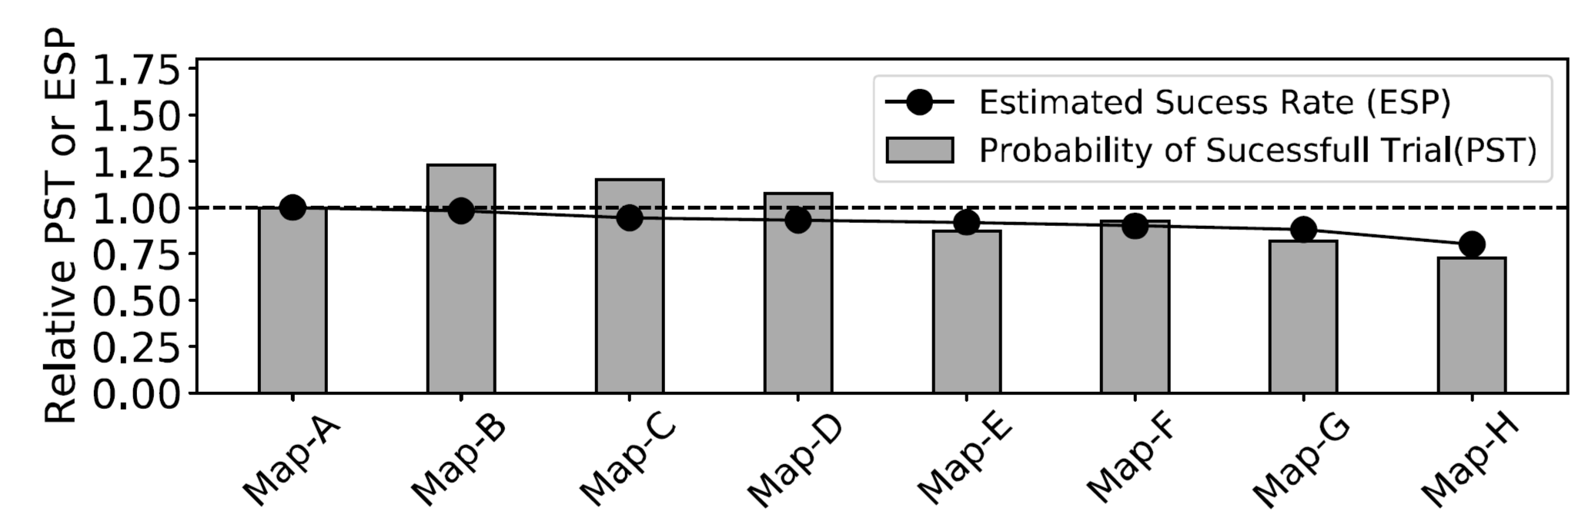
ESP vs PST

Slide 51
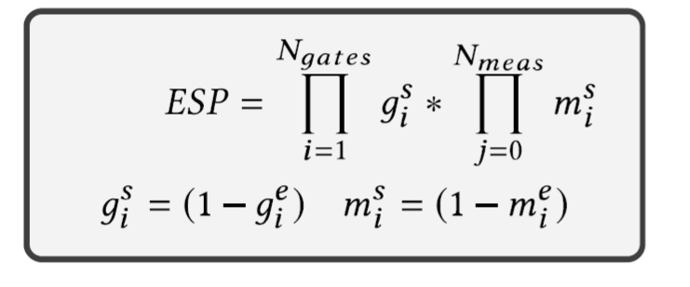
ESP vs PST
^{g}_{e} ^{→ gate error}
^{m}_{e} ^{→ Measurement error}

Slide 52
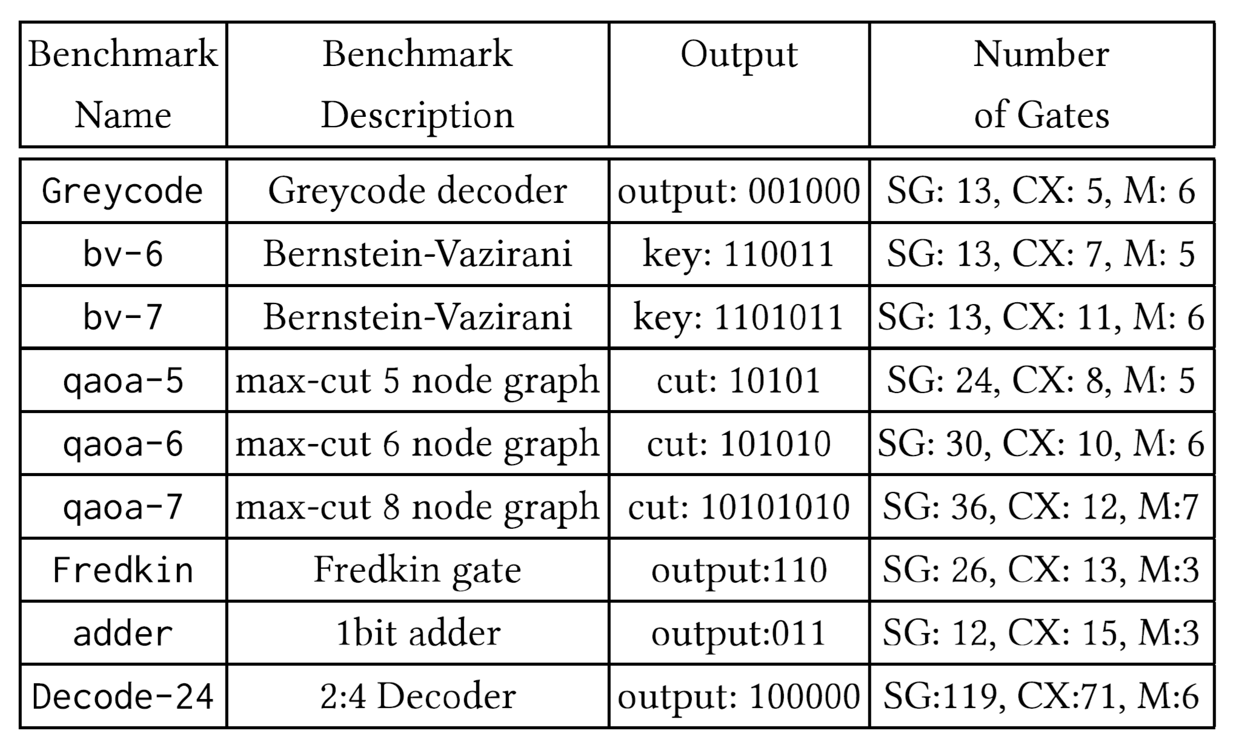
Benchmarks

Slide 53
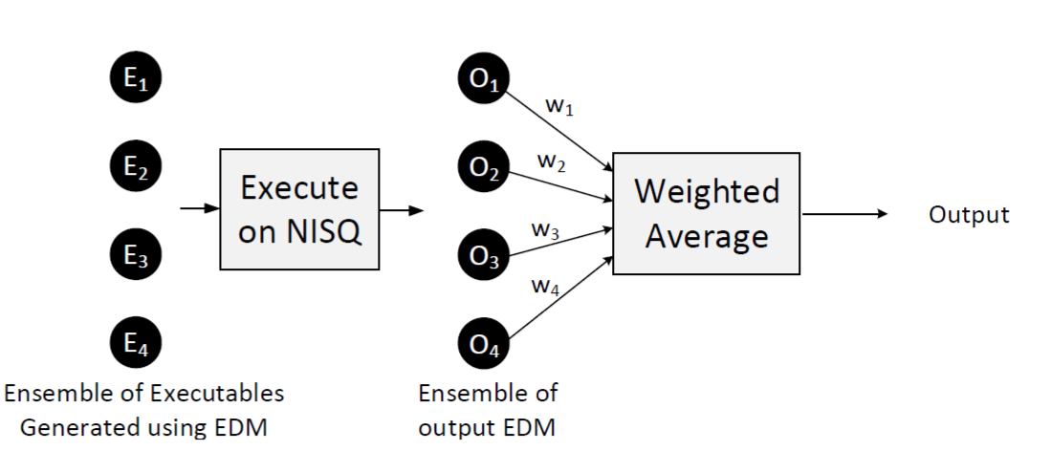
Weighted EDM

Slide 54
Backup Slides – Measurement Bias

Slide 55
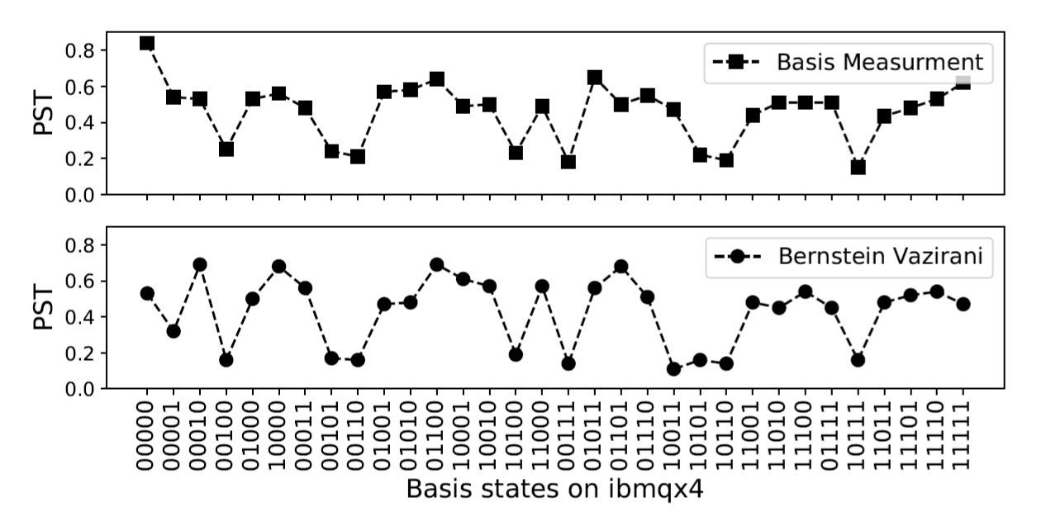
Arbitrary Bias on ibmqx4

Slide 56
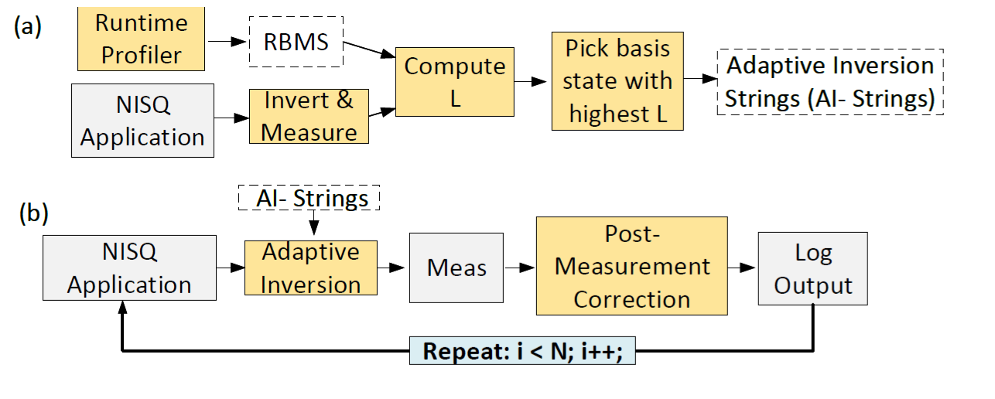
Adaptive Flip and Measure

Slide 57
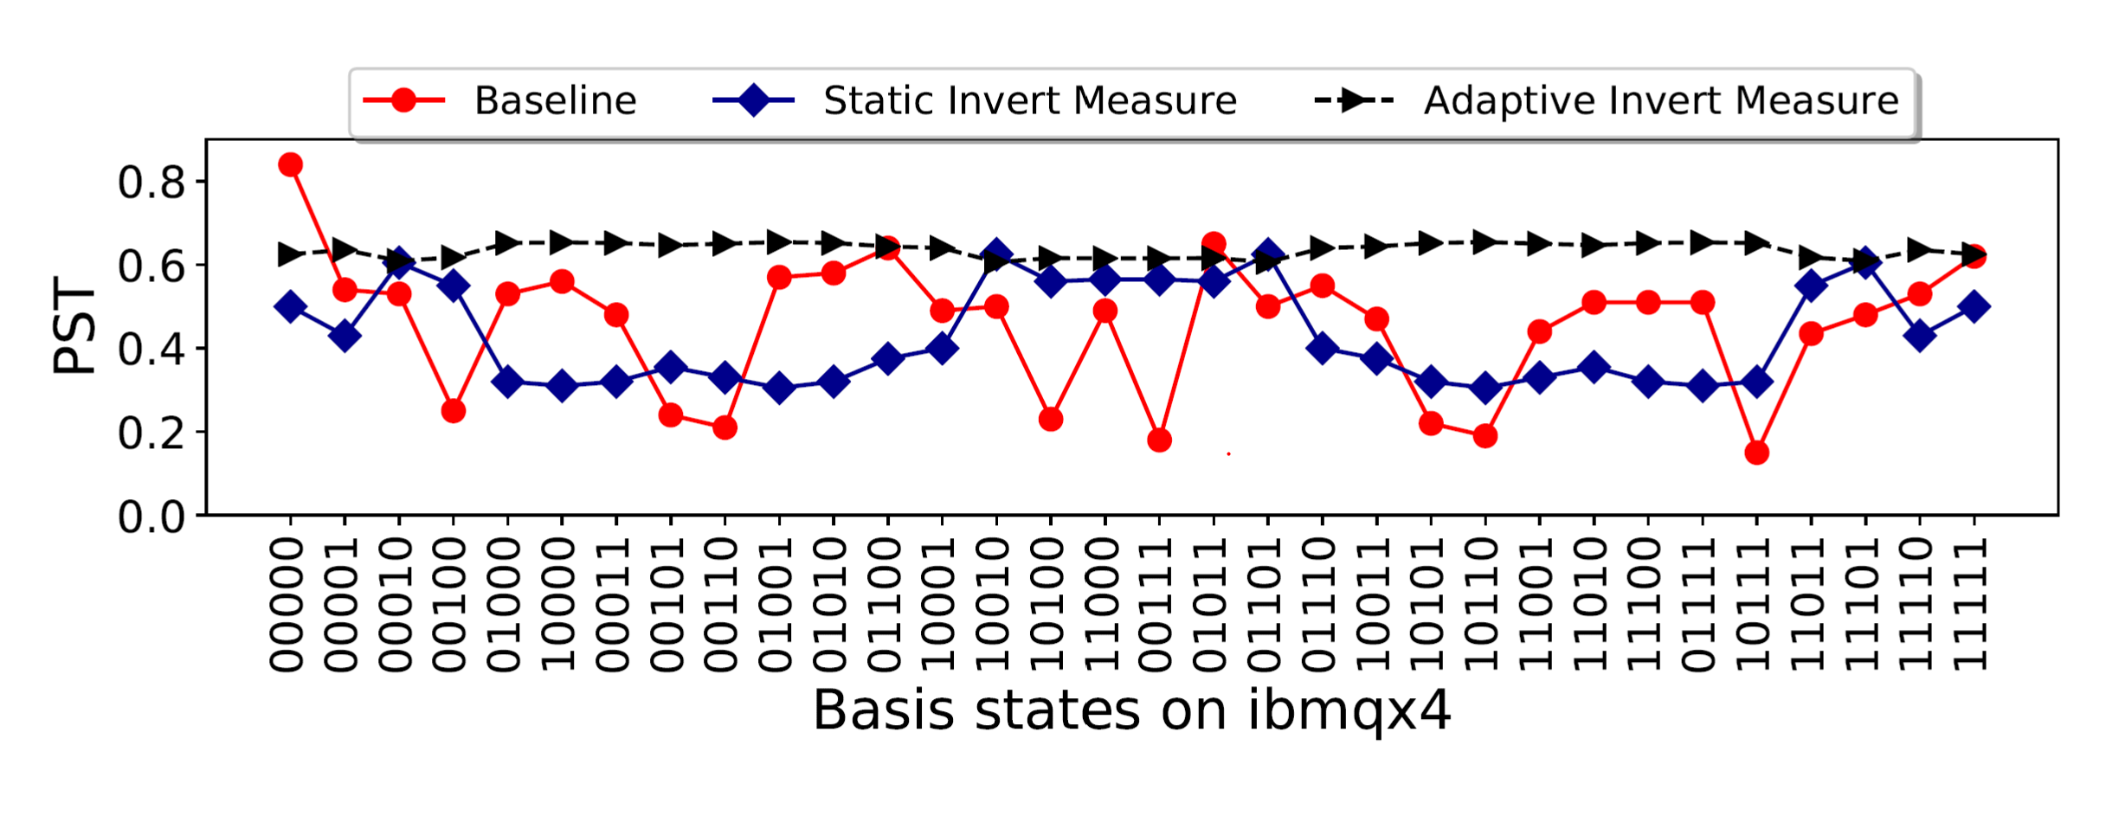
Evaluations: Bernstein Vazirani on ibmqx4

