Slide 1




Full-Stack, Real-System
Quantum Computer Studies
Noise-Adaptive Compilation, Technology Comparisons and Architectural Insights
Original slides Prakash Murali
Princeton University
(modified by Frank Mueller, NCSU)

Slide 2
Quantum Systems Research
Main Venues
  Systems: ASPLOS
  Architecture: MICRO, ISCA, HPCA
  Programming Languages: PLDI
Main Focus: Mitigate noise
  Agnostic of root cause of noise (environment, qubit imperfection, cross talk…)
    Studies to better understand noise source
    Subsequent techniques to reduce noise (cannot eliminate it)
  On actual hardware: IBM Q, Rigetti, D-Wave…
  In simulation: QX, …

Slide 3
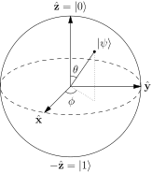
Quantum Computing: Fundamentally New Paradigm
|0⟩
Applications in chemistry, optimization, cryptography
Basic building block: Qubit
  Photons, ion trapped in an electromagnetic field, superconducting qubits
State is probabilistic superposition of 0 and 1
  α|0⟩ + β|1⟩, complex amplitudes α and β
  Measurement: Collapses state to either |0⟩ or |1⟩
Operations on qubits: Gates
  Single qubit gate: rotations on the unit complex sphere
  NOT gate on α|0⟩ + β|1⟩ produces β|0⟩ + α|1⟩
|1⟩
Qubit

Slide 4
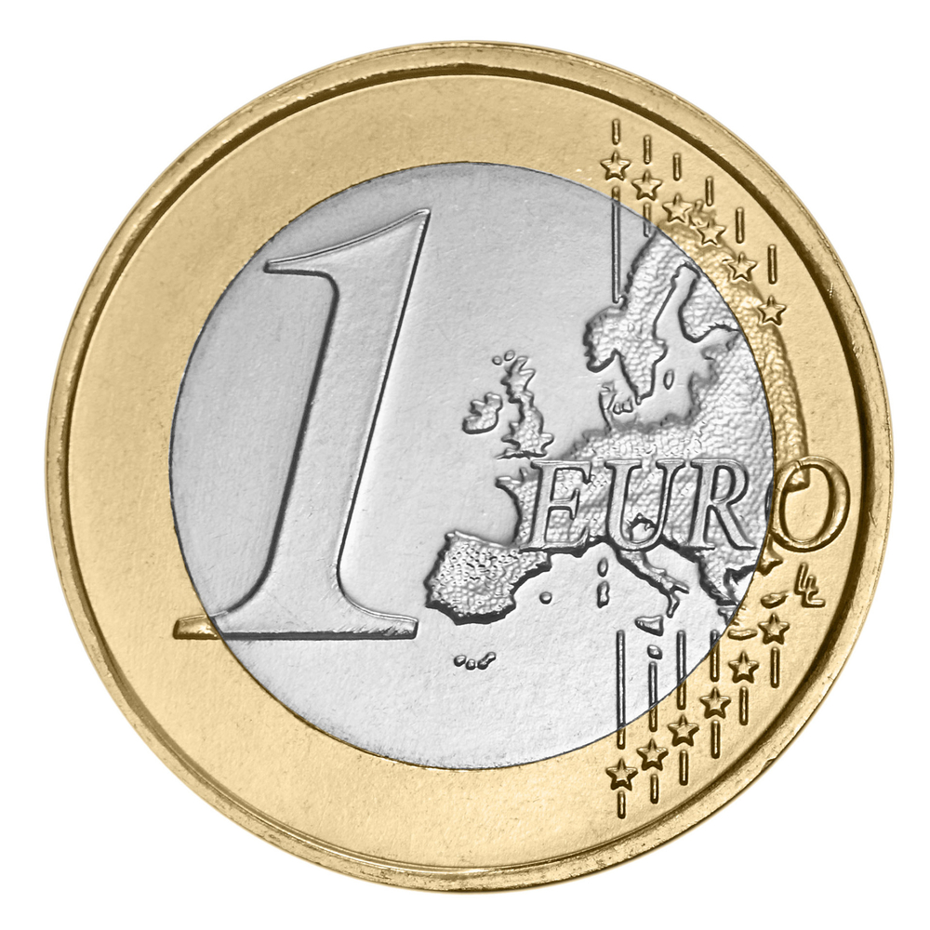
Key Enablers of Quantum Speedups
Superposition of states within a quantum bit (qubit)
  Large and probabilistic representation of possibilities
Entanglement of states between qubits
  Correlations between qubit states, once entangled.
  Einstein: ”Spooky action at a distance”
  Entangled correlations can be maintained even if qubits are physically distant (1400 kms distance record set last year)
Kilometers
Together, these properties support novel algorithms that can represent and explore large state spaces faster— sometimes exponentially faster—than classical computing.
?
Entangle. (~ QC Gate operation)

Slide 5
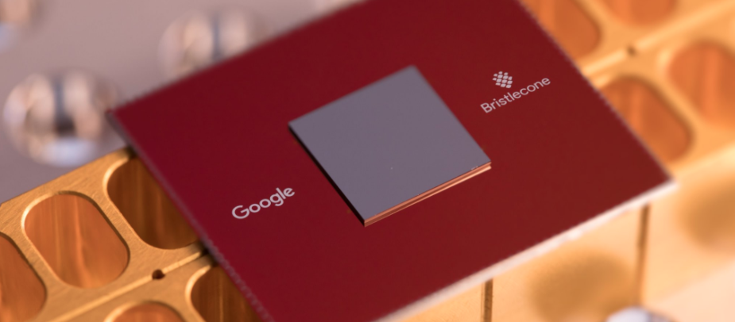
Noisy-Intermediate Scale Quantum Computing (NISQ)
5-53 qubit systems operational. 72+ qubits announced at IBM, Rigetti, Google, IonQ etc.
NISQ: Noisy operations, 10-1000 qubits
Large applications need 10³-10⁶ qubits
But, large state space even with 72 qubits
Need new algorithms and good software tools for efficiently using NISQ devices and bridging the the algorithm-hardware gap.
Source: IBM, Google, Intel

Slide 6
Quantum Systems Today
~1950’s Classical Computing
Today’s Classical Computing
Quantum Toolflows
Algorithms
Algorithms
Algorithms
High-Level Languages
High-level QC Languages.
Compilers.
Optimization.
Error Correcting Codes
Orchestrate classical gate control,
Orchestrate qubit motion and manipulation.
Compiler
OS
Architecture
Modular hardware blocks: Gates, registers
Assembly Language
VLSI Circuits
Vacuum Tubes, Relay Circuits
Semiconductor transistors
Qubit implementations

Slide 7
My Work
High-Level Language Programs
Compiler
Cross-Platform
Hardware-Software Assessment
[ISCA ‘19]
Exploration of architectural design choices, analysis of program performance across IBMQ, Rigetti, University of Maryland.
Noise-Adaptive Compilation
[ASPLOS ‘19]
Optimize programs using variations in qubit and gate noise properties.
Quantum Assembly Language
Gate implementation, calibration
Hardware qubits
[Murali, Baker, Abhari, Chong, Martonosi ASPLOS 2019]
[Murali, Abhari, Linke, Martonosi … ISCA 2019]
Notes:
In my research work, I am looking at this stack from the perspective of NISQ quantum systems. Specifically, I ask questions such as What are the best ways to compile...? What are the right metrics..? What factors...? From this perspective, I first developed an efficient compilation method for NISQ quantum systems. We call this noise-adaptive compilation.

Slide 8
Tight Resource Constraints in NISQ Systems
Low qubit count
5-72
High gate error rates
1-10%
Low coherence time
100us
Need near-optimal mapping of program qubits onto
highly resource constrained devices
Need a good initial placement of program qubits on hardware qubits
Operation orchestration to reduce communication between qubits
Reduce operational and decoherence errors which cause program failure

Slide 9
Current Approaches are Insufficient for NISQ
Compile once per input: more optimization opportunities
Reduce program execution time to avoid decoherence
Communication/SWAP optimizations
Used in IBM, Rigetti, Google compilers
NISQ systems have ~10X spatial and temporal noise variation!
Noise-unaware compilation leads to incorrect program execution,
not just a performance penalty.
Notes:
Noise-unaware executables have highly erratic behavior: succeed today but fail tomorrow because of unpredictable errors

Slide 10


Our Work: Noise-Adaptive Compilation
Compile once-per-execution using noise characterization data
Strategy 1: Place program qubits onto hardware qubits based on operation error rates
Strategy 2: Reduce decoherence errors by scheduling gates to finish within the coherence time of each qubit
Strategy 3: Reduce communication and use reliable routing paths, avoiding bad gates
Full stack compiler targeted for a real QC system IBMQ16
Up to 18X, average 3X improvement in the success rate of program execution compared to IBM Qiskit compiler.
Program operations
Hardware Qubits

Slide 11
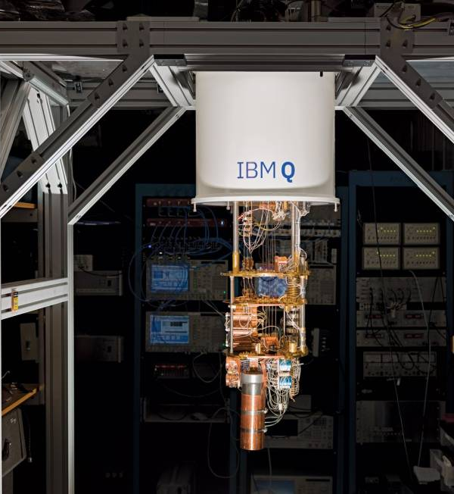
Background on IBMQ16
www.research.ibm.com/ibm-q/

Slide 12
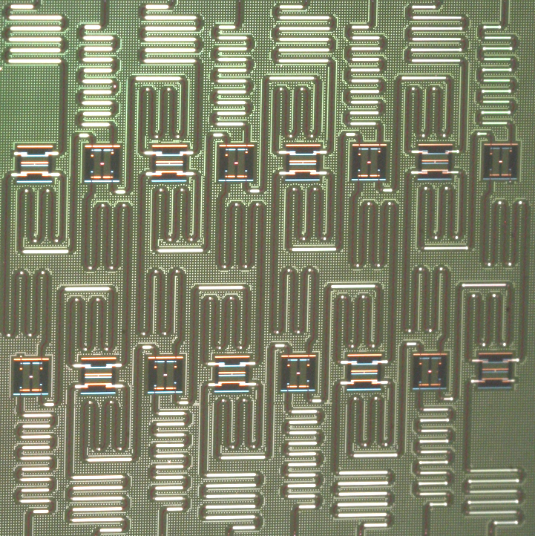
CNOT Q1, Q2
Q1
Q2
Single qubit: NOT Q1
Two-qubit Controlled NOT: CNOT Q1, Q2
Readout: Readout Q1
https://github.com/Qiskit/ibmq-device-information/

Slide 13
Execution Generates a Distribution of Outputs
Bernstein-Vazirani benchmark executed 8192 times on
a fixed set of 4 qubits. Expected answer: 1111

Slide 14
Execution Generates a Distribution of Outputs
Bernstein-Vazirani benchmark executed 8192 times on
a fixed set of 4 qubits. Expected answer: 1111
Success Rate
Fraction of correct trials
Correct answer observed in 35% runs
High success rate is crucial!

Slide 15
Our Work
What factors affect success rate?
How can we optimize success rate?

Slide 16
Noise Variation Impacts Success Rate
Lower is better
Noise data is measured twice daily by IBM. Includes coherence times and error rates of CNOTs, readouts and single qubit ops. Posted publicly once everyday at https://quantumexperience.ng.bluemix.net/qx/devices
Notes:
What affects the success rate of a program? The most important factor is the large fluctuations in qubit noise.
In this figure, I’ve highlighted 3 CNOTs, …
Corresponding to each CNOT, the graph shows the error rates.
If our compiled program uses blue CNOT, on some days, …

Slide 17
Strategy #1: Choose a good initial mapping
CNOT Error Rate 2-62%
1Q Gate Error Rate 0.1-16%
Readout Error Rate 2-48%
Place program qubits on the current best hardware qubits
Select best qubits using instruction mix + noise data.

Slide 18
Strategy #2: Coherence-aware scheduling
Coherence Time 5-195 us
Gate Time 170-390 ns
Schedule gates to finish before the coherence time of each hardware qubit
Influences mapping: choose qubits with good coherence time

Slide 19
Low Qubit Connectivity Increases Op Count
CNOT Q1, Q2: Q1 and Q2 should be adjacent
SWAP gates: Move a qubit’s state using a series of exchanges.
Enable non-adjacent CNOTs in software using SWAP gates.
1 SWAP = 3 CNOTs => Cubic error rates!
Notes:
The next factor that affects success rate is …

Slide 20
Strategy #3: Reduce chances of SWAP errors
CNOT
5% error
CNOT
5% error
CNOT
5% Error
CNOT
5% error
CNOT
5% error
CNOT
5% Error
READOUT
10% error
SWAP
SWAP
READOUT
Aggregated Error: Estimated success rate = (.95)⁶*.90 = 0.66
Reduce the number of swaps, and select low-error rate swap paths to improve success rate.

Slide 21
Compilation using Formal Optimization
Implement our strategies as a constrained optimization
Optimization decides qubit mapping, routing and scheduling choices.
Success rate is known only when we run an executable
Operation reliability = 1 – operation error rate from noise data
Program reliability = Product of operation reliabilities
Maximize reliability over the space of legal executables using noise data

Slide 22
Optimization Overview
Qubit Mapping
Routing choices
Gate Scheduling
Variables
Q_{x} ,Q_{y}
Set of paths
Gate times
Noise-based dependent variables and constraints
Operation Reliability
Coherence Time Constraints
R_{readout} R_{gate}
Maximization
Objective
Program Reliability
Product of all R_{readout},R_{gate}

Slide 23
Optimization Overview
Qubit Mapping
Routing choices
Gate Scheduling
Variables
Q_{x} ,Q_{y}
Set of paths
Gate times
Notice: This is an Optimization problem
Can we use quantum computers to provide a solution?
Implies that QC can help itself to bootstrap better programs!
Noise-based dependent variables and constraints
Operation Reliability
Coherence Time Constraints
R_{readout} R_{gate}
Maximization
Objective
Program Reliability
Product of all R_{readout},R_{gate}

Slide 24
LLVM Compiler using z3 SMT for IBMQ16
Scaffold Program
LLVM IR ScaffCC
Optimization using
z3 SMT Solver
OpenQASM Code
Benchmarks with 2-8 qubits, kernels/components of larger applications
Latest Available Device Noise Data
Posted publicly by IBM at 8am everyday.

Slide 25
Noise-Adaptivity Improves Success Rate
Real-system runs on IBMQ16
Higher is better
IBM Qiskit: lexicographic qubit mapping, randomized swapping heuristic
Geomean 2.9X, up to 18X improvement in measured success rate
Higher improvement for programs with more qubits
Notes:
On every benchmark we get higher …
These success rates are actual measured numbers on the real device, not simulations or estimates
We get the improvements because...
Average 3X, Up to 18X improvements.
On larger benchmarks we get higher improvements

Slide 26
Success Rate Optimization is Crucial for Correct Executions
Adder benchmark: correct answer 1001
Correct answer 1001 dominates
Wrong answer 0001 dominates

Slide 27
NISQ Compiler Insights
Compile for optimal success rate, in addition to performance optimization:
  Most important for optimization: CNOT and readout errors.
  Single qubit operations, coherence time, gate duration etc. are less important.
  Current programs are limited by gate errors rather than decoherence errors.
  Choose qubit placement using optimization techniques to maximize the chances of correct execution.
Noise is here to stay:
  Qubit manufacturing and gate control unlikely to be perfected soon
  Access to recent (1-2X daily) noise data matters
SMT optimization scales to 72 qubits, efficient heuristic strategies can scale to large scale systems with 1000s of qubits.
Notes:
In our optimization, we can vary the importance…
And our work shows to enable good executions on future NISQ systems, it is important to have access to this kind of noise data
We’ve also studied …

Slide 28
High-Level Language Programs
Compiler
Cross-Platform
Hardware-Software Assessment
[ISCA ‘19]
Exploration of architectural design choices, analysis of program performance across IBMQ, Rigetti, University of Maryland (IonQ).
Noise-Adaptive Compilation
[ASPLOS ‘19]
Optimize programs using variations in qubit and gate noise properties.
Quantum Assembly Language
Gate implementation, calibration
Hardware qubits
[Murali, Baker, Abhari, Chong, Martonosi ASPLOS 2019]
[Murali, Abhari, Linke, Martonosi … ISCA 2019]
Notes:
I can take.... We have multiple vendors building quantum systems, and when we build a system, we have to answer some fundamental architectural questions..What is the gate set ...? How should our qubits be connected? How does program performance...? In order to explore these questions, we performed a full-stack hardware software study of systems from three leading QC vendors.

Slide 29
Front-runner QC technologies
Superconducting qubits
Trapped Ion Qubits
https://github.com/Qiskit/ibmq-device-information/
https://www.uibk.ac.at/exphys/qo/research/trappedions.html.en
Notes:
These three vendors, IBM, Rigetti (A startup based out of California) and UMD (IonQ) have different qubit choices. IBM and Rigetti use superconducting qubits, you have seen this picture earlier…and UMD has a completely different tech called trapped ions. Here ions are trapped in a cavity ..in the picture on the right you can see a single ion suspended by electrical and magnetic fields.

Slide 30
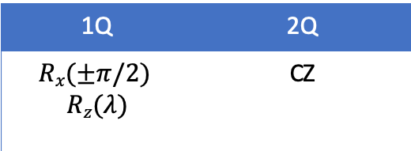
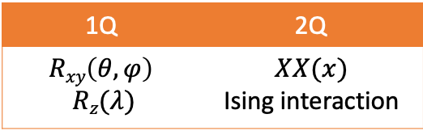
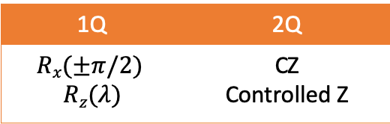
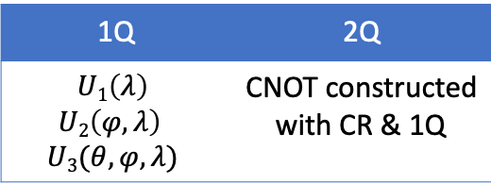
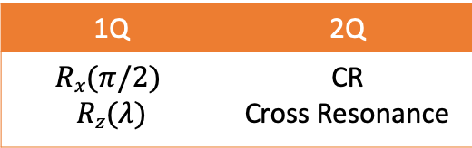
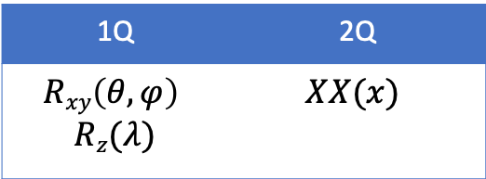
Architectural Gate Choices
Software-Visible Gates
1Q | 2Q
$$Rxy\left(θ, φ\right)$$ $$Rz(λ)$$ | $$XX(x)$$
1Q | 2Q
$$U1\left(λ\right)$$ $$U2\left(φ, λ\right)$$ $$U3(θ, φ, λ)$$ | CNOT constructed with CR & 1Q
1Q | 2Q
$$Rx(±π/2)$$ $$Rz(λ)$$ | CZ
Native Gates
1Q | 2Q
$$Rxy\left(θ, φ\right)$$ $$Rz(λ)$$ | $$XX(x)$$ Ising interaction
1Q | 2Q
$$Rx(π/2)$$ $$Rz(λ)$$ | CR Cross Resonance
1Q | 2Q
$$Rx(±π/2)$$ $$Rz(λ)$$ | CZ Controlled Z
Qubits
Yb⁺Ion trapped in EM field
Superconducting Josephson Junction
Superconducting Josephson Junction
University of Maryland
IBM
Rigetti
Should software-visible gates be unified across implementations or
important to have them be well-tailored to underlying device characteristics?
Notes:
In some ways, these qubit implementation options are analogous to how classical systems might be implemented with vaccum tubes or CMOS transistors.
But on the other hand, while classical devices can all be abstracted as on-off switches, qubit technologies are still more distinct.
So, each vendor has a qubit choice, shown in the lowest layer here. Depending on this qubit choice, they select a set of fundamental/native operations. Just like universal gates in classical computation, where we can express any computation with NAND gates, in QC we have a concept of a universal gate set which allows any algorithm to be implemented.
In the trapped ion system, 2Q operations are performed using ion motion.. Using these native gates, the vendor exposes a set of architectural gates or software visible gates…this is essentially the instruction set architecture for the device…

Slide 31
Architectural Connectivity Choices
IBMQ5
IBMQ14
IBMQ16
Rigetti Aspen1
UMD Trapped Ion
Rigetti Agave
How do different communication topologies affect application success rate and runtime?
How can we optimize programs across a variety of topologies?

Slide 32
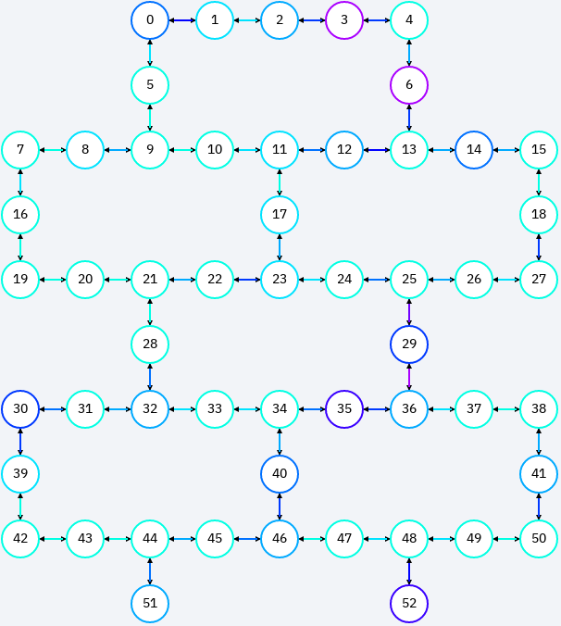
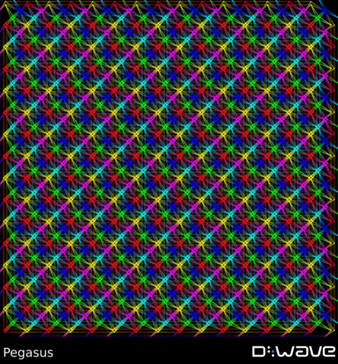
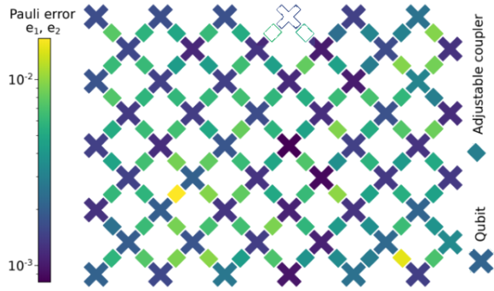
Update:
IBM 53Q Google 53Q D-Wave 5000Q

Slide 33
Microarchitecture Noise Properties
IBM & Rigetti:
  Spatio-temporal noise variance
  Up to 9X variation for CNOTs
UMD 5-qubit ion trap:
  Primarily spatial variation, negligible temporal variation
  CNOT error: 1-3%
Machine | Coherence Time (us) | 1Q Error (%) | 2Q Error (%) | RO Error (%)
IBMQ5 (5) | 40 | 0.2 | 4.76 | 6.21
Rigetti Agave (5) | 15 | 3.68 | 10.8 | 16.37
UMD Ion Trap (5) | 1.5 x 10⁶ | 0.2 | 1.00 | 0.6
How much does hardware noise-variation affect program performance?
Can small variations in error rates amplify into large success rate variation for programs?
Notes:
IBM calibrates twice a day
Rigetti calibrates 6 times a day
UMD - Calibrated a few times a day to adjust for drifts in laser beam alignment

Slide 34
Prior Work
Experimental comparison of two quantum computing architectures Linke et al. PNAS 2017
  Hand mapped programs for IBMQ5 and UMD Trapped Ion system
Vendor toolflows:
  Noise-unaware, mappings with too many SWAPs or manual
  IBM’s Qiskit compiler, Rigetti’s Quil compiler
  UMD: No automated tool
Can a single toolflow be built that optimizes programs well across these widely-divergent architectures? Are there a small, common set of figures of merit that can guide optimization?

Slide 35
High-Level Language Programs
Compiler
Quantum Assembly Language
Gate implementation, calibration
Hardware qubits

Slide 36
Noise Data
Qubit Topology
UMD/IBM/Rigetti-Specific Inputs
SW-Visible Gates & Transformations
High-Level Language Programs
Scaffold Programs
Compiler
TriQ Compiler
Quantum Assembly Language
Up to 1.5x better success rate compared to hand mapping
Up to 28x better success rate compared to Qiskit Compiler
Up to 2.3x better success rate compared to Quil Compiler
Gate implementation, calibration
Hardware qubits
UMD TI ASM
IBM OpenQASM
Rigetti Quil
UMD Native Gates
IBM Native Gates
Rigetti Native Gates
UMD 5-qubit Ion Trap
IBMQ5, Q14, Q16
Rigetti Aspen1, Agave

Slide 37
Reliability Matrix: Machine representation
 | 0 | 1 | 2 | 3 | 4 | 5 | 6 | 7
0 |  | 0.9 | 0.58 | 0.33 | 0.9 | 0.65 | 0.42 | 0.24
1 | 0.9 | - | 0.8 | 0.46 | 0.65 | 0.9 | 0.58 | 0.33
2 | 0.46 | 0.8 | - | 0.9 | 0.33 | 0.46 | 0.7 | 0.58
3 | 0.33 | 0.58 | 0.9 | - | 0.24 | 0.33 | 0.51 | 0.8
4 | 0.9 | 0.65 | 0.42 | 0.24 | - | 0.9 | 0.58 | 0.33
5 | 0.65 | 0.9 | 0.58 | 0.33 | 0.9 | - | 0.8 | 0.46
6 | 0.33 | 0.46 | 0.7 | 0.58 | 0.46 | 0.8 | - | 0.9
7 | 0.24 | 0.33 | 0.51 | 0.8 | 0.33 | 0.58 | 0.9 | -
 | 0 | 1 | 2 | 3 | 4 | 5 | 6 | 7
0 | - | 0.9 |  |  | 0.9
1 |  | - | 0.8 |  |  | 0.9
2 |  |  | - | 0.9 |  |  | 0.7
3 |  |  |  | - |  |  |  | 0.8
4 |  |  |  |  | - | 0.9
5 |  |  |  |  |  | - | 0.8
6 |  |  |  |  |  |  | - | 0.9
7 |  |  |  |  |  |  |  | -
0
0.9
1
0.8
2
0.9
3
0.9
0.9
0.7
0.8
4
5
6
7
0.9
0.8
0.9
Compute table of pairwise CNOT reliabilities, and per-qubit readout reliability
Device topology + average error => communication aware
Device topology + noise data => communication + noise aware

Slide 38
Vendor/Device Independent Passes
Mapping
Satisfiability Modulo Theory (SMT) optimization: map program using reliability matrix
Reliability function: Maximize the minimum reliability of all operations
Faster than maximizing the product reliability
Operation Orchestration
Topological-sort order
Route non-adjacent CNOTs along most reliable path using the reliability matrix

Slide 39
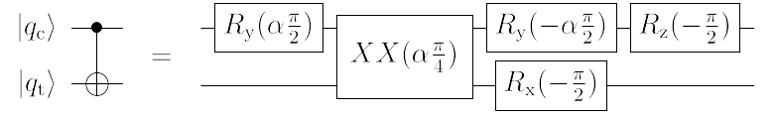
Vendor/Device Dependent Passes
Program IR: CNOTs + Single qubit gates
Translation pass: Program gates → software-visible gates (ISA)
Gate orientation pass: Adjust gate directions on IBM systems
Optimization pass: Merge adjacent single-qubit rotation operations
Z gates are error-free on IBM, Rigetti and UMD machine
Express merged rotations in the form of Z-X-Z or Z-Y-Z rotations
Notes:
This transformation is from CNOTs to Ising gates (XX) for trapped ions

Slide 40
Experimental Setup
Scaffold → LLVM IR → TriQ → IBM, Rigetti, UMD TI ASM
Different variants of TriQ to test design choices
12 benchmarks + sequences of Fredkin and Toffoli gates
Machines:
  IBM: 5Q, 14Q, 16Q
  Rigetti Agave 4Q, Aspen1 16Q
  UMD TI 5Q
Metrics: Gate count, Success rate
  8192 trials on IBM, Rigetti. 5000 trials on UMD TI

Slide 41
Software-Visible Gates

Slide 42
Optimizations using native gates yields lower gate count
1.4x reduction in native 1Q gate count on IBMQ14
Reduce op count + exploit error-free Z operations
Up to 1.26x improvement in success rates

Slide 43
Powerful native gates can be exploited to reduce gate count
1.6x reduction in native 1Q gate count on UMD
UMD offers an arbitrary rotation gate allowing more operations to merged.
Expose native gates to software for lower gate count and higher success rate

Slide 44
Communication Topology

Slide 45
Application + HW topology match matters
3
Adder benchmark:
10 program CNOTs
2
1
4
Rigetti Agave
IBMQ14
UMD
19 CZ gates
10 CNOT gates
10 XX gates
Notes:
Compiler can mitigate to some extent

Slide 46
UMD: Full connectivity allows high success rate
Oblivious to application patterns
> 0.8 success rate on all benchmarks that fit (5 qubits or less)

Slide 47
Communication optimization enables
more applications to succeed
Applications with good fit to grid typically succeed (HS4, HS6, BV4)
Compiler can mitigate sparse HW connectivity to some extent.
Notes:
Compiler can mitigate to some extent

Slide 48
Noise Characteristics of the Device

Slide 49
Noise variations get amplified for long programs
CNOT reliability 97-99%
Up to 1.47X improvement over noise-unaware programs
First demonstration of noise-adaptive compilation for ion traps

Slide 50
Noise-Adaptivity is Important Across Platforms
IBMQ14:
  Up to 28X over IBM Qiskit (geomean 3X)
Rigetti:
  Up to 2.3X over Quil (geomean 1.5 X)
UMD TI:
  Noise-optimization provides up to 1.47X over default hand mapped baseline (geomean 1.2x)

Slide 51
Putting it all together

Slide 52
NISQ Execution Stack Insights
  Expose native gates to software + exploit powerful native operations
  Application-HW Communication topology match matters. But, TriQ can mitigate sparse HW connectivity to some extent
  Important to have reliable connected regions of the machine
  Even small noise variations can get amplified into large success rate variations
  QC is not yet ready for too much hardware abstraction. But, TriQ provides a good compiler-level abstraction layer for programs

Slide 53
Conclusions
  Full-stack multi-vendor toolflow for QC systems.
  Compilation is crucial to get usable results from NISQ systems.
  Noise-adaptive techniques provide an order of magnitude improvement in program success rates over vendor toolflows.
  Largest benchmarking study of QC systems so far.
  Forward looking insights for compiler and architecture design for NISQ systems.
  Noise-aware placement from this work was adopted by IBM
  → now integral to Qiskit

Slide 54
For more information
Thanks to collaborators: Margaret Martonosi (advisor), Frederic T. Chong, Ali Javadi-Abhari, Jonathan M. Baker, Norbert M. Linke, Nhung Hong Nguyen, Cinthia Huerta Alderete
Code:
  Noise-adaptive compiler from Scaffold to IBMQ: https://github.com/prakashmurali/TriQ
  Contributed a noise-adaptive pass to IBM Qiskit: https://github.com/Qiskit/
Contact:
  pmurali@princeton.edu
  mrmgroup.cs.princeton.edu
  www.epiqc.cs.uchicago.edu

