Slide 1
ScaffCC: A Framework for Compilation and Analysis of Quantum Computing Programs
Ali JavadiAbhari, Shruti Patil,
Daniel Kudrow, Jeff Heckey, Alexey Lvov,
Frederic T. Chong, Margaret Martonosi
Princeton University, UC Santa Barbara, IBM

Slide 2
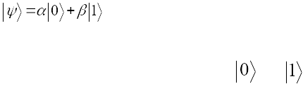
Background on Quantum Computers
A quantum bit (qubit) can exist in a superposition of states:
Quantum operations (gates) transform the state of qubits.
Measurement (observation) collapses it to either or .
Quantum computation is reversible.
Quantum Assembly
qbit a[1], b[5];
H(b[0]);
H(b[1]);
H(b[2]);
H(b[3]);
H(b[4]);
Z(a[0]);
CNOT(a[0],b[1]);

Slide 3
Compiling Quantum Codes
Algorithm
Data types and instructions in quantum computers:
Qubits, quantum gates
Decoherence requires QECC (quantum error correction codes)
Logical vs. Physical Levels
Efficiency crucial
Inefficiencies at logical level are amplified into greater physical level QECC requirements.
Quantum Program in High-Level Description Language
ScaffCC
Scaffold
Logical
Compiler & High-level Analyzer
QASM
Quantum Error Correcting Codes (QECC)
Error Correction
QASM with QECC
Physical Machine Description
Mapper (Scheduling, Placement and Routing)
Physical
Quantum Physical Operation Language

Slide 4
Goals and Contributions
1) Identifying differences in compiling for quantum vs. classical computers
2) Providing good scalability to practical algorithm sizes
3) Automatically synthesizing reversible computation (e.g. for math functions)
4) Developing important program analysis passes

Slide 5
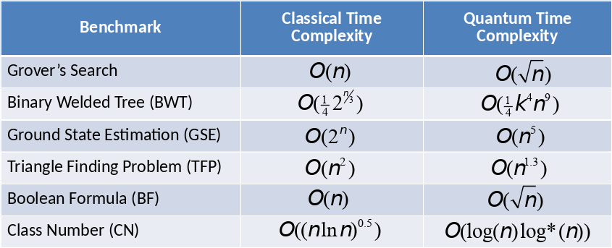
Benchmarks

Slide 6
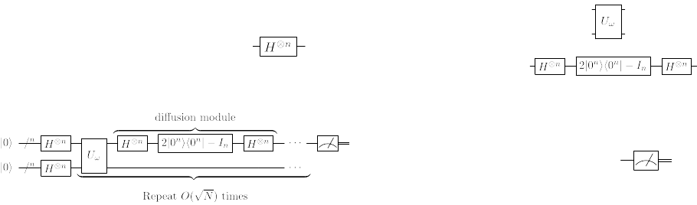
Scaffold Programs and Quantum Circuits
#include <math.h>
#define n 5
#define N pow(2,n)
// module prototypes
module Sqr(qbit a[n], qbit b[n]);
module EQxMark(qbit b[n], qbit t[1], int tF);
// diffusion module
module diffuse(qbit q[n]) {
// allocate qubits local to module
qbit x[n-1];
// Hadamard applied to q
for(j = 0; j < n; j++)
H(q[j]);
...
}
// main module
module main() {
// allocated qubits in main
qbit a[n], b[n], t[1];
// classical bits : measurement outcome
cbit ma[n];
// iteration bound
int nstep = floor((pi/4)*sqrt(N))
.
.
// Grover iteration: Repeat O(N^0.5) times
for (istep=1; istep<=nstep; istep++) {
Sqr(a,b);
EQxMark(b, t, 0);
Sqr(a,b);
diffuse(a);
}
.
.
// measure a to find outcome
for(i=0; i<n; i++)
ma[i] = measZ(a[i]);
}

Slide 7
From Scaffold to QASM: Deep Optimization through LLVM
ScaffCC translates from Scaffold Programming Language to QASM assembly language.
Implemented with LLVM, a rich and mature compiler framework.
Modified Clang front-end parses and converts ScaffCC to LLVM Intermediate Representation.
Clang Front-end
Classical Control Resolution
QASM Generation
Scaffold Program
LLVM-IR
QASM

Slide 8
Scalability in Compilation and Analysis (1)
Quantum circuits are typically specialized to one problem size, hence they are deeply and statically analyzable.
Classical control resolution
Static classical control resolution using LLVM passes
May cause code explosion during code transformation of larger problems

Slide 9
Resolving Classical Controls in the Code
Classical control surrounding quantum code must be resolved to disambiguate for the hardware the qubits and the exact set of gates
module Oracle_0(qbit a[1]) {
Rz(a[0],-0.01);
}
#define s_ 3000
module Oracle(qbit a[1], int j) {
double theta=(-1)*pow(2,j)/100;
Rz(a[0],theta)
}
module main() {
qbit a[1];
int i,j;
for (i=0;i<=s_;i++)
for (j=0;j<=3;j++)
Oracle(a,j);
}
.
.
module Oracle_3(qbit a[1]) {
Rz(a[0],-0.08);
}

Slide 10
Classical Control Resolution
module EQxMark_0 (qbit b[n], qbit t[1])
{
.
.
Z(x[n-2]);
.
.
}
module EQxMark (qbit b[n], qbit t[1], int tF)
{
.
.
if(tF==1)
CNOT(t[0], x[n-2]);
else
Z(x[n-2]);
.
.
}
clone
module EQxMark_1 (qbit b[n], qbit t[1])
{
.
.
CNOT(t[0], x[n-2]);
.
.
}
inter-procedural constant propagation
module main (qbit b[n], qbit t[1])
{
.
for (i=0; i<2; i++)
EQxMark(b,t,i);
.
}
module main (qbit b[n], qbit t[1])
{
.
EQxMark(b,t,0);
EQxMark(b,t,1);
.
}
unroll
EQxMark(b,t,0); EQxMark_0(b,t);
EQxMark(b,t,1); EQxMark_1(b,t);

Slide 11
Pass-Driven vs. Instrumentation-Driven
Pass-Driven:
Loop unrolling
Procedure Cloning
Inter-procedural Constant Propagation
or Instrumentation-Driven:
Leveraging the dual nature of quantum programs
Instrument code such that a fast classical processor executes through the classical portion, collecting information regarding the quantum portion
Further speed-up by memoizing same module calls

Slide 12
The Instrumentation-Driven Approach Scales Better
Better
Compilation time (s)
(Normalized per benchmark)

Slide 13
Scalability in Compilation and Analysis (2)
Traditional QASM:
No loops or modules: only sequences of qubits and gates
Used for small program representations
Programs that we examined contained between 10⁷ to 10¹² gates
We need a more scalable output format:
QASM with Hierarchy (QASM-H)
200,000X smaller code
QASM with Hierarchy and Loops (QASM-HL)

Slide 14
Managing Scalability with QASM Format
Scaffold
#define n 1000
module foo(qbit q[n]) {
for(int i = 0; i < n; i++)
H(q[i]);
CNOT(q[n-1],q[0]);
}
module main() {
qbit b[n];
foo(b);
}
QASM-H
module foo(qbit* q) {
H(q[0]);
H(q[1]);
..
H(q[999]);
CNOT(q[999],q[0]);
}
module main() {
qbit b[1000];
foo(b);
}
Flat QASM
qbit b[1000];
H(b[0]);
H(b[1]);
.
.
H(b[999]);
CNOT(b[999],b[0]);
QASM-HL
module foo(qbit* q) {
H(q[0:999]);
CNOT(q[999],q[0]);
}
module main() {
qbit b[1000];
foo(b);
}

Slide 15
Comparison of QASM-H and QASM-HL
A large reduction is already obtained from QASM-H over flat QASM.
Better
Grover BWT GSE TFP BF CN
Notes:
1 loops
2 no loops

Slide 16
Synthesizing Reversible Computation
Classical-To-Quantum-Gate (CTQG): A ScaffCC feature for efficiently translating classical modules to quantum modules.
CTQG Translation
CTQG Classical Modules
CTQG
Compilation
Classical Control Resolution
Clang Front-end
Classical Control Resolution
CTQG
Separation
Scaffold Quantum Modules
Clang Front-end
QASM Linker
QASM Generation
QASM Generation
QASM
Scaffold Program
QASM
Scaffold Program
LLVM-IR
LLVM-IR

Slide 17
CTQG: Classical-To-Quantum-Gate
Facilitates the synthesis of quantum circuits from classical mathematical expressions:
Basic integer arithmetic (a=a+b, a=a+bc, ...)
Fixed-point arithmetic (1/x, sin x, ...)
Bit-wise manipulations (shift operators, ...)
State-of-the-art in reversible logic synthesis, minimizing the use of extra (ancilla) qubits
Produces output gate-by-gate on the fly
Not limited by memory

Slide 18
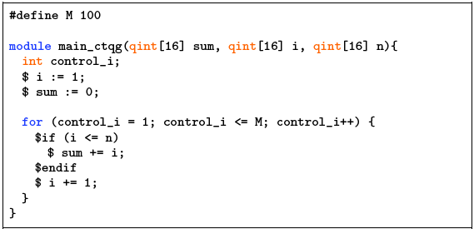
Example CTQG: Classical-To-Quantum-Gate

Slide 19
Program Analysis
Analysis passes:
Program correctness checks
Program estimates
CTQG Translation
CTQG Classical Modules
CTQG
Compilation
CTQG
Separation
Scaffold Quantum Modules
Clang Front-end
Classical Control Resolution
QASM Linker
QASM Generation
Scaffold Program
LLVM-IR
QASM
Correctness Check
Program Analysis
Analysis Output
Timing / Resource Estimates

Slide 20
Program Analysis
ScaffCC supports a range of code analysis techniques:
Program correctness checks:
No-cloning checks
Entanglement and un-computation checks
Program estimates:
Resource estimation
Timing analysis (Parallel scheduling)

Slide 21
Program Correctness Checks
No-Cloning:
Theorem: The state of one qubit cannot be copied into another (no fan-out)
Check that multi-qubit gates do not share qubits
CNOT(q1,q1) → uses alias analysis to detect this (seems trivial)
Entanglement:
The joint state of two qubits cannot be separated
Data-flow analyses to automate the tracking of entanglement and disentanglement

Slide 22
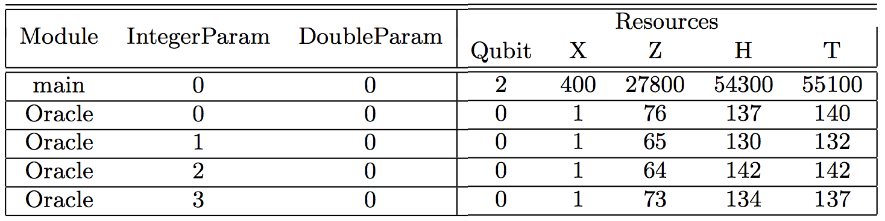
Quantum Program Analysis: Resource Analysis
Obtaining estimates for the size of the circuit:
Qubits are expensive
More gates require more overall error correction and hence more cost
The same pass-driven and instrumentation-driven approaches apply
Dynamic memoization table records number of resources

Slide 23
Timing Estimate
Estimates the critical path length of the program
Assuming unlimited hardware capability for parallelization
Scheduling based on qubit data dependencies between operations
Hierarchical scheduling for tractability:
Obtain module critical paths separately and then treat them as black boxes.

Slide 24
Remodularization
Analysis makes use of modularity
Avoid repetitive analysis
Reduce analysis time
Results in loss of parallelism at module boundaries
Decreased schedule optimality
Idea:
Inline small modules at call sites – larger flattened modules
Define threshold for “small” modules
Results in better critical path estimates

Slide 25
Hierarchical Approach Tradeoff
Module Toffoli(a,b,c)
Modular Analysis
Flattened Analysis
PrepZ(s0)
PrepZ(s1)
X(s1)
Toffoli(a0,s1,s0)
X(s1)
. . .
a
b
c
a0
s1
s0
a0
s1
s0
1
H
1
Pz
Pz
1
Pz
Pz
2
C
2
X
H
3
T
2
X
3
C
4
C
4
T
Closeness to actual critical path is dependent on the level of modularity
Flatter overall program means more opportunity for discovering parallelism
5
T
5
C
6
C
6
T
7
T
T
3-14
7
C
8
C
8
T
T
9
C
T
9
C
10
T
H
10
C
T
11
C
11
T
H
12
S
12
C
T
More Accurate
13
T
S
Faster
14
X
15
X

Slide 26
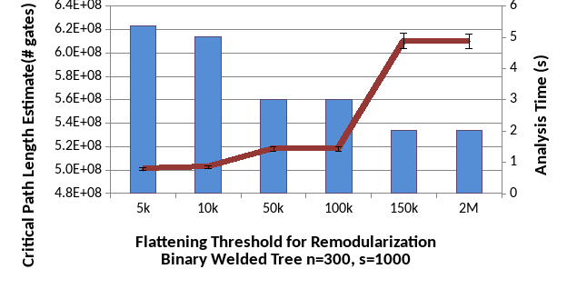
Effect of Remodularization
Based on resource analysis, flatten modules with size less than a threshold
Tradeoff between speed of analysis and its accuracy

Slide 27
Conclusion
Extended LLVM’s classical framework for quantum compilation at the logical level
Managed scalability through:
Output format:
200,000X on average + up to 90% for some benchmarks
Code generation approach:
Up to %70 for large problems
CTQG: Automatic generation of efficient quantum programs from classical descriptions
Developed a scalable program analysis toolbox
ScaffCC can be used as a future research tool

