Slide 1
Architecting Our Way Up the Quantum Ladder
from NISQ to Fault-Tolerant Quantum Computers
Yongshan Ding
University of Chicago
MAR 22, 2019
@ NC State

Slide 2
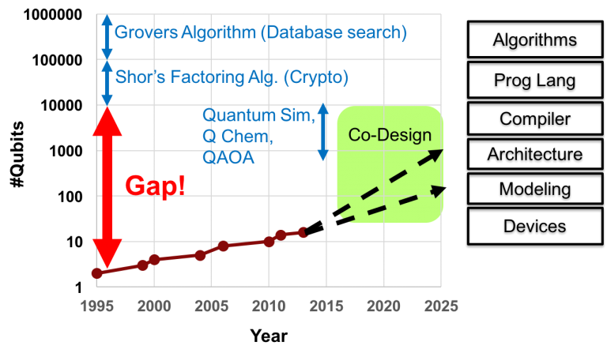
OVERVIEW
NISQ to Fault-Tolerant Quantum Computers

Slide 3
OVERVIEW
Vertical Hardware-Software Integration
More noise-resilient: e.g. variational algorithms
Quantum Kernel
Programming Language
Application Layer
Classical Processing
Compiler Optimizations
&
Circuit Synthesis
Systems Software
Layer
Error Correction
Pulse Compilation
Control & Measurement Plane
Hardware Layer
Control Processor
Quantum Data Plane
More reliable and scalable: e.g. qubit mappings
Higher fidelity, better connectivity, etc

Slide 4
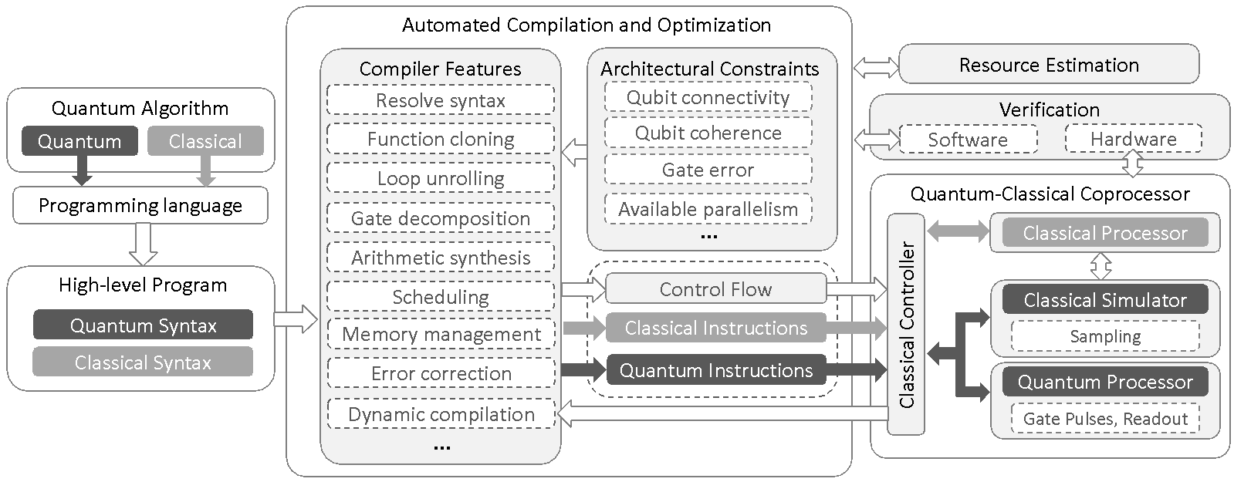
OVERVIEW
Data Flow in Quantum Computer Systems

Slide 5
OUTLINE
1
Overview
2
Quantum Error Correction and Magic-State Distillation
→ so-called surface codes for error correction
3
Memory Management, Pulse Compilation, et cetera
4
Summary and Outlook

Slide 6



FAULT-TOLERANT QC
Operations on Error-Corrected Quantum Computers
Easy single-qubit gates:
Difficult 2-qubit gate: CNOT gate
H
X
Z
Expensive to implement: requires braiding
Difficult single-qubit gate: T gate
T
Useful applications contain
a significant number of T gates.
Consume: 1 magic state
Expensive to implement: requires magic state distillation
prepare logical qubits in a known (expensive )state → support fault tolerance

Slide 7
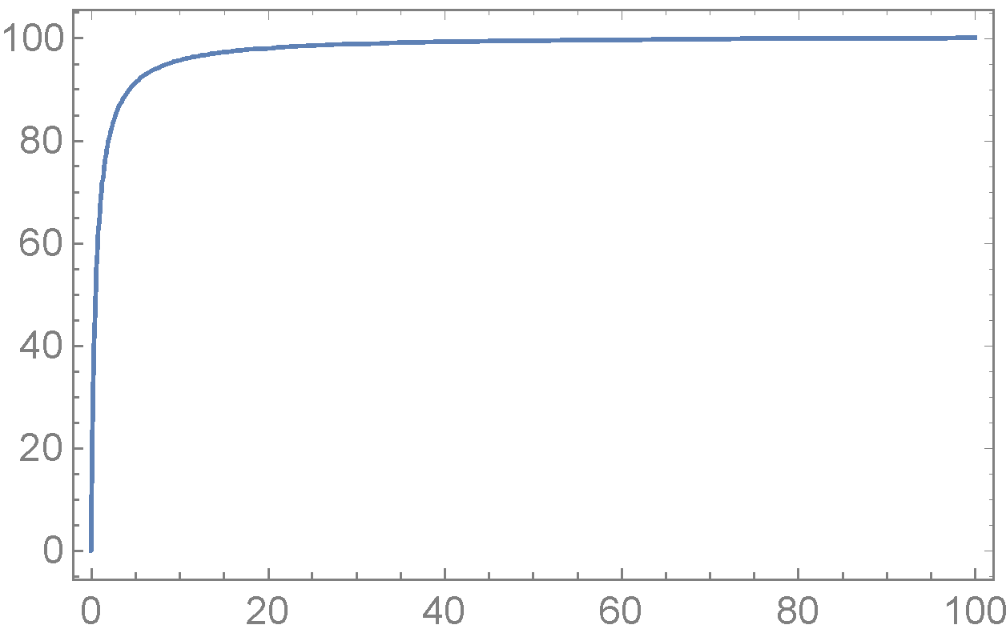
MAGIC-STATE DISTILLATION
Magic State Distillation is Expensive
Quantum Chemistry
*Ising Model of spin chain with size 500.
Ising Model
QFT
Operations spent on magic state distillation: 99.4%
Operations spent on distillation (percentage)
Common Kernel
*Quantum Fourier Transform with size 100.
Operations spent on magic state distillation: 99.8%
T-gate Percentage

Slide 8






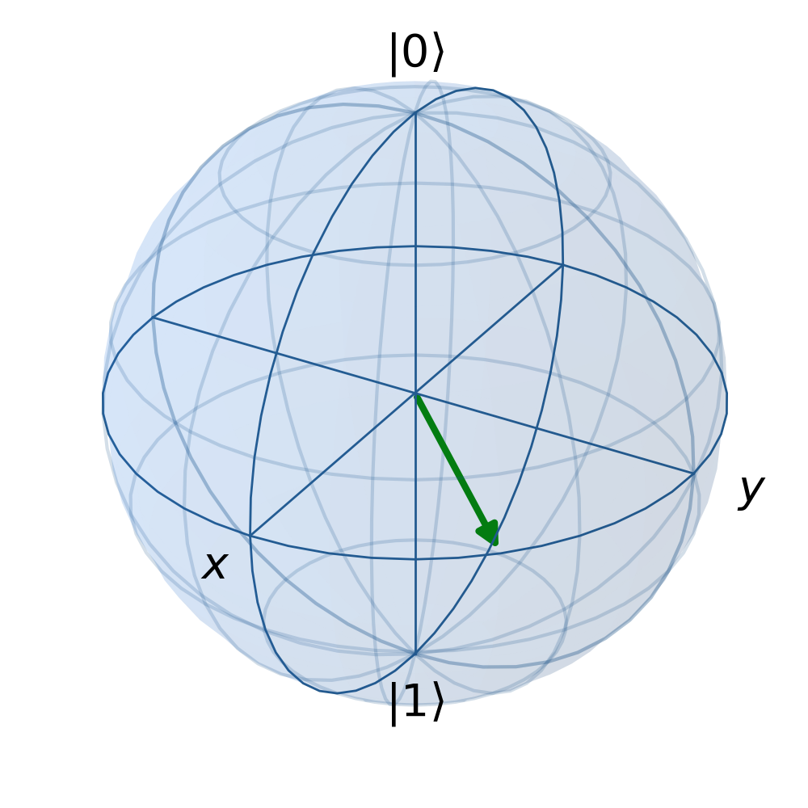
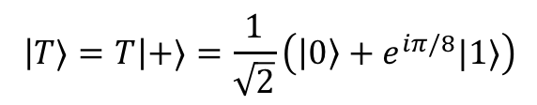
MAGIC-STATE DISTILLATION
T-Gate Injection Circuit
T-Gate Injection
T
Magic state
S
Clifford gates
Magic state

Slide 9




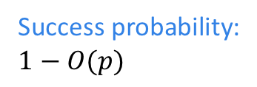


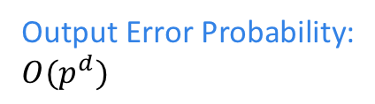


MAGIC-STATE DISTILLATION
Making Magic States
T
T
Encode
Post-select on syn
Decode
Measure Syndrome
...
...
...
...
T
T
Detect Errors
p²
T gates (raw or injected)
p

Slide 10



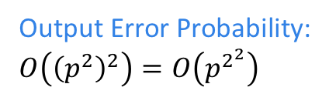







MAGIC-STATE DISTILLATION
Better Magic States
T
T
Encode
Measure Syndrome
Post-select on syn
Decode
...
...
...
...
T
T
T
T
Encode
Measure Syndrome
Post-select on syn
Decode
...
...
...
...
T
T

Slide 11
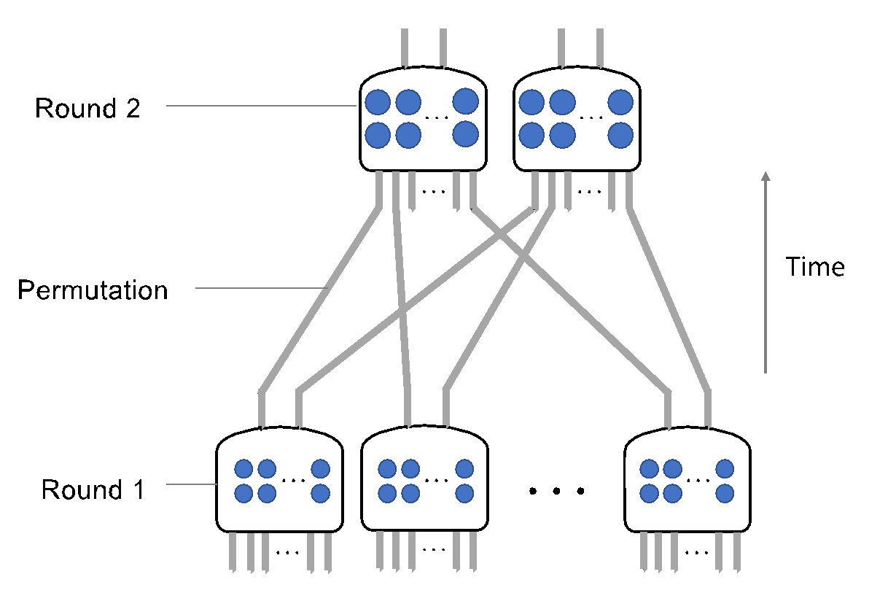

MAGIC-STATE DISTILLATION
Block Code Distillation Factory
T
T
p²
T
p
T
T
“Distillation Factory”
T

Slide 12


A
Z
Z
X
X
Z
Z
X
X
X
Z
Z
X
X
X
Z
Z
X
X
Z
Z

Slide 13
B
A
C

Slide 14

COMMUNICATION VIA BRAIDING
Fewer crossings?

Slide 15
Making Magic States Efficiently
https://doi.org/10.1109/MICRO.2018.00072
[with A. Holmes et. al.]

Slide 16


OBJECTIVE
Mapping

Slide 17
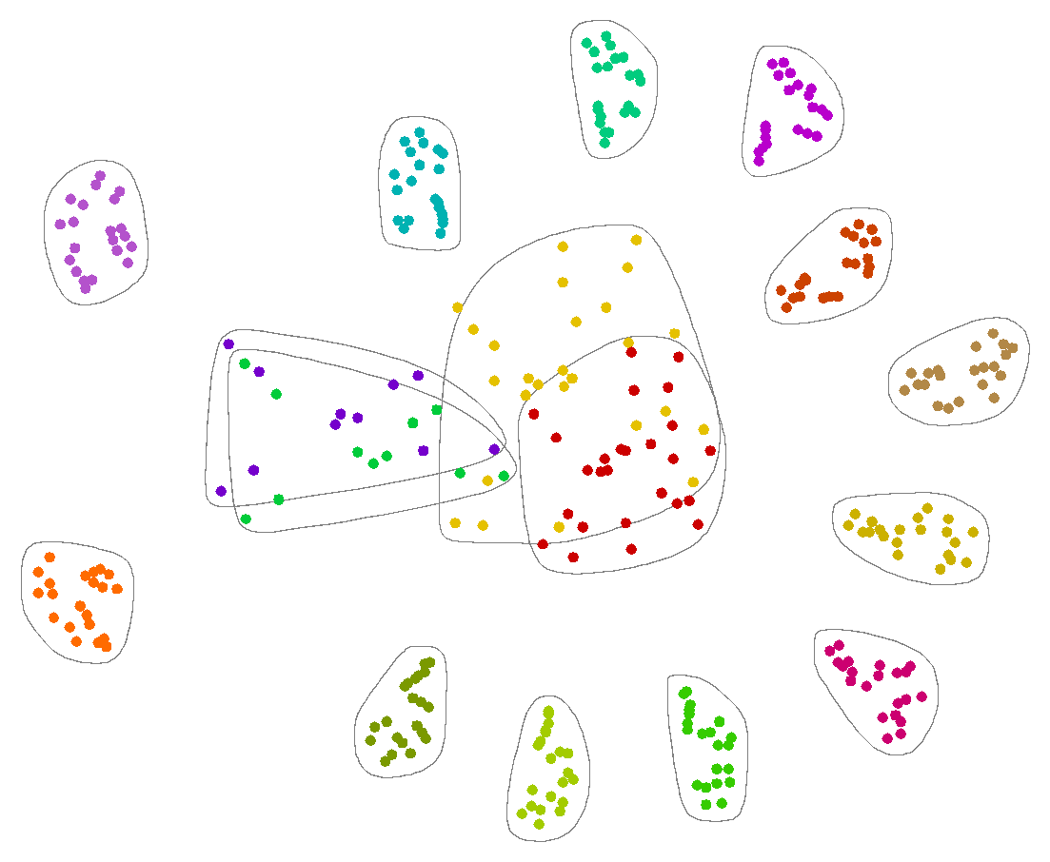

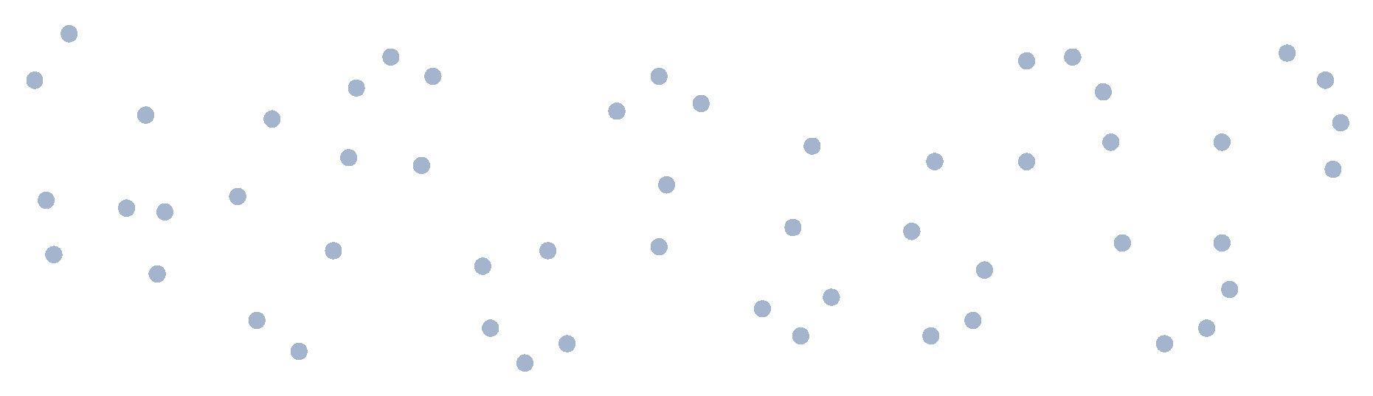
TECHNIQUES
Mapping

Slide 18
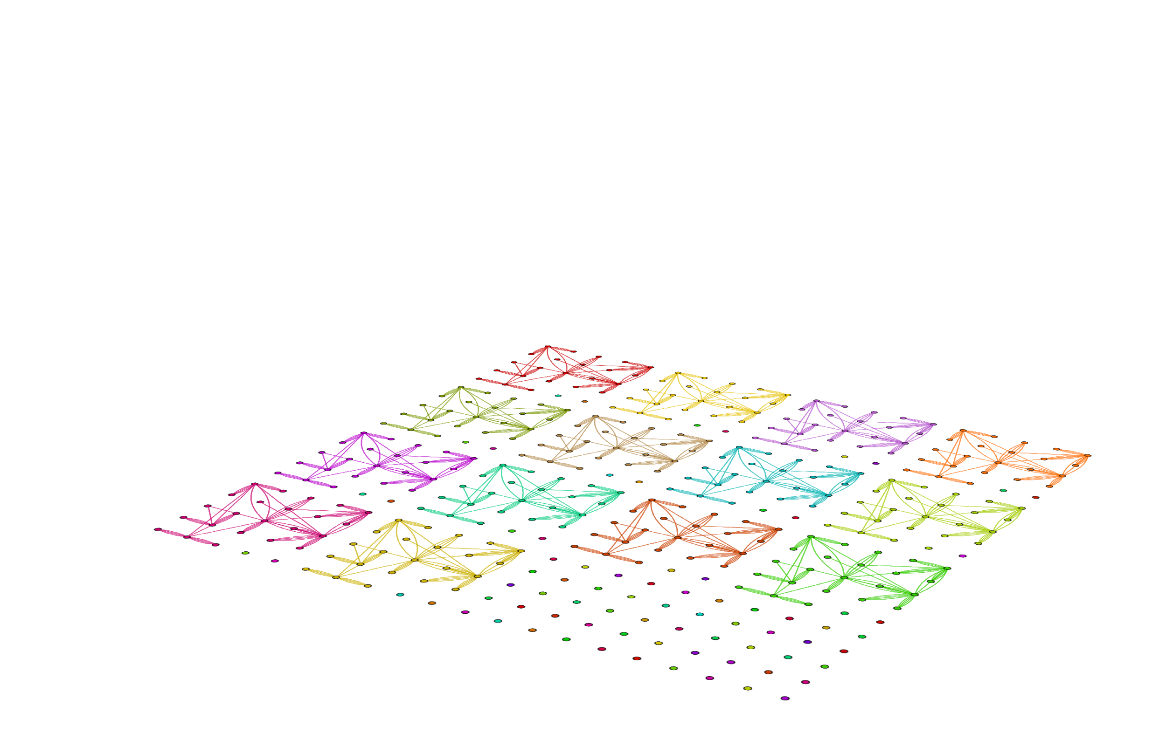
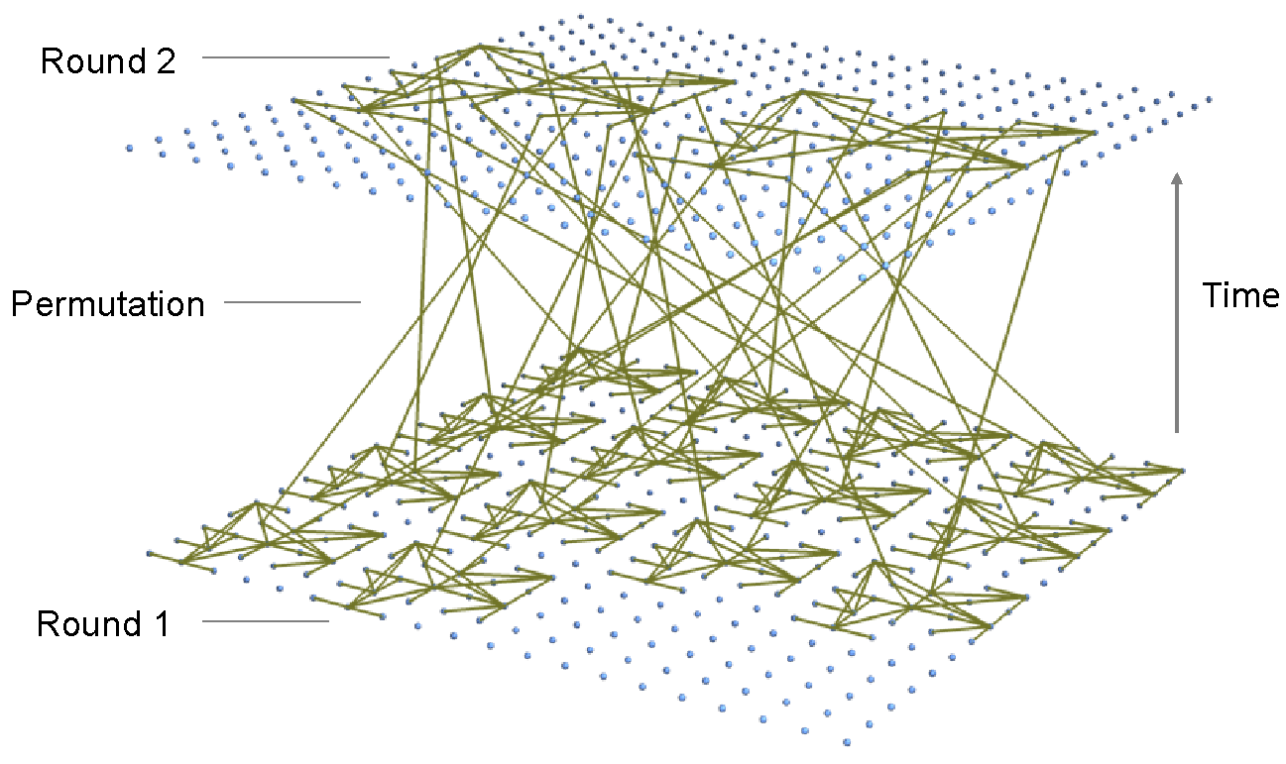
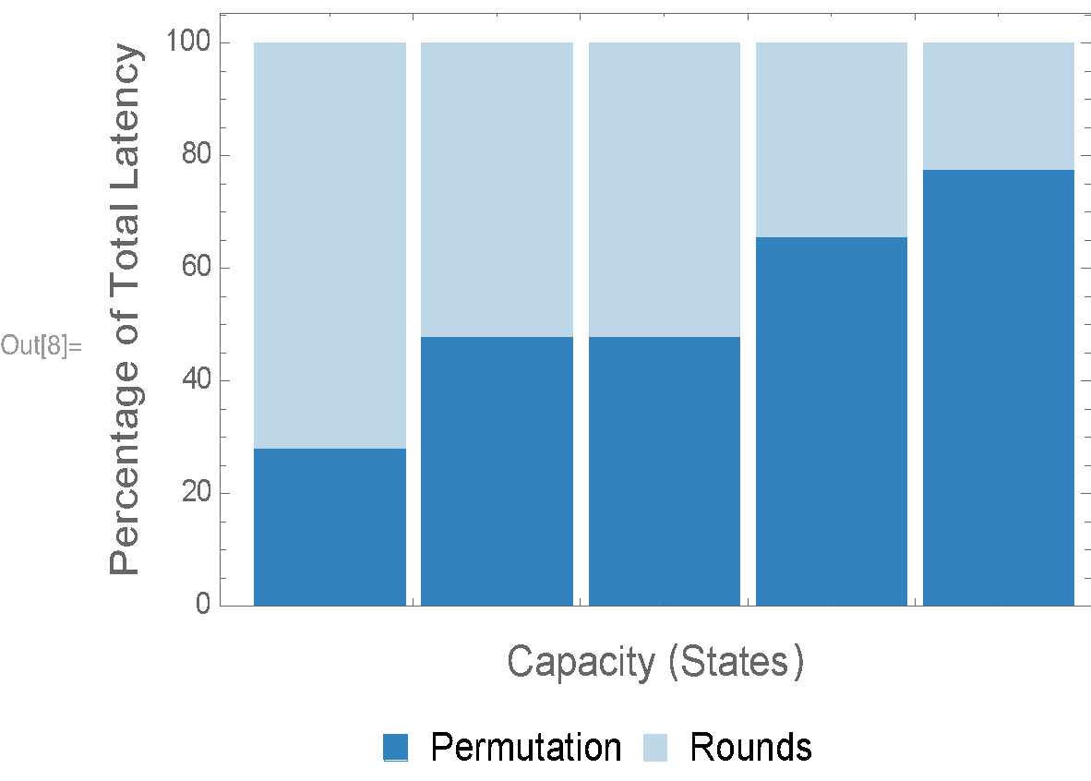
TECHNIQUES
Concatenate and Arrange
Cost of Permutation Step
78%
66%
48%
48%
28%
4 16 36 64 100

Slide 19
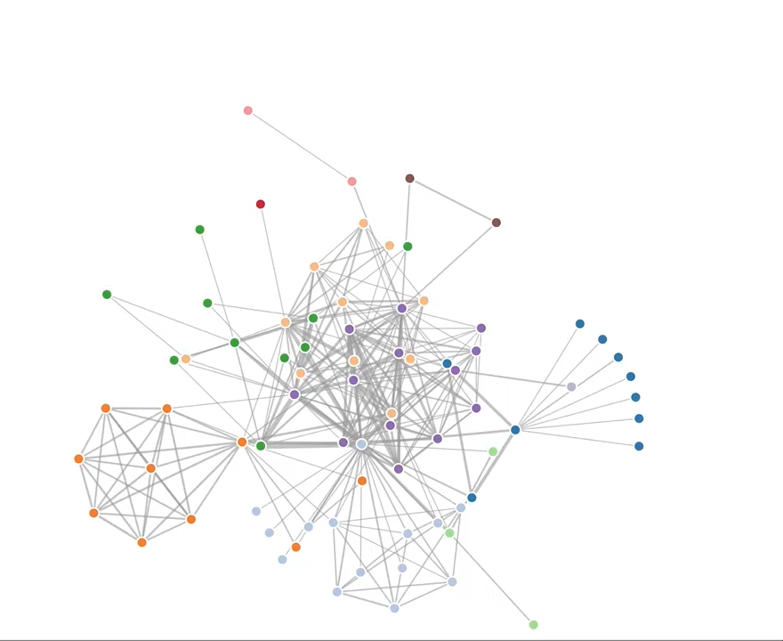
TECHNIQUES
Force-Directed Annealing
1
Vertex-Vertex Attraction
2
Edge-Edge Repulsion
3
Magnetic Dipole
Source: http://jsfiddle.net/4sq4F/

Slide 20
Vertex-Vertex Attraction

Slide 21
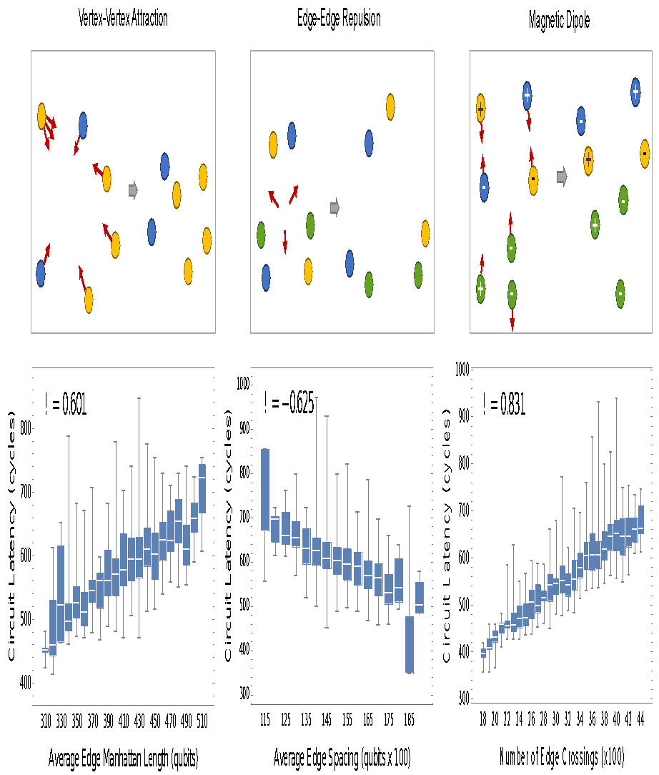
FORCE-DIRECTED ANNEALING
Vertex-Vertex Attraction
Calculated with
cycle-by-cycle simulation

Slide 22
Edge-Edge Repulsion

Slide 23
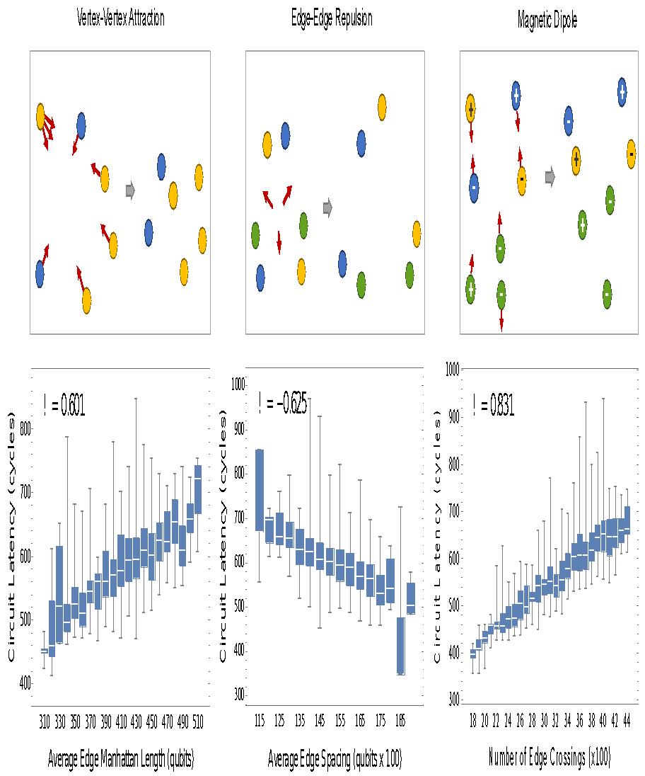
FORCE-DIRECTED ANNEALING
Edge-Edge Repulsion

Slide 24
Magnetic Dipole
+
+
-
-
-
+
-

Slide 25
FORCE-DIRECTED ANNEALING
Magnetic Dipole Rotation

Slide 26
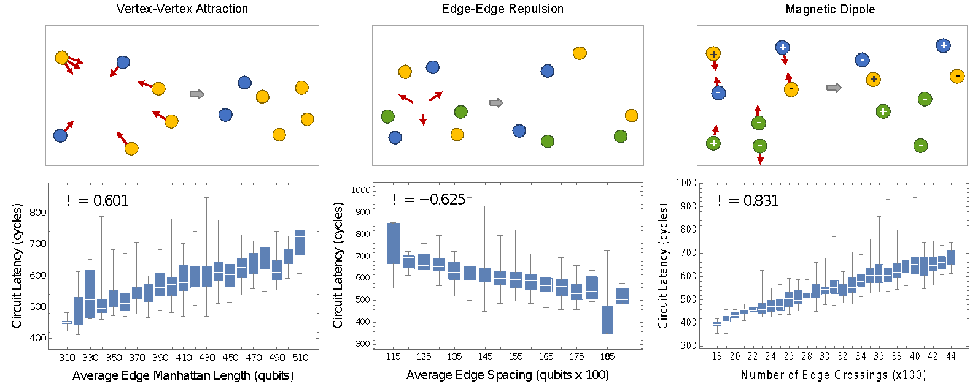
HIERARCHICAL STITCHING
Force-Directed Annealing

Slide 27
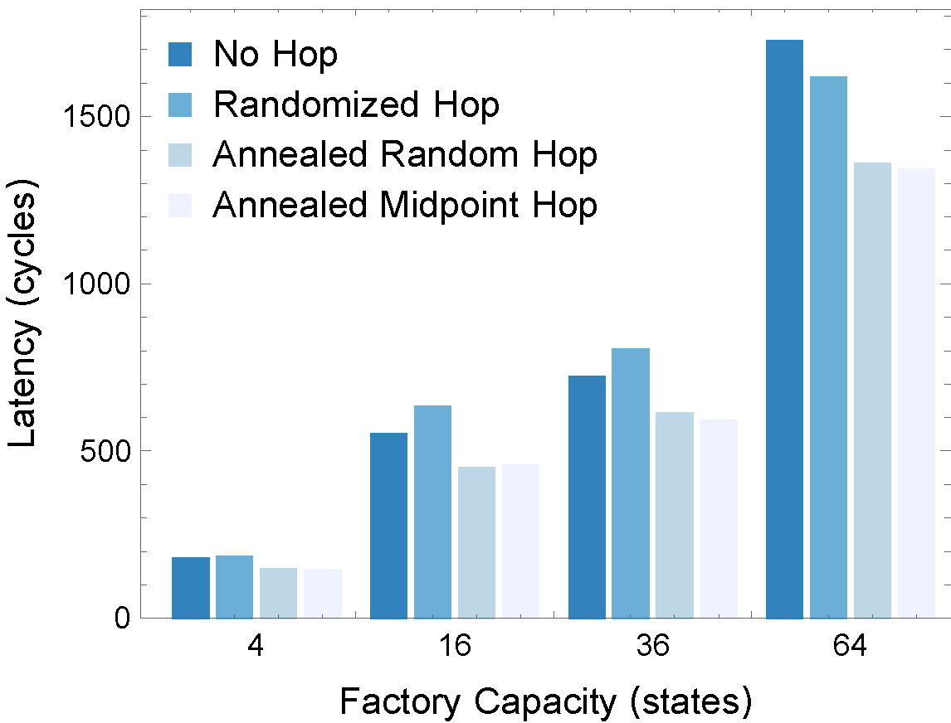
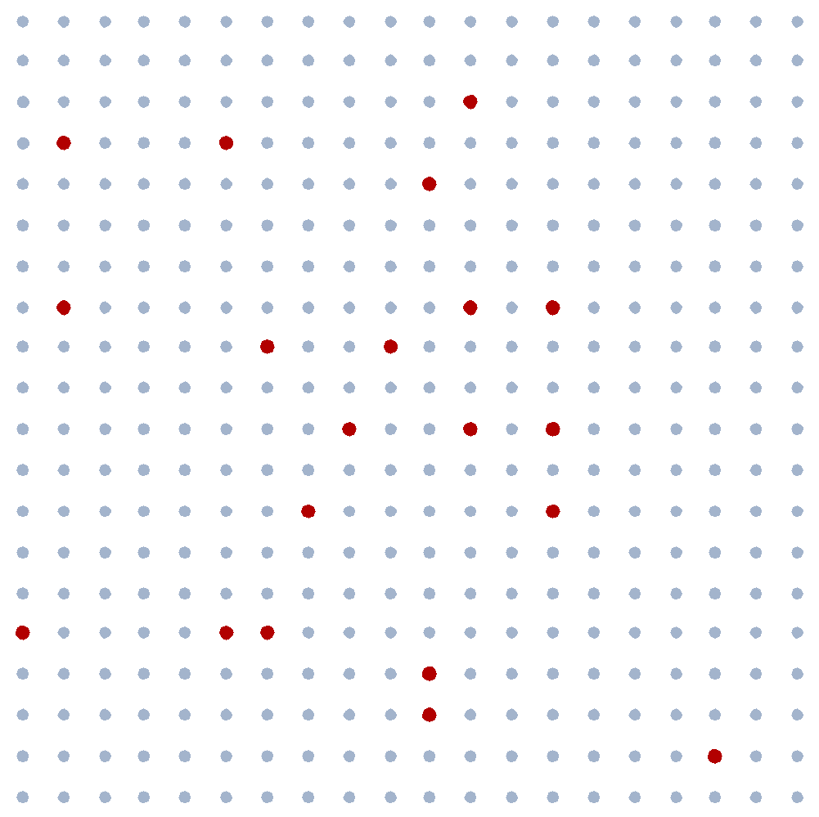
HIERARCHICAL STITCHING
Valiant-Style Routing

Slide 28
HIERARCHICAL STITCHING
Port Reassignment
Output ports from round 1
Input ports from round 2

Slide 29
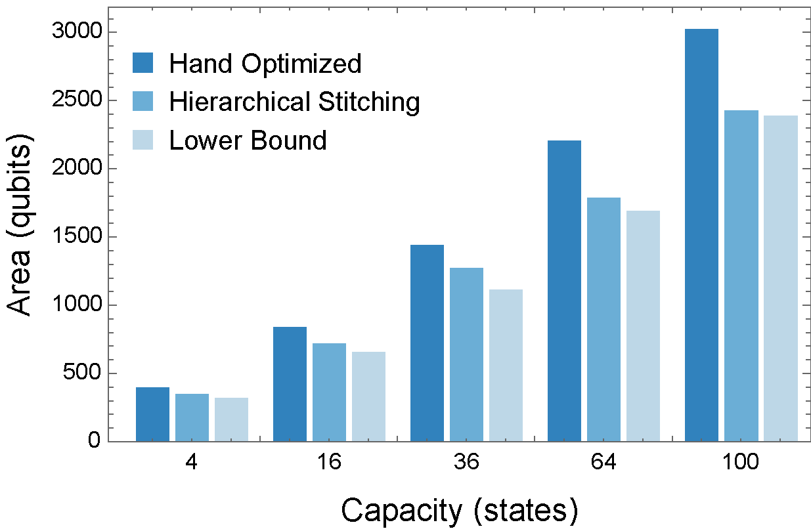
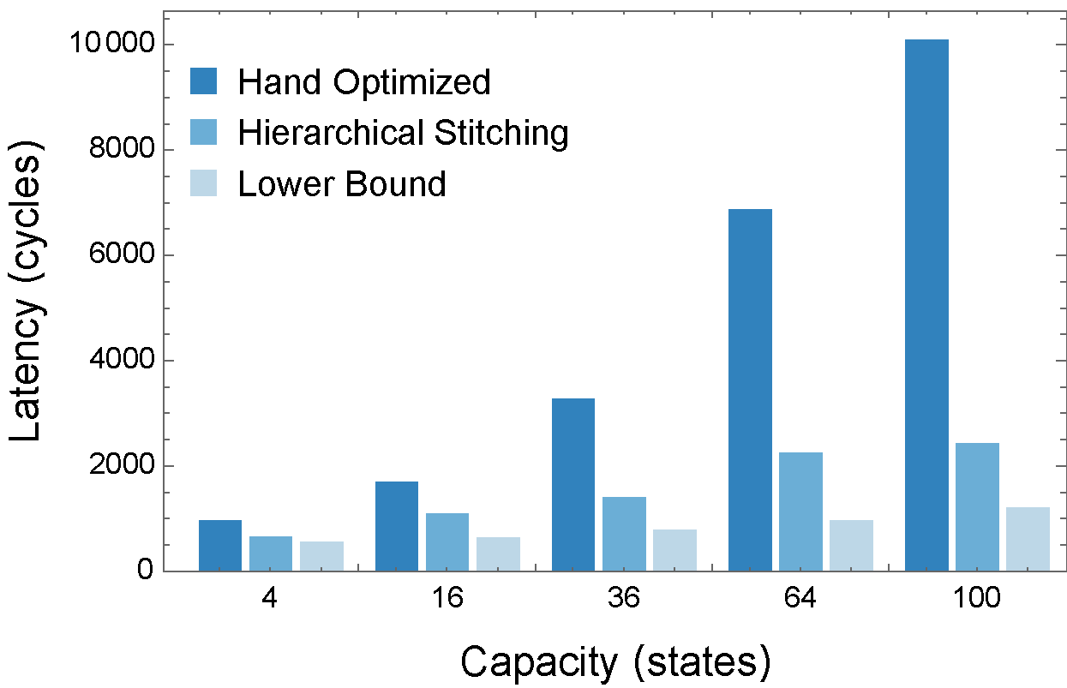
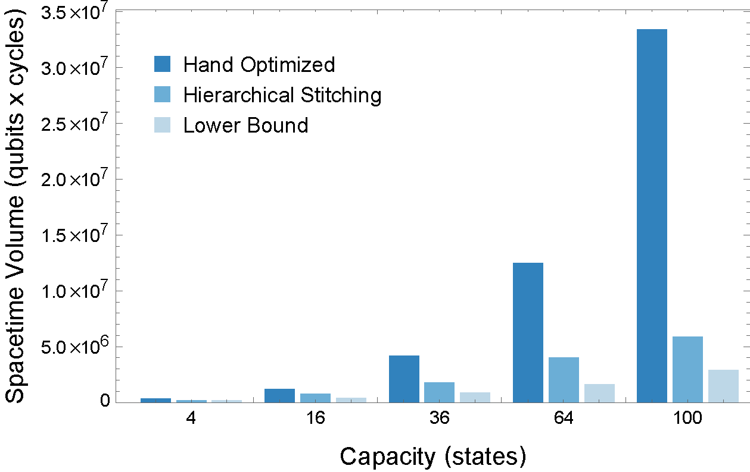
RESULTS
Multi-Level Factories
82% overhead reduction

Slide 30
Distributing Magic States Efficiently
https://doi.org/10.1016/j.micpro.2019.02.007
[with A. Holmes et. al.]

Slide 31
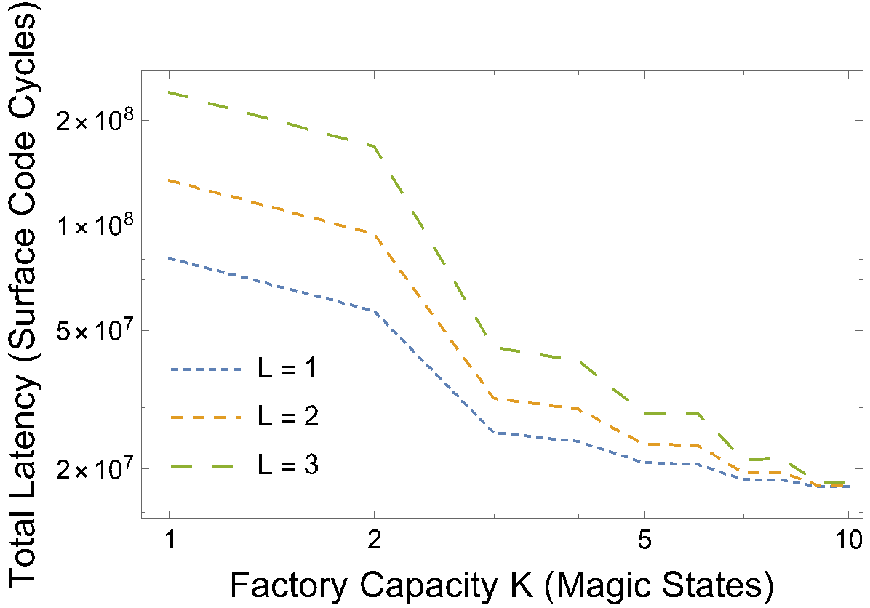
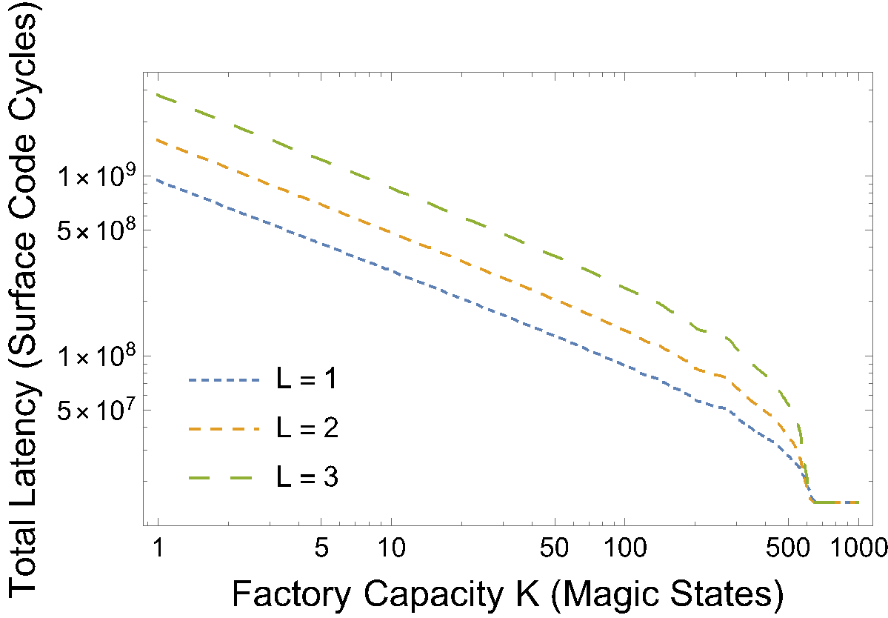
DISTRIBUTION
Embed Distillation Factories into the System
Given a target application:
How much area should we use for distillation?
How many levels of distillation do we need?
Where should we map the factories?
Ground State Estimation
Ising Model

Slide 32
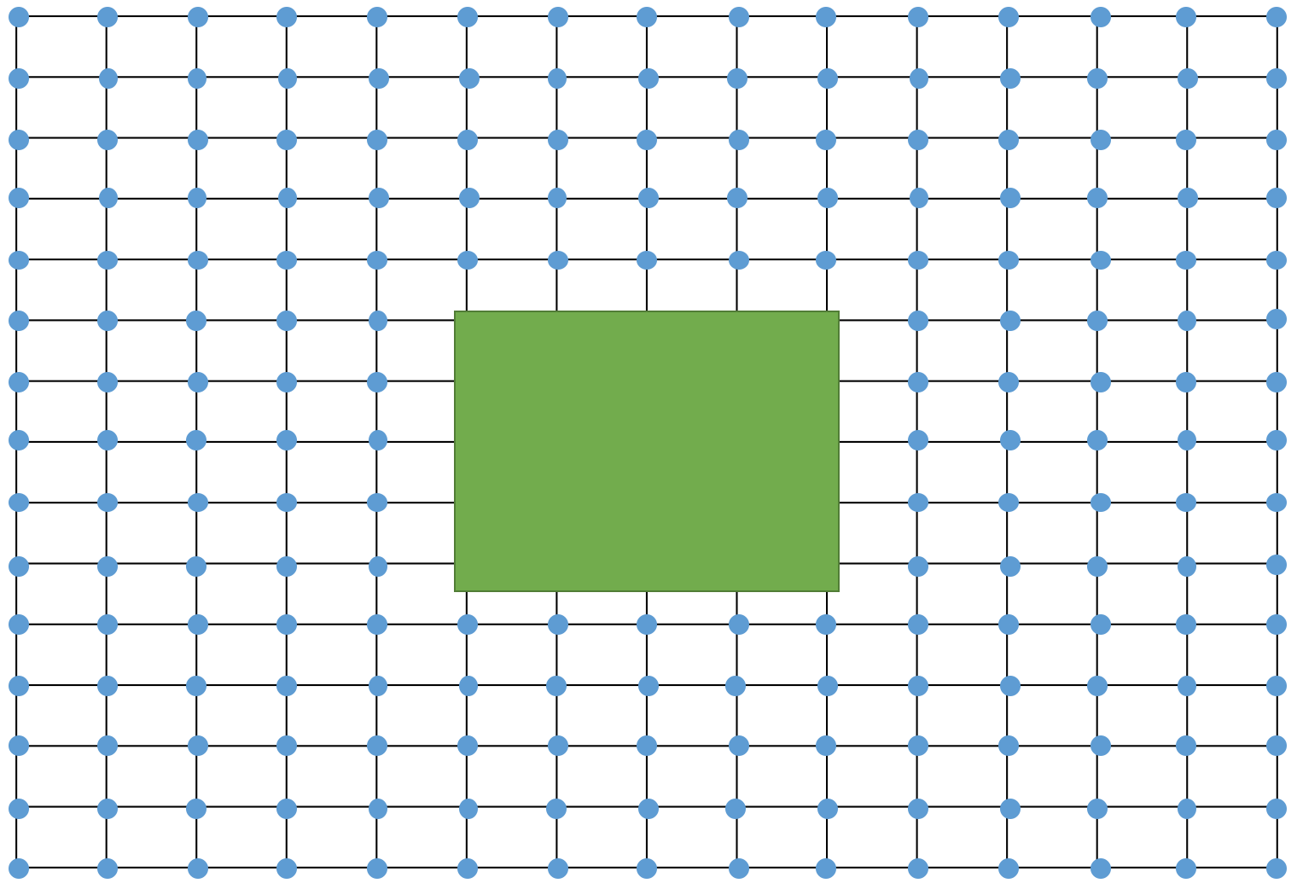
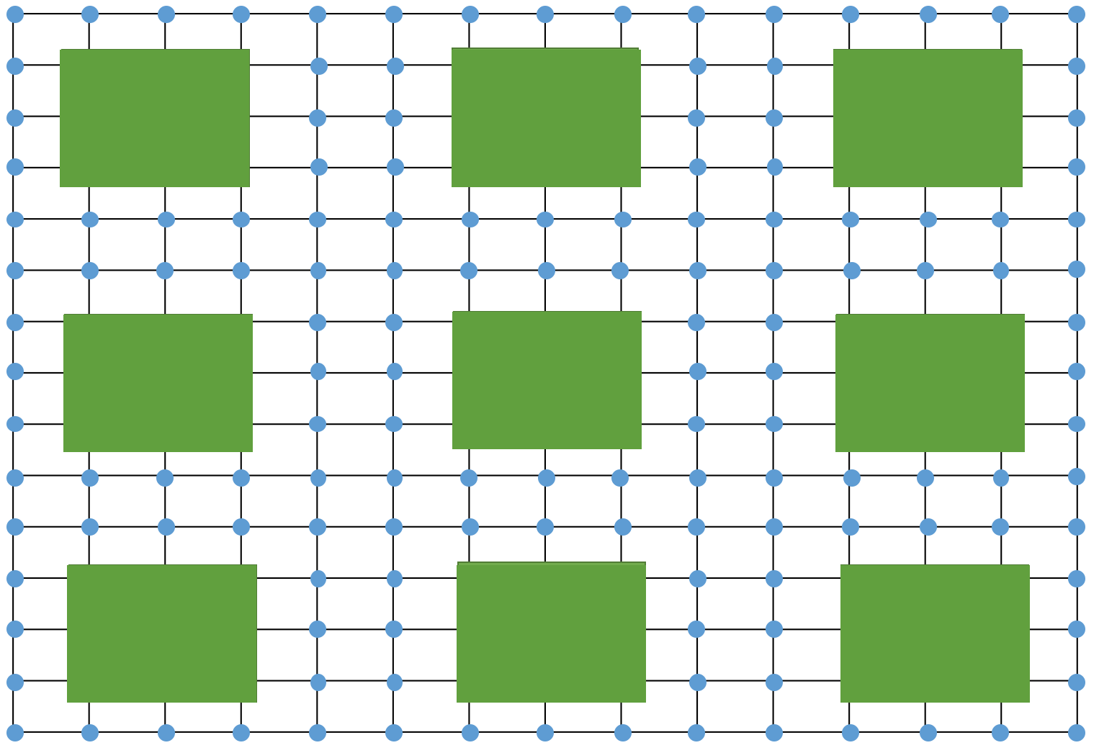
DISTRIBUTION
Embed Distillation Factories into the System
Given a target application:
How much area should we use for distillation?
How many levels of distillation do we need?
Where should we map the factories?

Slide 33
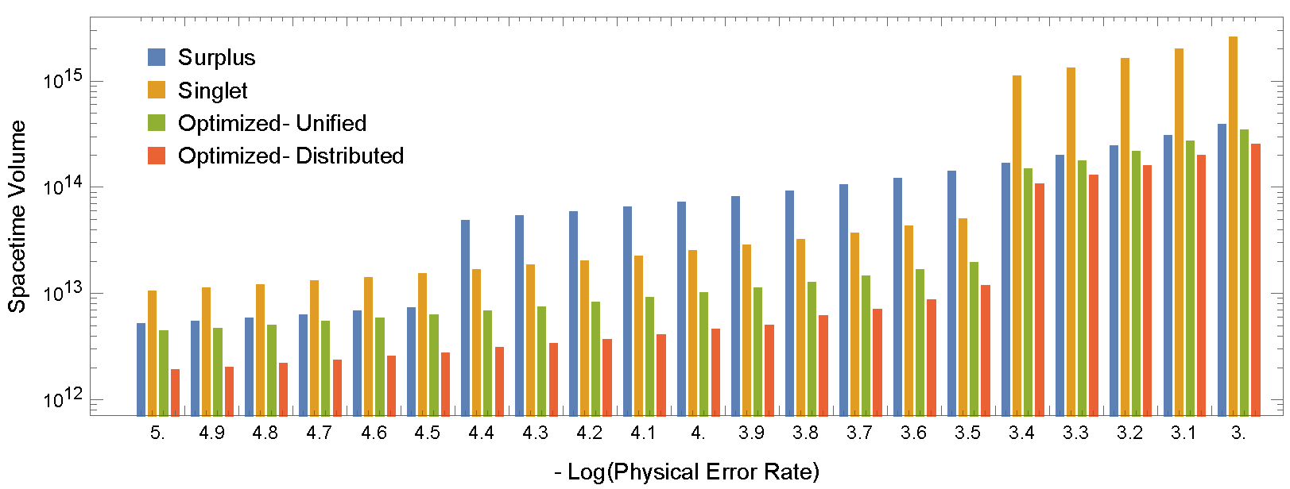
DISTRIBUTION
Embed Distillation Factories into the System

Slide 34
Using Qubits Sparingly in Computation
[with X.-C. Wu et. al.]

Slide 35
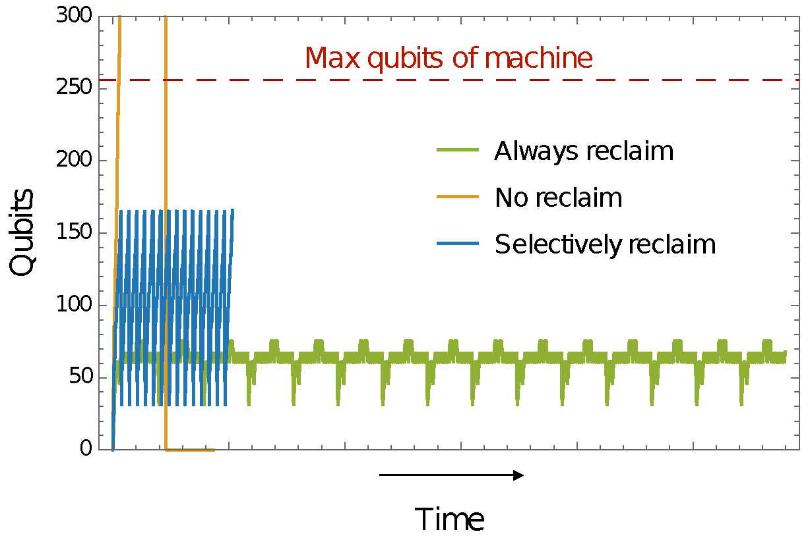
MEMORY MANAGEMENT
Qubit usage over time
Modular Exponentiation
Active Quantum Volume := area underneath

Slide 36
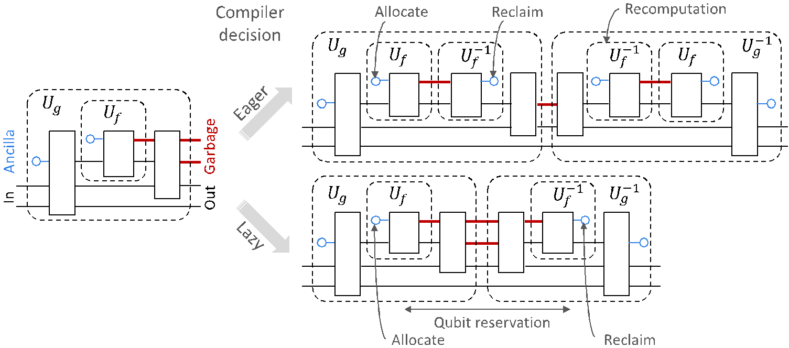
MEMORY MANAGEMENT
Qubit Reclamation Imposes Costs

Slide 37
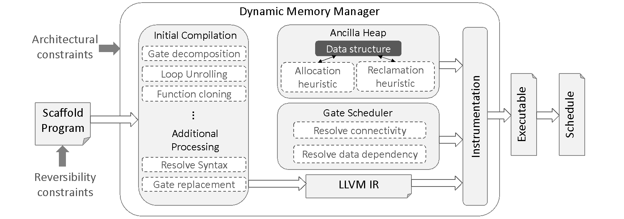
MEMORY MANAGEMENT
Compiler Tool Flow

Slide 38
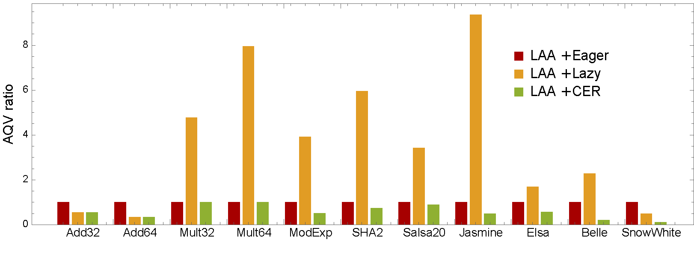
MEMORY MANAGEMENT
Results

Slide 39
Compiling for Variational Algorithms
[with P. Gokhale et. al.]

Slide 40
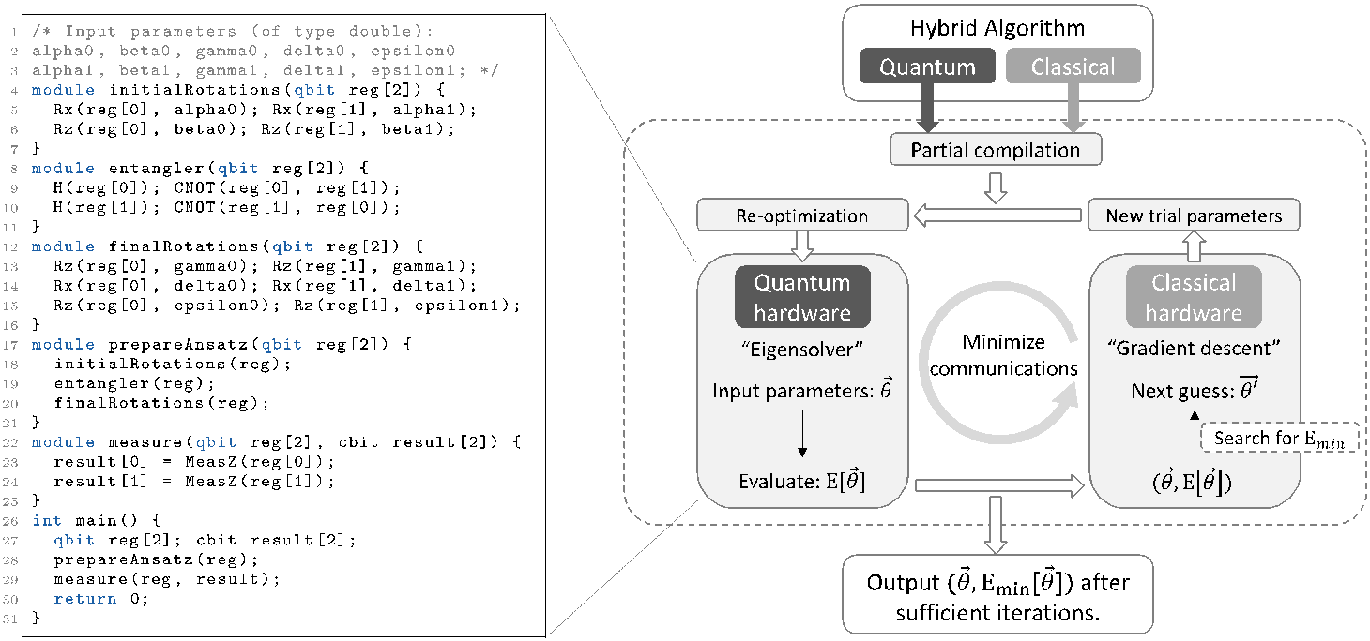
VARIATIONAL ALGORITHMS
Dynamic Compilation Flow

Slide 41
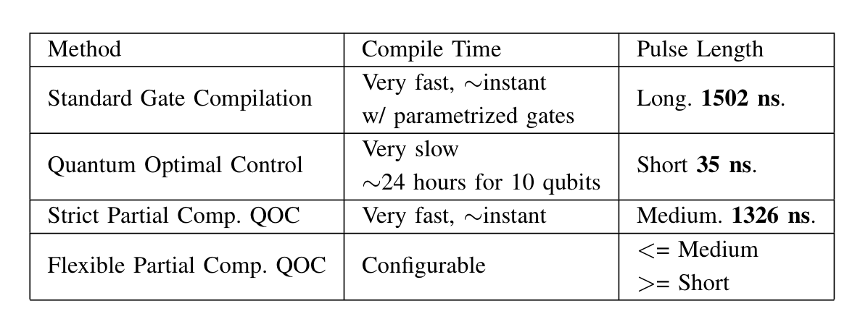
VARIATIONAL ALGORITHMS
Pulse Compilation Comparisons
~1000 ns
~50 ns
~1000 ns
UCCSD Ansatz Preparation for LiH

Slide 42
Summary and Outlook

Slide 43
SUMMARY & OUTLOOK
Verify correctness of qubit reclamation?
Automatically detect points of qubit reclamation?
And a language support for that?
Apply to lattice surgery instead of braiding?
Relax the correlated-error constraints?
Braid crossing?
Embed data into distillation factory?
Faster pulse compilation?
More accurate pulse compilation?
Frederic T. Chong, Diana Franklin, Pranav Gokhale, Henry Hoffmann, Adam Holmes, Ali Javadi-Abhari, Nelson Leung,
Margaret Martonosi, Thomas Propson, David Schuster, Ash Wiseth, Chris Winkler, Xin-Chuan Wu.

