Slide 1
Quantum Convolutional Neural Networks (QCNN)
Authors: Iris Cong., Soonwon Choi, Mikhail D. Lukin
1Department of Physics, Harvard University 2Department of Physics, University of California, Berkeley
Pre-Print Submission: 9 Oct 2018
Slides by: Sreeraj Rajendran
Date: Nov 28, 2018

Slide 2
Motivation
Classical Machine Learning:
Self Driving Vehicle
Object Classification
Speech Recognition
Machine Learning + Quantum many-body physics = Exciting!
Notes:
Machine learning based on neural networks has recently provided signicant advances for many practical applications
Much progress has been made in realization of quantum information processors
Explore quantum computers can be utilized to further enhance performance of machine learning systems

Slide 3
Multi Body Interaction problems
Physical problems pertaining to the properties of microscopic systems made of a large number of interacting particles.
Repeated interactions between particles create quantum correlations, or entanglement
The wave function of the system is a complicated object holding a large amount of information
Makes exact or analytical calculations impractical or even impossible
Notes:
Theoretical analysis difficult.
Interactions create quantum correlations and entanglement
State function is extremely complicated

Slide 4
Motivation…
Classical Machine Learning to study Quantum Physics
machine learning techniques can be used for efficient description of different input states of complex quantum systems
Quantum Machines to enhance machine learning for practical problems
Quantum phase recognition (QPR)
Convolutional Neural Networks provide successful machine learning structure for classification tasks
Notes:
Classical: Neural Nets to model ground states and hamiltonians: G. Carleo and M. Troyer, Science 355, 602 (2017)
Artificial neural network encoding a many-body quantum state of N spins.A restricted Boltzmann machine architecture that features a set of N visible artificial neurons (yellow dots) and a set of M hidden neurons (gray dots) is shown. For each value of the many-body spin configuration , the artificial neural network computes the value of the wave function
Quantum circuits: Farhi and Navin

Slide 5
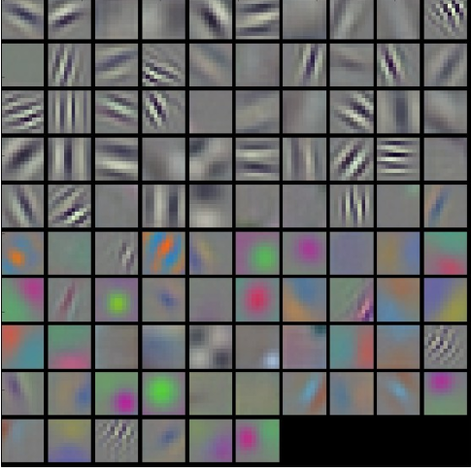
Classical Convolutional Neural Network(CNN)
CNN transforms an input image into a series of feature maps (blue rectangles), and finally into an output probability distribution (purple bars)

Slide 6
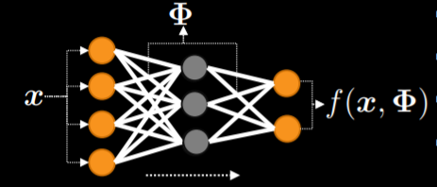
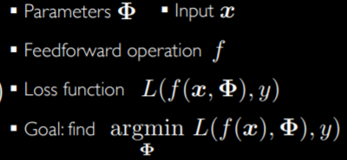
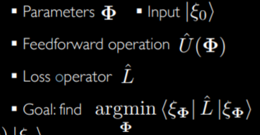
Classical vs Quantum Deep Learning
Classical
Quantum

Slide 7
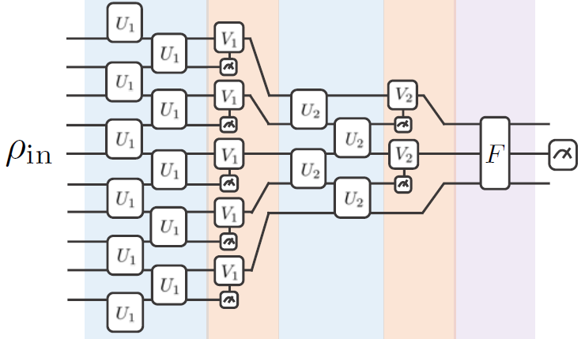
QCNN Circuit Model
Layer structure inspired by CNN
Input: Unknown Quantum state
Convolution: Apply unitaries Ui
Pooling:
Reduce size by measuring fraction of input
Unitary controlled rotations are applied to remaining based on measurement
Repeat until system size is small
Fully Connected unitary F
Non-local measurement
Result by measuring fixed number of output qubits

Slide 8
QCNN Circuit Model…
classified training data : α = 1, ..., M}
|ψα are input states and yα = 0 or 1 are the corresponding binary classification outputs.
QCNN is characterized by unitaries
and has an expected final measurement value
Initialize randomly
Optimize:
η is the learning rate

Slide 9
Quantum Phase Recognition (QPR)
Objective: Given quantum many-body system in unknown ground state , does belong to a particular quantum phase P.
Test setup: Detect 1D symmetry protected topological phase (P)

Slide 10
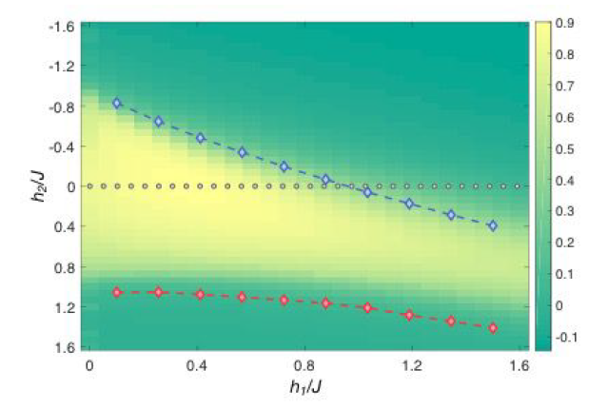
Data Preparation
Input= Ground State
Training data consists of ground states along the line h2 = 0, where the Hamiltonian is exactly solvable by Jordan-Wigner transformation.
40 evenly spaced points with h1 in range [0,2] –Gray dots in image
|ψα> input states
yα = 0 or 1 are the corresponding binary classification outputs.
M=40
Notes:
The blue and red diamonds are phase boundary points extracted from infinite size density-matrix renormalization group (DMRG) numerical simulations, while the colors represent the expectation value of the QCNN output.

Slide 11
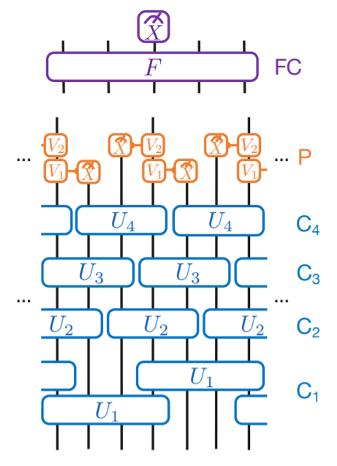
QCNN test model architecture
Choose n= 3 ( as Hamiltonian involved 3 qubit terms)
Convolution layer:
C1 : (n+1) qubit unitaries on every nth qubit
U1=4 qubit Unitary
n convolution layers of n-qubit unitaries
C2,C3,C4 with 3 qubit unitaries U2,U3 and U4 respectively
Pooling Layer
The pooling layer measures n − 1 out of every contiguous block of n qubits
Apply unitary V on remaining 1 qubit
2 qubits measured and associated with unitary V based on measurement result
Repeat conv + pool layer for required depth (eg: d=1 )
Fully Connected Layer:
arbitrary unitary on the remaining N/n^d qubits
Classification output = measurement output of the middle qubit( or any other fixed one)

Slide 12
Learning Procedure
All parameters cµ are set to random values between 0 and 2π for the unitaries
{Ui , Vj , F}.
In every iteration of gradient descent, compute the derivative of the mean-squared error function (slide 8) to first order with respect to each of these coefficients cµ
Update Cu:
repeat the gradient descent procedure until the error function changes on the order of 10^−5 between successive iterations
Hyperparameter tuning: Learning rate is calculated using bold driver technique.

Slide 13
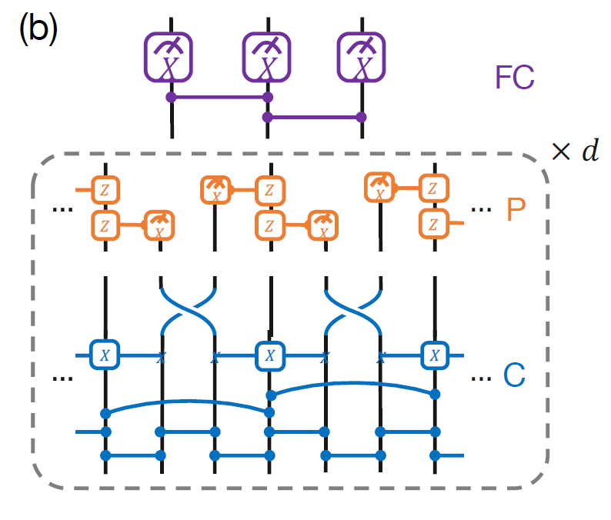
QCNN Circuit for QPR
Blue line segments: controlled-phase gates
Blue three-qubit gates flip the middle/target qubit when the left and right (control) qubits both have X =−1
Orange two-qubit gates flip the phase of the target qubit when the X measurement of the control yields −1
FC layer applies controlled-phase gates followed by an Xi projection, effectively measuring

Slide 14
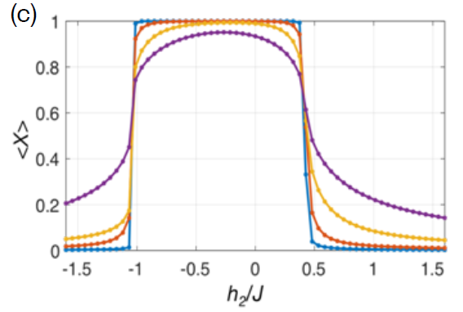
QCNN output for varying depths
Layer depth=1,2,3 &4 for violet, yellow , red and blue respectively
Adding more layers gives sharper contrasts

Slide 15
Why QCNN works
QCNN circuit with multiple pooling layers can be viewed as a combination of MERA (multiscale entanglement renormalization ansatz) — an important variational approach for many-body wavefunctions — and nested QEC (Quantum Error Correction) — a mechanism to detect and correct quantum errors without collapsing the entire wavefunction.
This makes QCNN a powerful architecture to classify input quantum states.

Slide 16
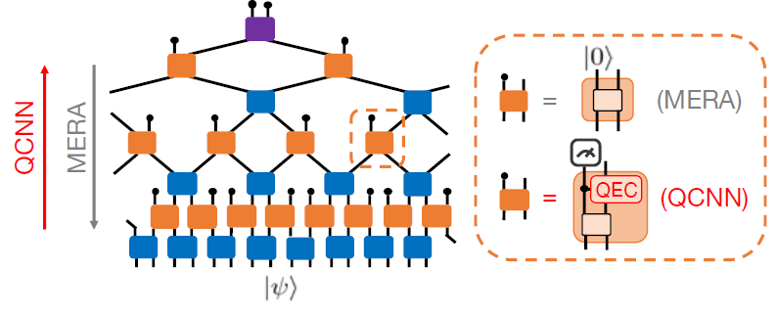
Why QCNN works…
QCNN circuits combine the multi-scale entanglement renormalization ansatz and quantum error correction to mimic renormalization-group flow, making them capable of recognizing different quantum phases and associated phase transitions.

Slide 17
Why QCNN works (Alternative explanation)
Although a QCNN performs nonunitary measurements in the pooling layers, similar to QEC circuits, it is equivalent to a setup where all measurements are postponed to the very end and the pooling layers are replaced by unitary controlled gates which act on both the measured and unmeasured qubits. In this way, the QCNN can be viewed as unitary evolution of the N input qubits followed by measurements, and the classification output is equivalent to measuring a nonlocal observable.

Slide 18
Conclusion
Concrete circuit model for quantum classification
Application to quantum phase recognition
Theoretical explanation for the working:
QCNN= MERA + QEC = RG flow

Slide 19
Discussion
QCNN for two and higher dimension phase detection
Potentially help identify nonlocal order parameters for lesser-understood phases, such as quantum spin liquids or anyonic chains, which have sharp expectation values up to the phase boundaries.
Design of fault-tolerant quantum storage and quantum operations, where specific noise models can be used to generate training data to optimize the design of QEC codes and operations on their code spaces.
Structural similarity of QCNN with its classical counterpart motivates potential adoption of more efficient gradient computation schemes

Slide 20
Thank You

