Slide 1
Quantum circuits for floating-point arithmetic
Authors:
Thomas Haener, Mathias Soeken, Martin Roetteler, and Krysta M. Svore
Slides by: Sreeraj Rajendran
Date: Nov 19, 2018

Slide 2
Contents
Motivation
Background
Hand-optimized Circuits
Automatic Circuit Synthesis
Analysis
Conclusion
Feasibility

Slide 3
Motivation
Floating point can support a much wider range of values than fixed point, with the ability to represent very small numbers and very large numbers.
Dynamic range is especially important when processing extremely large data sets or data sets where the range may be unpredictable. Hence, ideal for computationally intensive applications like Quantum Machine Learning.
Algorithms that focus on physical phenomena, such as quantum chemistry and quantum field theory calculations seem especially likely to be able to take advantage of floating point arithmetic.

Slide 4
Motivation…
Study the impact of different choices of floating-point representations on the number of quantum bits (qubits) and number of T-gates that are required for basic arithmetic operations.
Great savings in number of qubits compared to fixed point representation when the required range of values and/or relative precision is large.
Efficient hardware-software co-design : It is crucial to analyze the resulting circuits in order to acquire resource estimates.

Slide 5
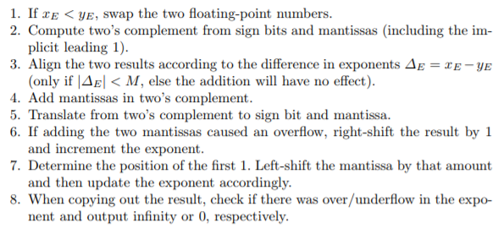
Background
Floating point representation:
Every number x is approximated using three registers:
1 sign bit xS, M bits for the (non-negative) mantissa xM ([1, 2)), and E bits for the exponent xE.
Addition

Slide 6
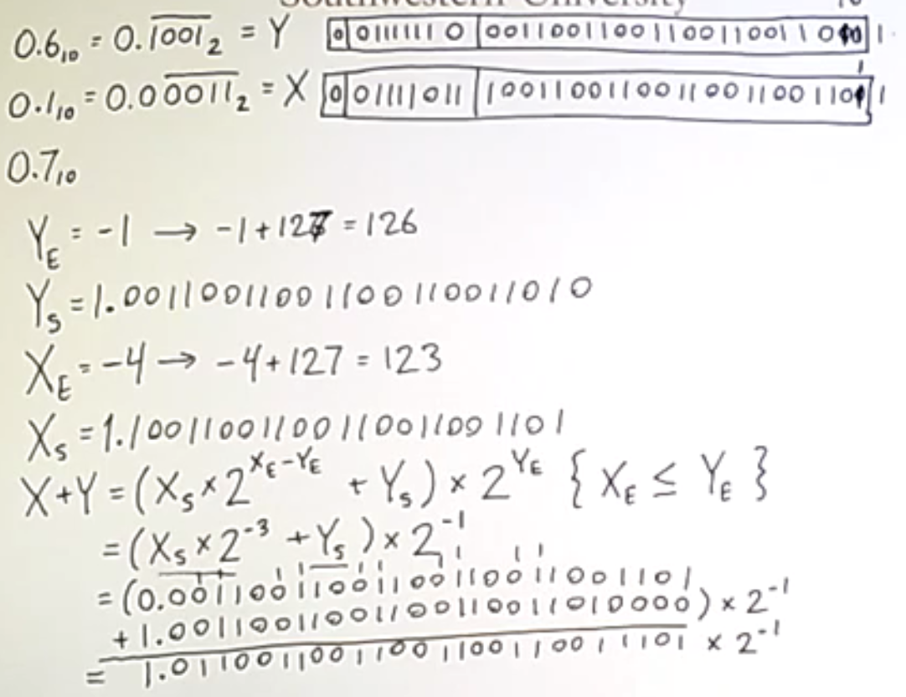
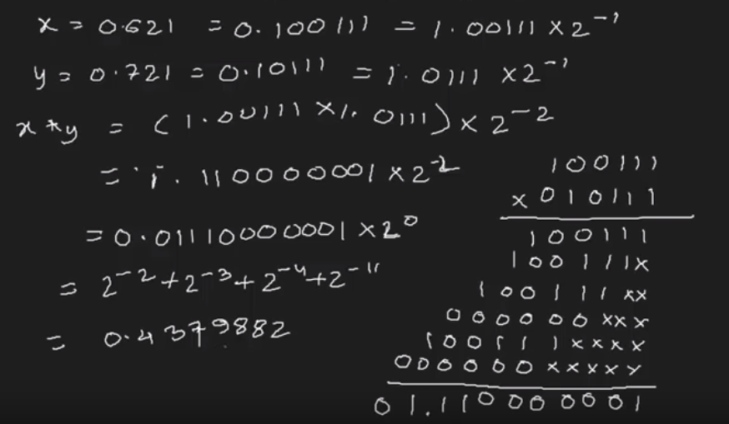
Background…
Multiplication:
Multiplication:

Slide 7
Background …
Quantum Circuits
Every quantum instruction must be reversible
Intermediate results need to be stored in ancilla qubits
Quantum Error Correction : all quantum operations need to be mapped to a discrete gate set (Clifford+T)
T-gate - most expensive quantum operation
Circuit size: KQ= T-depth.#Qubits
T –count: number of T gates ( 7)
T -depth : number of T-stages(6)

Slide 8
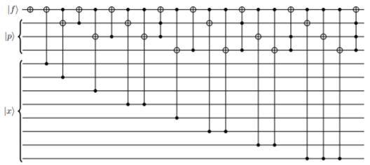
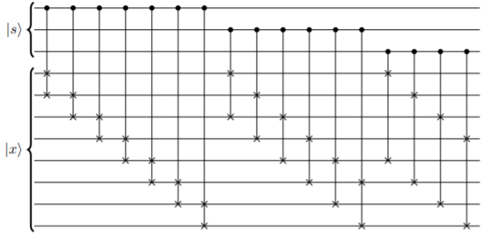
Hand Optimized Circuits
Building blocks:
Circuit for finding the first one in the bit-representation of x. f is toggled on finding first 1 and position of the first one is stored in the p-register.
QUIRK
Shift circuit for an 8-bit number x. The shift s must be such that the top, i.e., least-significant s bits of x are 0.
Shift_circuit

Slide 9
Hand Optimized Circuit: Addition Circuit
Sort inputs by exponent : CMP +SWAPs
Shift 2nd mantissa by difference of exponents
Add 2nd mantissa to first and convert back from 2’s compliment
If carry, shift result by 1bit and increment exp by 1
RN gate renormalize the intermediate result using first one ckt followed by shifting the mantissa by the output of the first-ones circuit and copies out the resulting floating point representation.

Slide 10
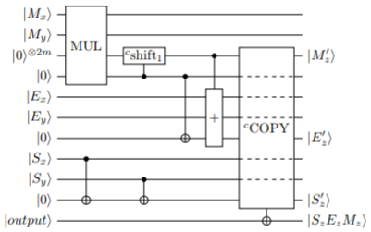
Hand Optimized Circuit: Multiplication Circuit
Multiply input mantissas (Mx and My) into new register of 2m qubits
Right shift by 1 if Mx.My>=2
Update exponent
Add input exponents Ex and Ey to Ez’ if Mx.My!=0
COPY: copying out of the resulting exponent, mantissa and sign bit to take care of special cases such as over- and underflows in computing the resulting exponent which turn to infinity and zero outcomes, respectively

Slide 11
Automatic Circuit Synthesis
LUT based hierarchical synthesis approach (LHRS)
Input - classical gate-level logic network (Verilog file)
Apply logic synthesis algorithms to map the gate-level netlist into a LUT(lookup table) network.
There is a one-to-one connection between a k-input LUT in a logic network and a reversible single-target gate with k control lines in a reversible network.
Single-target gates: reversible gates in which the value of a target line is inverted if a given Boolean control function evaluates to true on the control line.
Translate into a reversible network composed of single-target gates.
Each single-target gate can be synthesized into a quantum circuit using techniques such as exclusive-sum-of-product (ESOP) decomposition.
Notes:
Hierarchical Reversible Logic Synthesis Using LUTs
In this paper we present a hierarchical synthesis approach based on k-feasible Boolean logic networks. These are logic networks in which every gate has at most k inputs. These are often also referred to as k-LUT (lookup table) networks. We show that there is a one to-one connection between a k-input LUT in a logic network and a reversible single-target gate with k control lines in a reversible network. A single-target gate has a control function and a single target line, that is inverted if and only if the control function evaluates to 1. Each single-target gate can be synthesized into a quantum circuit using techniques such as exclusive-sum-of-product (ESOP) decomposition [13]. As a first step, our synthesis approach can quickly derive a skeleton for the reversible network that is only based on single-target gates. In this skeleton, the number of required additional lines is already final, and also it is guaranteed that it has no garbage outputs. In the second step, each single-target gate is synthesized using a separate algorithm. It is possible to parallelize the second step.
The ability of a K-input LUT to implement any Boolean function of K variables di$eren,tiates the synthesis of LUT circuits from synthesis for conventional ASIC technologies. The major difference occurs during the technology mapping phase of logic synthesis.

Slide 12
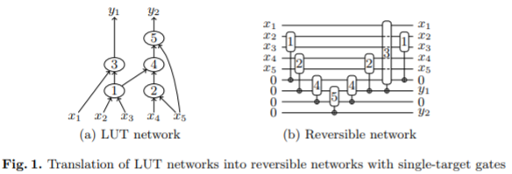
Automatic Circuit Synthesis

Slide 13
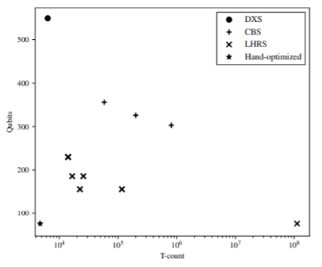
Automatic Circuit Synthesis
Aim: find a reversible network with as few ancillae as possible
Each single-target gates is mapped to a Clifford+T network
For each single-target gate, all available mappers were implemented and the quality of resulting Clifford+T networks were compared
Notes:
evaluate circuits using circuit depth (execution time) and KQ metric\
In order to use quantum error correction, however, all quantum
operations need to be mapped to a discrete gate set. One such set of operations
is called Cliord+T, where the T-gate is usually the most expensive quantum
operation.

Slide 14
Comparison of Resource Counts
Resource counts for Hand Optimized Circuit
Resource counts for Automatically Generated Circuits
Notes:
minimum possible number of T gates (called the T-count)
T -stages in a circuit, rather than the number of T -gates. A T -stage is a group of one or more T - and/or T † -gates on distinct qubits that can be performed simultaneously.

Slide 15
Analysis: Disadvantage of Automatic Synthesis
cost in handcrafted floating-point circuits are much lower than automatic synthesis tool
Optimization function is based on classical problems where in the objective is to minimize time and bits are available in plenty.
It also highly depends on the logic network that is input to the synthesis algorithm. The relation of this objective to the number of qubits and T-count is not fully understood.

Slide 16
Analysis: Advantages of Automatic Synthesis
Automatic synthesis can be applied to various designs and results can be obtained immediately compared to several months in case of hand crafted.
Adjustable synthesis parameter : various different implementations of the same design can be found.
Design space exploration: depending on the targeted quantum platform or the context of the design inside a quantum algorithm, one can address different objectives.
Potential to find a design that requires fewer qubits. Automatic synthesis techniques can in principle find quantum circuits without any ancilla qubits (except to store the result of the outputs)

Slide 17
Feasibility
Floating-point arithmetic using hand-optimized circuit for quantum computing is viable. Automatic synthesis results in v.large circuits.
Circuit size, KQ= T-depth.#Qubits <= 439,320 : 39.3% improvement over previous work (KQ=723,301)
Cost of floating-point multiplication is very similar to performing it in a fixed-point representation
floating-point multiplier can deal with a much wider range of values at constant relative error

Slide 18
Conclusion
The cost of using floating-point arithmetic is manageable and incurs almost no overhead for typical scientific applications.
For many quantum algorithms, the extra range and constant relative error offered by a floating-point representation are well worth an increase in circuit size of 2-3×.

Slide 19
Discussion
Larger overheads compared to fixed point arithmetic is partly because of strict requirements of IEEE standards for floating point arithmetic.
In combination with manual circuit optimization, relaxing the requirements allows for significant savings size of the circuit.
Differences in objective functions in optimization process for classical and quantum computing.
Future scope: investigate this combination of approaches.
Some of the subroutines in hand optimized circuits can still be further optimized using methods from the automatic synthesis approach.

Slide 20
Thank You

