Slide 1
QuMA: A Microarchitecture for a Superconducting Quantum Processor
X. FU et. al. QUTECH, Delft University of Technology, J. C. DE STERKE Topic Embedded Systems, W. J. VLOTHUIZEN Netherlands Organization for Applied Scientific Research, R. N. SCHOUTEN et. al. QUTECH, Delft University of Technology
Top picks Micro 2018
PRESENTED BY: Mahita Nagabhiru
DATE: Nov 5th 2018

Slide 2
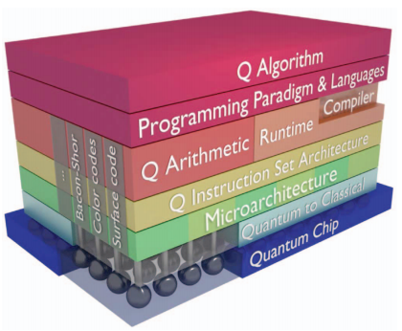
Motivation
This paper provides the first systematic discussion of the functionality that fills the gap between high-level algorithms and the quantum physical layer.
To this purpose, a multi-layered system stack for a quantum computer is defined.

Slide 3
Key ideas presented
Compiler support beyond logical QASM- logical QASM to physical QASM mapping (borrowed from their prior work).
QISA + Micro-architecture: Quantum ISA with multilevel instructions, decoded to micro-code- both classical and quantum, dispatched to respective components with control/timing pulses. (crux of this paper)
Discussion of future work for the proposed micro-architecture. (future/on-going work).

Slide 4

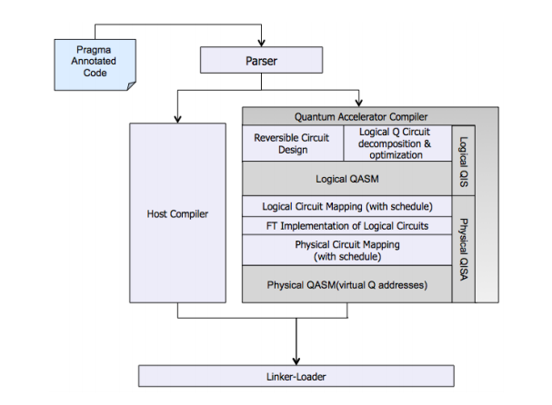
From Code to ISA: Compiler Support
Need for Hybrid compiler- Host (like GCC) + Quantum Accelerator Compiler (QAC).
QAC is hardware agnostic but needs to know the right QEC code to map logical qubits to physical ones.

Slide 5
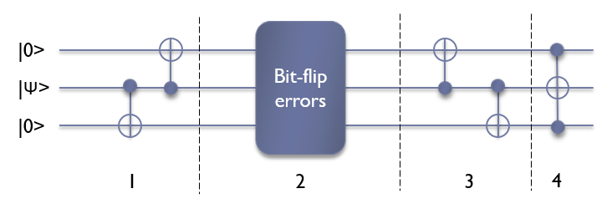
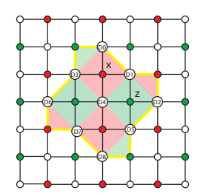
Quantum Error Correction: Relevant to this paper
1 data bit needs 2 ancilla bits for bit/phase correction.
Thus, 1 logical qubit mapped to multiple physical qubits in surface code. (ancilla bits can be shared) see ninja star.

Slide 6
Need for Micro-Architecture Framework
Prior to this paper, popular methods to controlling qubits were mainly based on autonomous arbitrary waveform generators (AWG) and data collection units. These methods were inefficient because of:
  high resource consumption
  long configuration times
  control complexity
  lack of scalability with the number of qubits.

Slide 7
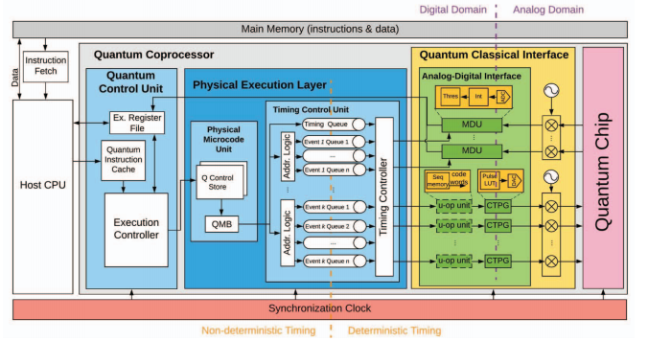
Quantum Micro-Architecture: QuMA
Quantum coprocessor seen as accelerator to a classical host CPU.
Compiled code consists of
  Classical code from classical compilers like GCC to host CPU from main memory.
  Quantum code that contains
    Classical code for control information.
    Quantum code for quantum operations.

Slide 8
Review of Classical Micro-architecture
I-type
R-type
I-type | loads | load rd, #immed(rs1) | addr = Regs[rs1] + sign_extend(immediate) Regs[rd] = Mem[addr]
 | stores | store #immed(rs1), rs2 | addr = Regs[rs1] + sign_extend(immediate) Mem[addr] = Regs[rs2]
 | register-immediate ALU operations | op rd, rs1, #immed (e.g., add) | Regs[rd] = Regs[rs1] op sign_extend(immediate)
 | conditional branches | bopz rs1, #immed (e.g., bez, bnez, …) | cond = (Regs[rs1] op 0) target = PC + 4 + sign_extend(immediate) PC = (cond ? target : PC + 4)
 | jump register / call register
R-type | register-register ALU operations | op rd, rs1, rs2 (e.g., add) | Regs[rd] = Regs[rs1] op Regs[rs2]

Slide 9
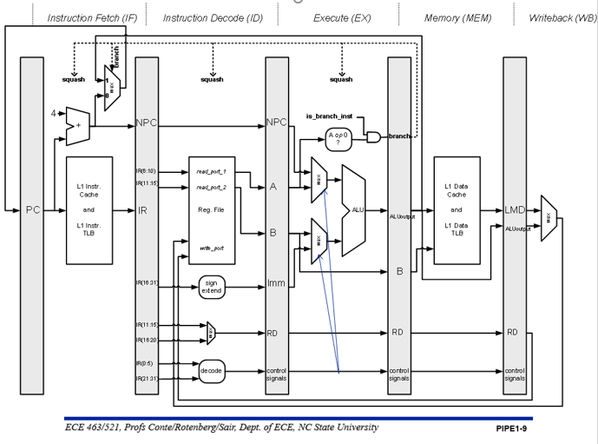
Review of Classical Micro-architecture

Slide 10
QuMA: Quantum Control Unit
Quantum code from main memory comes to QCU- A multilevel instruction decoding unit
Execution controller takes care of:
  quantum code movement to Ex. Reg-file and Physical execution layer
  Classical code movement

Slide 11
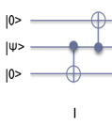
QuMA: Physical Execution Layer
  Physical Microcode Unit:
  Converts micro-instructions at the Q control store, puts micro-operations at the QMB (Quantum microinstruction buffer) with timing info which in-turn are put into codeword triggers at the u-op unit.

Slide 12
QuMA: Physical Execution Layer
  Timing Control Unit has a Queue-based event timing control scheme
  issues event triggers with precise timing at nanosecond scale to the
  measurement discrimination unit MDU and the u-op unit.

Slide 13
QuMA: Quantum Classical Interface
Quantum Classical Interface:
  Codeword-based event control scheme at codeword-triggered pulse generation unit (CTPG) produces analog input to the quantum processor based on codeword triggers.
  The MDU converts the analog output from the quantum processor into binary results.

Slide 14
QuMA: Quantum Classical Interface
  Each micro-op is associated with a timing pulse (related to its timing label) and codeword. Codeword is nothing but an index for this time pulse corresponding to this timing pulse into the CTPG or MDU units.
  CTPG and MDU units have fixed latencies and precise timing pulses and take care of the further Analog to digital conversion interfaces. This is claimed to be more precise and systematic instruction-driven and hence overcomes of the AWGs drawbacks.

Slide 15
QuMA: Quantum Classical Interface
  Fast and flexible feedback control is also possible in principle because the CTPG scheme does not require the waveform to be uploaded at runtime and codeword triggers this dynamically.
  The whole of QCI interface actually needs to be Technology dependent making the previous stages of micro-architecture Quantum technology agnostic making this very modular and adaptable.

Slide 16
Experimental setup
Not Done:
  Writing measurement results from the MDU to the exchange register file.
  The automatic conversion from quantum instructions to quantum microinstructions
Done:
  The timing management part of the physical microcode unit.
    the microinstruction set, QuMIS executed to from time cycle to cycle.
    QEC as a part of gate characterization experiment done using Randomization benchmarks.

Slide 17
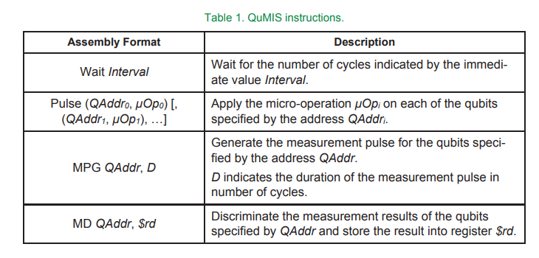
QUMIS

Slide 18
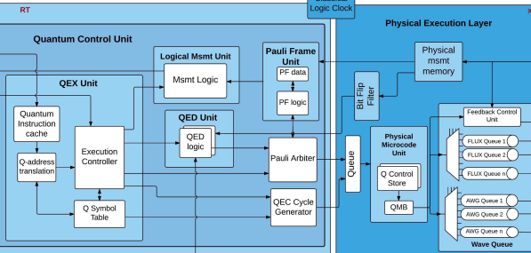
QEC Experiment With Pauli Frames

Slide 19
Open Problems
They talk about QISA and integrating classical and quantum instructions but discussion is limited to QEC- related classical components. Interaction between host CPU and Quantum co-processor is still unclear on the overall algorithm implementation.
Single issue rate discussion so far- but reality of Quantum Algorithms is SIMD- like; so need for support extension for the same- Single-Operation-Multiple-Qubit (SOMQ) execution.
There is a need for design of verification environment for their proposed architecture.
Scalability: A tiled architecture consisting of multiple QuMA nodes with each node controlling tens of qubits would be a potential solution for scaling up a system using their architecture model but detailed communication mechanisms between these tiles has to be established.
Even though the movement of data from digital to analog (Quantum) and back to digital is theoretically faster in their implementation, the CTPG still uses classical AWGs- just in a much more controlled fashion. Any developments of moving the AWGs functionality from room temperature to lower temperatures of Quantum Chip will make this entire movement much faster.

Slide 20
References
X. Fu et al., “A heterogeneous quantum computer architecture,” Proceedings of the ACM International Conference on Computing Frontiers, 2016.
X. Fu et al., “Pauli Frames for Quantum Computer Architectures”, Proceedings of the 54th Annual Design Automation Conference 2017
M. D. Reed, “Entanglement and quantum error correction with superconducting qubits,” dissertation, Yale University, 2013
. C. G. Almudever et al., “The engineering challenges in quantum computing,” 2017 Design, Automation & Test in Europe Conference & Exhibition (DATE), 2017, pp. 836–845

Slide 21
Questions?

