Slide 1
Applying quantum algorithms to constraint satisfaction problems
Earl Campbell, Ankur Khurana, Ashley Montanaro
Slides by: George Li

Slide 2
Motivation
Use Boolean satisfiability and graph coloring algorithms with constraint satisfaction problems
In depth analysis of speedup of complexity and runtimes of quantum algorithm vs classical

Slide 3
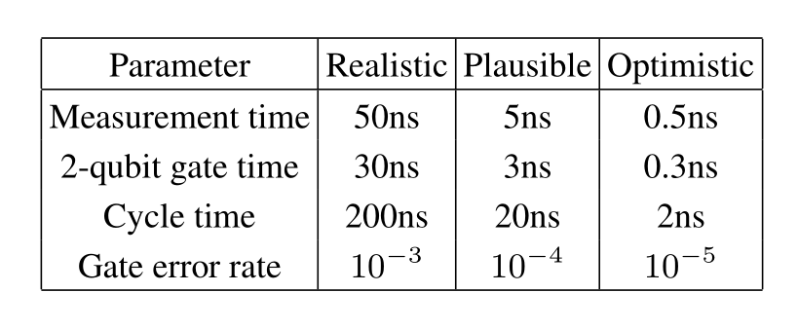
Background
Parameter regimes
Speedup factor estimation
Notes:
Realistic corresponds to values reported in literature as possible now, or predicted in near future, cycle time is time required to performs one surface code cycle
Each cycle comprises of four 2-qubit gates, with twi 1-qubit gates and a measurement; performed for each of X and Z, but parallelized to an extent that depends on relative times and measurements; therefore only consider one X/Z cycle when estimating the cycle time, and assume that a 1-qubit gate can be implemented in half the time required for a 2-qubit gate
Assumed order of magnitude improvements possible

Slide 4
Motivation
Apply quantum optimization algorithms to two NP-complete problems
Graph coloring
Boolean satisfiability
Apply k-colouring and k-sat
Compare against classical implementations

Slide 5
Timing and Cost model
Determine the cost of the quantum circuit, in terms of number of gates used and depth
Calculate the number of physical qubits used for logical communication and physical depth
Compute physical runtime using hardware-dependent parameters for timing variables; should be <1day
Compare cost of quantum vs classical computation

Slide 6
Grover’s Algorithm
Notes:
Given access to an oracle function f : [N] → {0,1},
Grover’s quantum search algorithm can be used to find x
such that f(x) = 1, or output that no such x exists, using
O( √ N) evaluations of f [24, 57], with arbitrarily small fail-
ure probability δ. The algorithm is based on “Grover itera-
tions”, each of which can be written as DO f , where D is a
fixed “diffusion operator” and O f is an oracle operator per-
forming the map |xi|yi 7→ |xi|y ⊕ f(x)i. If the size S of the
set {x : f(x) = 1} is known in advance, the optimal number
of Grover iterations to maximise the success probability can
be calculated in advance; otherwise, one can show that run-
ning the algorithm using varying numbers of iterations (e.g.
exponentially increasing, or random) is sufficient to solve the
unstructured search problem.
Each Toffoli gate controlled on c ≥ 2 bits can be imple-
mented using a circuit containing 2c−3 standard Toffoli gates
arranged into 2dlogce−1 layers in a tree structure. However,
almost half of these gates can be replaced with classically con-
trolled Clifford gates using the “uncompute AND” operation
described in [56], to give a circuit containing c − 1 Toffoli
gates. This does not change the measurement depth of the re-
sulting circuit, as the classically controlled Clifford operation
itself requires a measurement.
The operation of fanning out a single bit b to c copies can be
implemented via a tree of CNOT operations of the following
form, illustrated for c = 8:
The depth of the circuit is dlogce, and it uses c − 1 CNOT
gates and no other gates. However, in the surface code a fan-
out operation (equivalently, a CNOT gate with multiple target
bits) can be executed in the same time as required for one
CNOT gate [53]. So we assign this operation the same cost
as one CNOT gate, which in any case is 0, when considering
Toffoli depth and Toffoli count.
Combining all the components of Algorithm 3, the Toffoli
depth is
4d(logk) − 1e + 2d(logm) − 1e + 3

Slide 7
Grover’s Algorithm Complexity
Complexities of oracle algorithm
Depth is low, but count is very high

Slide 8
Backtracking Algorithm
Backtracking approach can be applied to any constraint satisfaction problem where we can rule out partial solutions that fail constraints
Can be seen as exploring a tree whose vertices correspond to partial solutions of the CSP

Slide 9
Backtracking continued
Backtracking algorithmic skeleton implemented using
K-colouring: Returns true if valid, false if not
K-sat: returns true of x is a valid assignment, false if not

Slide 10
Backtracking Complexity Optimisation
Use algorithm which detects existence of marked vertex, given an upper bound in number of vertices T in tree
Notes:
The algorithm is based on the use of a quantum walk to detect a marked vertex within a tree containing T nodes. A marked node corresponds to a valid solution. Abstractly, the quantum walk operates on the Hilbert space H spanned by {|ri}∪{|xi : x ∈{1,...,T −1}}, where r labels the root. The walk starts in the state |ri. Let A be the set of nodes an even distance from the root (including the root itself), and let B be the set of nodes at an odd distance from the root. We write x → y tomeanthat y isachildof x inthetree. Foreach x,let dx bethedegreeof x asavertexinanundirectedgraph. Thewalkisbasedonasetofdiffusionoperators Dx,where Dx acts on the subspaceHx spanned by{|xi}∪{|yi : x → y}. The diffusion operators are deﬁned as follows: • If x is marked, then Dx is the identity. • If x is not marked, and x 6= r, then Dx }.
The diffusion operators are deﬁned as follows: • If x is marked, then Dx is the identity. • If x is not marked, and x 6= r, then Dx = I − 2|ψxihψx|, where |ψxi = 1 √dx |xi+ X y,x→y |yi!. • Dr = I −2|ψrihψr|, where |ψri = 1 √1 + drn |ri+√n X y,r→y |yi!. A step of the walk consists of applying the operator RBRA, where RA =Lx∈A Dx and RB = |rihr|+Lx∈B Dx. Then the detection algorithm from [76] is presented as Algorithm 5. Wewillmostlybeinterestedinthecomplexityofthephase estimation step. The outer repetition step can be performed across mult

Slide 11
Backtracking Algorithm Complexity Optimisation
Implement optimized phase estimation algorithm, but with final inverse QFT replaced with Hadamard gates
Only need to distinguish between eigenvalue 1 and far from 1
Ra and Rb operations are parallelized

Slide 12
RA operation for k-colouring
Inputs need to be converted
P and h are most complex, and executed in parallel using fan-out

Slide 13
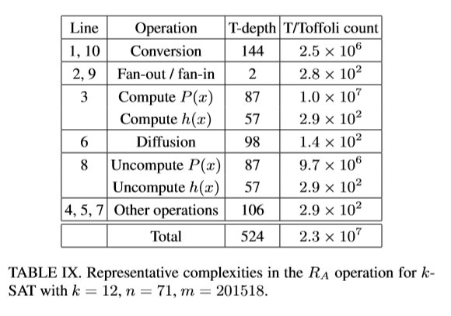
Backtracking Circuit Complexities
Gate synthesis operations are necessary for implementation

Slide 14
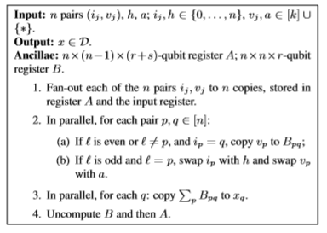
Conversion of Input
Need to copy nonzero element for each q
Use CNOT tree to sum mod 2
Set each bit of xq correctly with depth 4[logn]
Notes:
We now describe each of the operations in Algorithm 7 in more detail, and calculate their complexities. First, the fanout and fan-in operations are implemented in the same way as in Grover’s algorithm. In step 1 of Algorithm 7, each bit can be fanned out in parallel, so this operation corresponds to n(r + s) parallel fan-outs of 1 bit to n bits. To implement step 2, we can ﬁrst use a Toffoli gate controlledonsbitswithatargetofoneancillabittostorewhether ` = p (in the case of odd p; for even p, this is omitted). Then to carry out step 2a, we perform r parallel bit copy operations controlled on this bit being 0 and on ip = q (corresponding to aToffolicontrolledons+2bits). Step2bthenconsistsoftwo controlled-swapoperations,eachcontrolledontheancillabit, which can be performed in parallel. Swapping pairs of bits can be implemented as 3 CNOT gates. At the end of step 2, we uncompute the ancilla bit. For step 3, we need to copy the one non-zero element of the n-element set Sq := {Bpq0 : q0 = q} to xq, for each q. We could achieve this by a binary tree of addition operations (qv) but a simpler method is to use a tree of CNOT gates. We consider each set Sq in parallel, and each bit within elements of this set in parallel too, corresponding to a sequence of n bitscontainingatmostone1. Forsequencesofthisform,their sum is just the same as their sum mod 2. So, for each pair of bits (bi,bj), we can copy their sum into an ancilla qubit with the circuit |bii • |bii |bji • |bji |0i |bi ⊕bji Using a binary tree

Slide 15
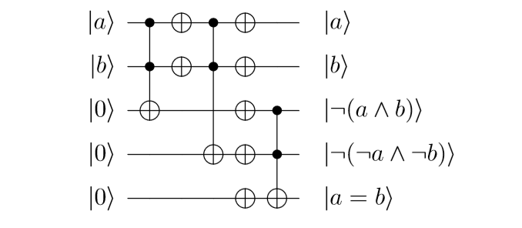
Backtracking – Checking Violation of Constraint
Equivalence checking circuit

Slide 16
Backtracking applied to k-SAT
Applied to SAT problems in much the same way
*->00, F -> 01, T -> 10
Each variable is 2 qubits

Slide 17
DSATUR
Uses heuristic, so h is simple
Calculation of P and h are much less intensive operations
MAPLE_LCM_Dist SAT solver won the “main track” of the SAT competition 2017

Slide 18
Classical Satisfiability Results
Notes:
TABLEX.EstimatedruntimescalingwithnoftheMaple LCM Dist SAT solver on random k-SAT instances with n variables and≈ αkn clauses. Table lists suspected exponents f(n) in runtimes of the form 2f(n), measured in CPU-seconds. Based on taking linear leastsquares ﬁts to the log of median runtimes from ≥ 100 random instances, omitting instances where n < 100 for k = 3; n < 60 for k = 4; n < 50 for k = 5. nmax column lists the maximal value of n considered in each case.
Figure 13. Runtime of the Maple LCM Dist SAT solver on random k-SAT instances with n variables and ≈ αkn clauses. Solid line represents the median of at least 100 runs, in CPU-seconds. Dashed lines are linear least-squares ﬁts.

Slide 19
Classical Backtracking Approach
Notes:
TABLE XI. Estimated backtracking tree size on random k-SAT instances with n variables and≈ αkn clauses, when variables are ordered in terms of appearance count. Table lists suspected exponents f(n) in tree sizes of the form 2f(n). Based on taking linear leastsquaresﬁtstothelogofmedianruntimes,from: 15randominstances and 10 ≤ n ≤ 30 for k ≤ 9; 7 random instances and 15 ≤ n ≤ 25 for 10 ≤ k ≤ 12; 5 random instances and 15 ≤ n ≤ 20 for 13 ≤ k ≤ 15 (omitting n = 15 in the case k = 15).
Figure15. Backtrackingtreesizewhenvariablesareorderedinterms of appearance count. Solid line represents the median on random kSATinstances;numberofrunsasdescribedinTableXI.Dashedlines are least-squares ﬁts.

Slide 20
Classical Colouring (DSATUR)
Notes:
Figure 16. Ratios between the number of nodes in the DSATUR backtrackingtreesforcomputingchromaticnumberandchecking kcolourability, over 1000 random graphs for each n ∈{30,...,75}. Solid line: median; dashed lines: 5th/95th percentiles.
Figure 17. Number of nodes in the DSATUR k-colourability backtracking tree vs. runtime in CPU-seconds on a 3.20GHz Intel Core i7-4790S processor. Scatter plot showing 1% of the 1000 random graphsconsideredforeachn ∈{10,...,75}. Lineisaleast-squares ﬁt.

Slide 21
DSATUR back-tracking
Notes:
Figure 18. Number of nodes in the DSATUR k-colourability backtracking tree. Median (solid) and 90th percentile (dashed) over 1000 random graphs for each n ∈ {10,...,75}. Dotted lines are leastsquares ﬁts for the range n ≥ 30.
Figure 19. Median ratio between the number of nodes in the unoptimisedDSATURbacktrackingtree,asusedinthequantumalgorithm, and the number of nodes in the optimised DSATUR backtracking tree. Taken over 1000 random graphs for each n ∈{10,...,75}.

Slide 22
Conclusion
Have detailed analysis of the complexity of quantum algorithms for graph coloring and Boolean satisfiability
Overheads for fault tolerance computed as well
Most of the classical speedups available by implementing quantum algorithms are nullified by available classical speedup methods

Slide 23
Further Work
Controlled quantum walk used with phase estimation; if could compute directly it could have a ~20% reduction in runtime
Optimisations targeted at classes of graphs that could consider different heuristic functions
Fault tolerance improvements would make these algorithms practical

