Slide 1
Compiler Management of Communication and Parallelism for Quantum Computation
Authors: Jeff Heckey, Shruti Patil, Ali Javadi Abhari, Adam Holmes, Daniel Kudrow, Kenneth R. Brown, Diana Franklin, Frederic T. Chong, Margaret Martonosi (ASPLOS ‘15)
Slides by: George Li

Slide 2
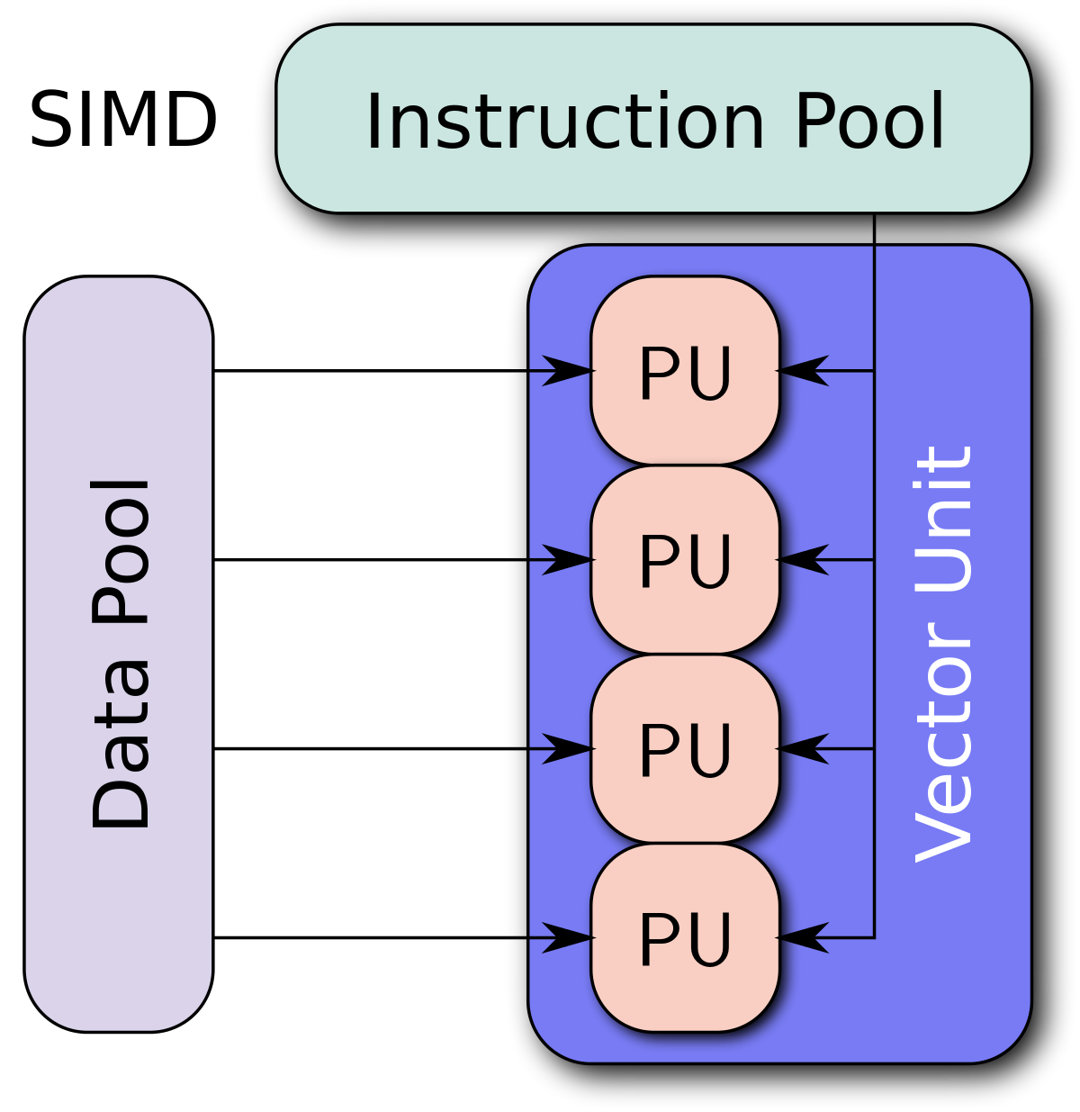
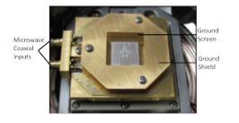
Objective
Proposes a muti-SIMD (single instruction, multiple datastream) scalable quantum computing architecture, using microwave control fanout, quantum teleportation and global/local memories
Efficient use of Multi-SIMD requires orchestration of qubits to maximize parallelism and to reduce qubit move/teleport operations, so communication-aware scheduling techniques are the main focus

Slide 3
Ion Trap Technology
Trapped-ion systems seem the most promising candidate for large scale QC (2015)
Well characterized qubits; long decoherence; can initialize, measure, and perform universal set of gates
Laser tuning for phase must be extremely precise, limiting QCs to ~6-12 lasers because they’re too big
Experiments with microwaves show potential multi-qubit control scalability from 10-100 qubits for a single microwave emitter; additional fanout level could create SIMD regions for ~100-10,000 qubits
Microwave control doesn’t actually allow for measurement, so assume laser-controlled measurement

Slide 4
Quantum Teleportation
EPR (Einstein-Podolsky-Rosen) pair q2/q3 pre-distributed between communication regions before teleportation, q3 is used as destination
States q1 and q2 are measured, then classically transmitted to q3 via X and Z operations
q1 state destroyed in process
Teleportation process requires up to 4x the communication cost of a single qubit
Assume all gates with same latency
Scheduling algorithm should optimize to minimize QT operations
Allows for simplified global memory to make long distance communication constant

Slide 5
Multi-SIMD Architecture Model
k SIMD compute regions with d qubits each
k limited by number of microwave signals, d limited by fanout without disturbing system
Uses microwaves to control states
Each region has a teleportation unit and local memory, as well as a global memory for scheduling purposes
QT uses classical communication channels, which reduces quantum decoherence over repeatedly moving qubits on physical fabric

Slide 6
Multi-SIMD Architecture (cont.)
The k SIMD regions can be used as active computation as well as passive storage for qubits
Active qubits must be moved between regions, idle qubits moved to global memory
Using local memory could reduce overhead
Centralized global memory model assumes QT latency constant
Constant cost favors parallelism; memory access takes same time for serial vs parallel
With simplified model, local memory assumed to take 1 compute cycle, global memory takes 4

Slide 7
Compiler Framework
Uses ScaffCC for scheduler
Translates algorithms in Scaffold into LLVM, then into QASM
for loops and state-based conditional statements allows for parallelism control
QASM uses qubits, cbits, and instruction set of universal gates (X, Y, Z), CNOT, H, Phase (S), and π/8 (T) gate
QECC Sub-operations below logic level are not optimized
Classical-To-Quantum-Gates (CTQG) integrated into flow
Decomposes arithmetic operations and if-then-else into QASM
Compiler uses decomposition stage to translate rotation and Toffoli gates into approximate equivalents
Scheduling is targeted after this decomposition step
Full unrolling using iteration counts, gate operations available w/ Scaffold; too large for benchmarks
Extend LLVM intermediate of ScaffCC to also analyze modules for leaf and non-leaf hierarchies
Allows for fine grained and coarse grained scheduling of leaf modules

Slide 8
Leaf Module Flattening Example
Two dependent toffoli operations in example
Toffoli operation decomposed into QASM gates
Modular case (coarse grained) does not detect inter-blackbox parallelism

Slide 9
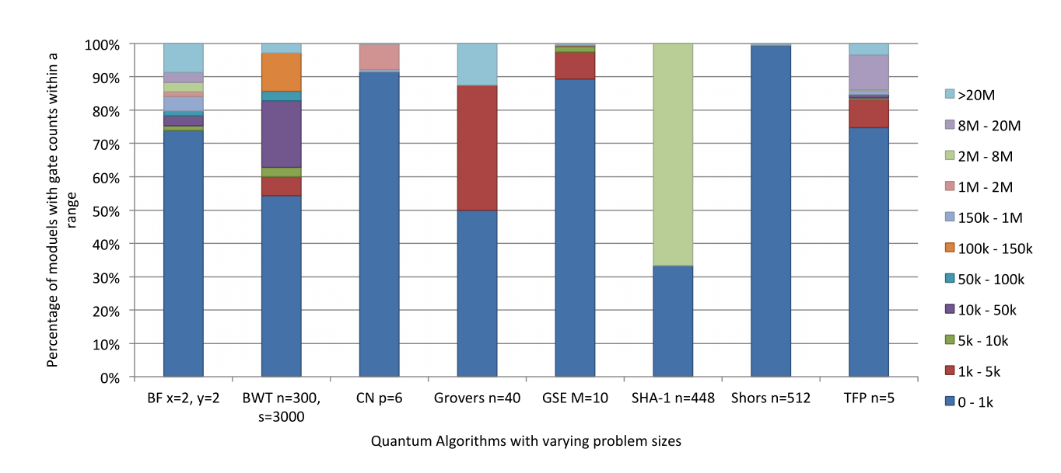
Flattening Results
Flattening Threshold (FTh) – resource estimation on each module to count number of gates
If less than threshold it is “flattened”
80% of modules were flattened

Slide 10
Execution and Scheduling Model
Multi-SIMD(k,d) model allows 1 to k discrete, simultaneous gates to executed in one logical timestep, each which can be applied on 1 to d qubits each
Gate operations assumed to take one logical timestep, constrained by longest operation time
Compiler assume modules are blackboxes, so all active qubits are flushed to global memory during calls
Assume ancilla bits are generated by global memory and teleported to SIMD needed
QT between SIMD regions must also be scheduled
Schedulers need to account for data movement costs; QT uses 4 timesteps, which results in a potential 5x longer runtime than computed critical path
Schedules are a list of sequential timesteps, each timestep contains an array of k+1 SIMD regions
0th region lists the qubits that will be moved and corresponding sources and destinations
Rest list the operations to be performed in the associated region

Slide 11
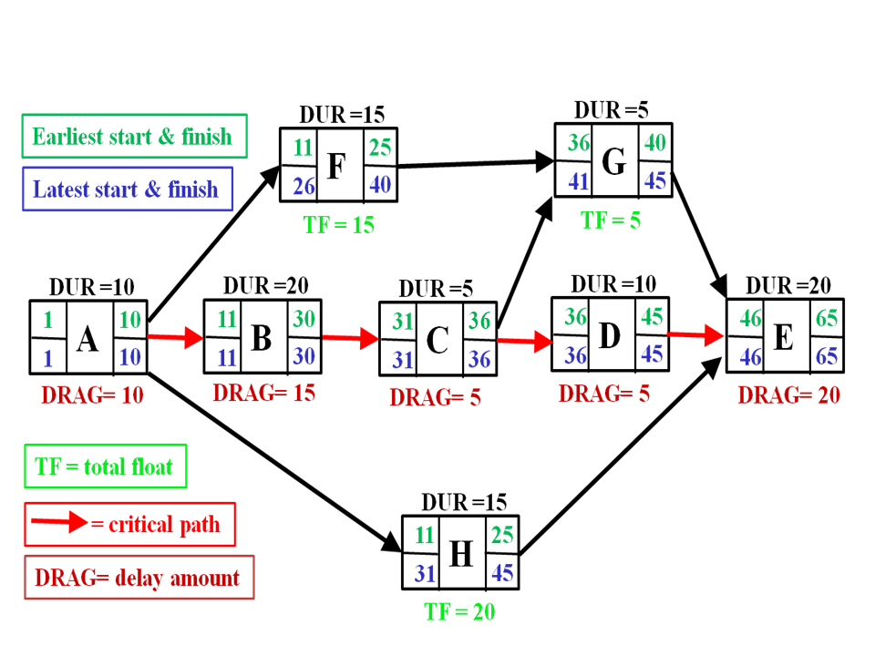
Scheduling with Ready Critical Path (RCP)
Method for scheduling tasks to prioritize those which take the longest, and schedule other tasks during this time to not delay the next dependency
Identifies the longest chain of successive dependent activities and associated time to identify critical paths
Schedule other tasks alongside this timing constraint to minimize delay
Maintains a ready list instead of a free list for tasks, and only queues tasks with dependencies met
Unsorted list of operations
Evaluates operation type, movement cost, and slack
Slack is graph distance between uses of a qubit
Can also weight each of these, but set to 1 for this case
Visualization of critical path method
https://en.wikipedia.org/wiki/Critical_path_method#/media/File:SimpleAONwDrag3.png

Slide 12
Ready Critical Path Algorithm
At each timestep, priority for each operation type in each SIMD is calculated with its associated region and operation
When priority for configurations have been calculated, the SIMD region and operation type with highest priority is scheduled
SIMD region is removed from available regions
Ready list updated
Repeat until all operations in ready list are scheduled or all regions occupied
Then update ready list with operations ready for next timestep until queue is empty

Slide 13
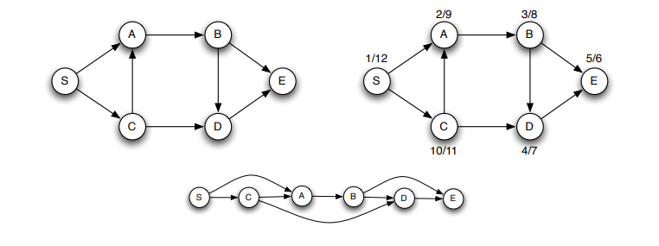
Longest Path First Search (LPFS)
Illustration of linearization of DAG
LPFS assigns l SIMD regions, where l < k for l longest paths
Longest path algorithm starts by finding the critical path in the LLVM generated DAG (directed acyclic graph)
http://www.mathcs.emory.edu/~cheung/Courses/171/Syllabus/11-Graph/Docs/longest-path-in-dag.pdf

Slide 14
LPFS Algorithm
Start at the top, sets a tag at each node with the furthest distance from the top
Find largest depth from bottom, then trace back and record paths
Multiple paths can be found sequentially and at arbitrary positions in the execution
Longest paths returned as ordered list of the operations to be performed
Stored in array of size l for each statically scheduled region
Operations not on any of the longest paths added to a free list
Scheduled in any available SIMD in range [l+1, k] based on order of operations as they are scheduled
2 more options SIMD & Refill
SIMD scheduling allows any SIMD region dedicated to longest path to execute an operation from the free list of the same type
Refill lets longest paths of unequal lengths to schedule another path to schedule after the first finished; refill a reserved SIMD with another longest path
Experiments run with l = 1 and SIMD and Refill enabled

Slide 15
Scheduling Algorithm
Because benchmarks are so large, coarse-grained scheduler stiches together the optimized leaf modules scheduled by RCP and LPFS
Algorithm for k SIMD regions
Operations are scheduled in priority order
Flexible blackbox dimensions considered for parallelizable modules to find the best combination
For each operation Fi in priority ordered set
Check dependencies for scheduling timestep
If dependencies don’t allow for it, serialize Fi into own schedule
Find l & w of operation
If it fits into constraints, just add to schedule of current block
If not, try different combinations of length and width to see if any will fit
If so, add it to schedule of box
If not, serialize operation into own box
Merge current box with total box dimensions

Slide 16
Scheduling Communication with Local Memory
To further reduce communication overheads, a rudimentary optimization using local memories attached to SIMD regions
Computed after communication-aware algorithm has finished mapping computations to SIMD and communication schedules are computed
Determine if some qubits can be moved to local memory instead of teleporting to global memory
Based on when the qubit’s next computation is scheduled
Local memory also constrained by capacity
Qubit can be stored in global memory, source local memory, destination local memory, or an idle SIMD region
Unless source SIMD region is idle, qubits moved to global memory
After each compute cycle, qubits not scheduled for next operation are moved to global or scratchpad memory; reused ones are left in place
Local moves are derived from the schedules on leaf modules and the schedule is modified to reflect moves.
If any region requires a move to/from global memory, wait 4 cycles to avoid race condition

Slide 17
Benchmarks Used
Benchmarks modularly describe quantum circuit acting on logical qubits. Range from 10^7 to 10^12 gates.
Grover’s Search
Amplitude amplification to search database of 2^n elements, parameterized by (n)
Binary Welded Tree
Uses random walk algorithm to find path between entry and exit node.
Parameterized by height (n) and time (s) to find solution
Ground State Estimation
Quantum phase estimation algorithm to estimate ground state energy of molecule. Parameterized by size of molecule in terms of molecular weight (M)
Triangle Finding Problem
Finds a triangle in dense, undirected graph; parameterized by nodes (n)
Boolean Formula
Algorithm to compute winning strategy for a game of Hex. Parameterized by board size (x, y)
Class Number
Computational algebraic number theory; compute class group of a quadratic number field
Parameterized by (p) number of digits after radix point for floating point numbers used
Secure Hash Algorithm 1
Message decrypted using SHA-1 function as oracle in Grover’s search. Parameterized by message size (n)
Shor’s Factoring Algorithm
Factorization using QFT. Parameterized by (n), size of bits in number to factor

Slide 18
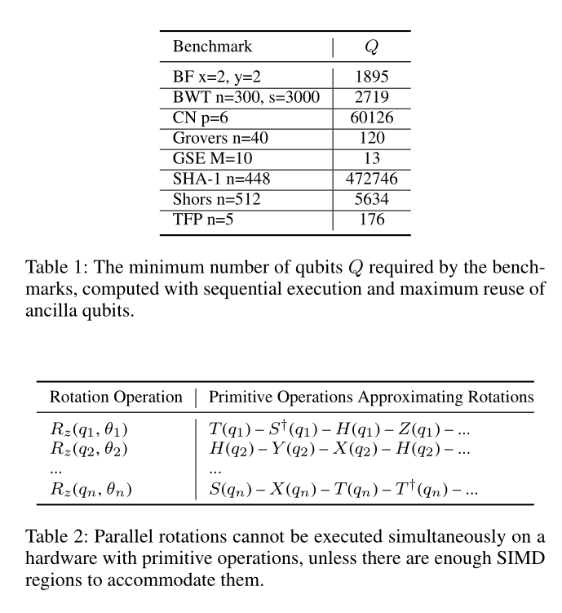
Results
CTQG modules are unoptimized and highly locally serialized
ex. Shor’s algorithm has long chains of non-parallelizable rotations which require many SIMD regions to parallelize; thus k sensitive

Slide 19
Benchmark Speedup Results
Without optimizing for communication latency, the estimated critical path runtime for Shors achieves a 10x speedup, while the actual runtimes only results in a 2-3x speedup
Still able to achieve estimated critical path runtime
Using a communication-aware scheduler increases the runtime speedups compared to a naïve movement model
GSE benchmark shows the largest improvement

Slide 20
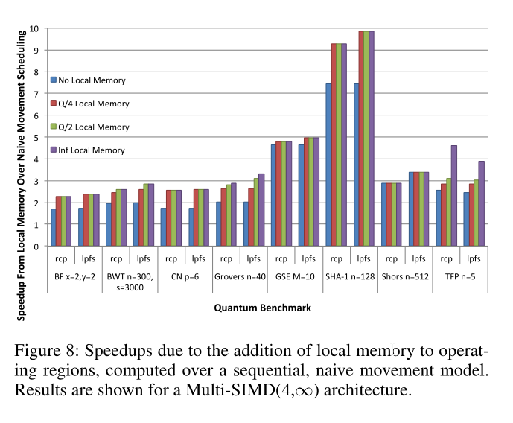
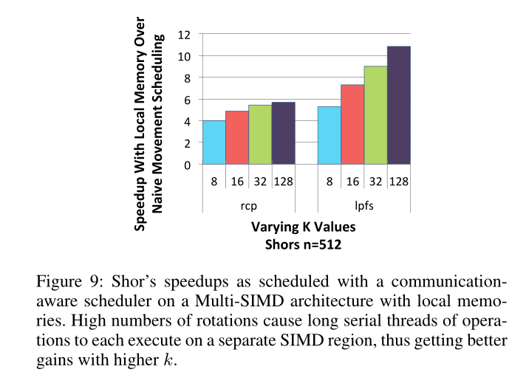
Speedup Results (continued)
Data level parallelism is able to capture most parallelism, even with relatively small k
Even though an infinite amount of data-parallelism is assumed, reducing d to 32 results in marginal changes in effectiveness
Solely logic-level approach results in optimized architecture that can even handle additional error correction qubits

Slide 21
Conclusion
Proposed Multi-SIMD architecture which incorporates quantum computing physical constraints works with compiler
Ion trap technology with microwave control and quantum teleportation used as practical bases
Scalable and maximizes parallelism while minimizing communication overhead
Hierarchical analysis scheme allows the scheduling algorithm to parallelize at coarse-grained and fine-grained levels
Produces observable speedup when evaluated against sequential execution using naïve communication model

Slide 22
Open Problems
Level below logic level not explored
Speedup is only in comparison to naïve sequential execution
Local and global memory optimizations, latency analysis
Proposed target architecture based on theoretical assumptions for practicality

Slide 23
Questions?

