Slide 1
Experimental Comparison of Two Quantum Computing Architectures
Norbert M. Linke, Dmitri Maslov, Martin Roerreler, Shantanu Debnath, Caroline Figgatt, Kevein A. Landsman, Kenneth Wright and Christopher Monroe
UMD, NSF, Microsoft Research and IonQ Inc.

Slide 2
Contents
Motivation
The Two Quantum Computers
Experiments
Experimental Results
Discussion

Slide 3
Motivation
Leap in performance with Quantum
Many candidate architectures
Need to determine which is better

Slide 4
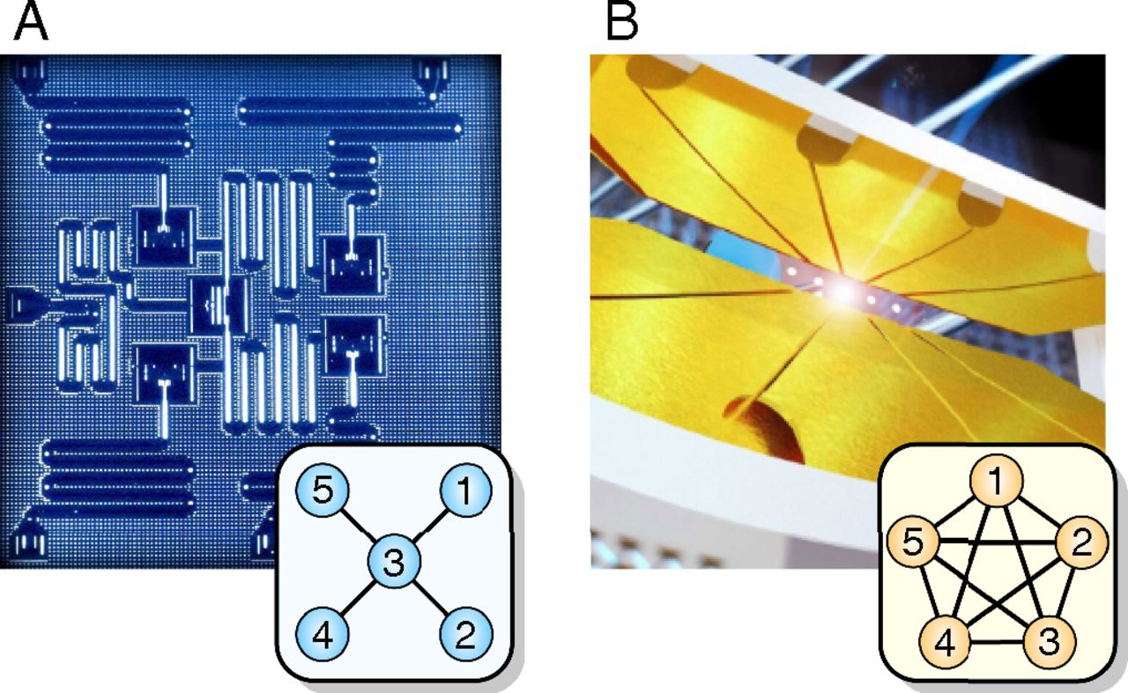
The Two Quantum Computers
IBM-Q (5 qubit, Star topology)
Ion Trap (5 qubit, Fully connected)

Slide 5
IBM-Q
Ion Trap
Superconductor Islands with Josephson Junctions
130ns single qubit gates
250-450ns 2-qubit gates
Lower accuracy (80%)
More gates used for mapping algorithms
Uses the Clifford + T library (X, Y, Z, T, H, CNOT and S)
Ytterbium Ions
20μs single qubit gates
250μs 2-qubit gates
Highly accurate (95.7%)
Requires fewer gates
Uses R/XX Library
Notes:
These accuracies are readout accuracies
Gate for ion trap 99.1 and 97 (1 and 2)
Single qubit ion 0 99.7 and 1 99.1
Reading all 5 is 95.7
IBM Q reading all 5 is 80
Reading is 96
99.7 and 96.5 for 1 and 2 qubit gates

Slide 6
More on Accuracy
IBM-Q
Ion Trap
1 qubit gate – 99.7%
2 qubit gate – 96.5%
Reading one qubit – 96%
Reading all five qubits – 80%
1 qubit gate – 99.1%
2 qubit gate – 97%
Reading one qubit – 99.7 for 0 and 99.1 for 1
Reading all five qubits – 95.7%
Notes:
These accuracies are readout accuracies
Gate for ion trap 99.1 and 97 (1 and 2)
Single qubit ion 0 99.7 and 1 99.1
Reading all 5 is 95.7
IBM Q reading all 5 is 80
Reading is 96
99.7 and 96.5 for 1 and 2 qubit gates

Slide 7
Experiments
Four algorithms (Gates) :-
Margolus
Toffoli
Bernstein-Vazirani
Hidden Shift

Slide 8
Margolus
Simplified Toffoli gate
Uses 3 CNOTs
Creates a phase shift for |101> input
Notes:
http://algassert.com/quirk#circuit={%22cols%22:[[%22X%22,1,%22X%22],[%22Sample3%22],[1,1,%22Y^%C2%BC%22],[1,%22%E2%80%A2%22,%22X%22],[1,1,%22Y^%C2%BC%22],[%22%E2%80%A2%22,1,%22X%22],[1,1,%22Y^-%C2%BC%22],[1,%22%E2%80%A2%22,%22X%22],[1,1,%22Y^-%C2%BC%22]]}

Slide 9
Toffoli
Uses five 2-qubit gates for Ion trap
Uses ten 2-qubit gates for IBM-Q

Slide 10
Bernstein Vazirani
Finds c in f(x) = x.c
c is encoded as CNOT by oracle on ancilla bit

Slide 11
Hidden Shift
Finds the hidden s for Boolean function f
Oracle gives function f(x+s)
Returns s for above shifted function in one call

Slide 12
Gates Required for each Circuit
Connectivity | Star |  | LNN |  | Full
Hardware | Superconductor |  | Superconductor |  | Ion Trap
Gate type | 1-qubit | 2-qubit | 1-qubit | 2-qubit | 1-qubit | 2-qubit
Margolus | 20 | 3 | 20 | 3 | 11 | 3
Toffoli | 17 | 10 | 9 | 10 | 9 | 5
Bernstein–Vazirani | 10 | 0–4 | 10 | 0–10 | 14–26 | 0–4
Hidden shift | 28–34 | 10 | 20–26 | 4 | 42–50 | 4
QFT-3 | 42 | 19 | 11 | 7 | 8 | 3
QFT-5 | * | * | 35 | 28 | 22 | 10

Slide 13
Experimental Results
Connectivity | Star shaped |  |  | Fully connected
Hardware | Superconducting |  |  | Ion trap
Success probability/% | Obs | Rand | Sys | Obs | Rand | Sys
Margolus | 74.1 | 82 | 75 | 90.1 | 91 | 81
Toffoli | 52.6 | 78 | 59 | 85.0 | 89 | 78
Bernstein–Vazirani | 72.8 | 80 | 74 | 85.1 | 90 | 77
Hidden shift | 35.1 | 75 | 52 | 77.1 | 86 | 57
Notes:
Random is (1-eg)rootN (1-em)M
Sys is (1-eg)N (1-em)M

Slide 14
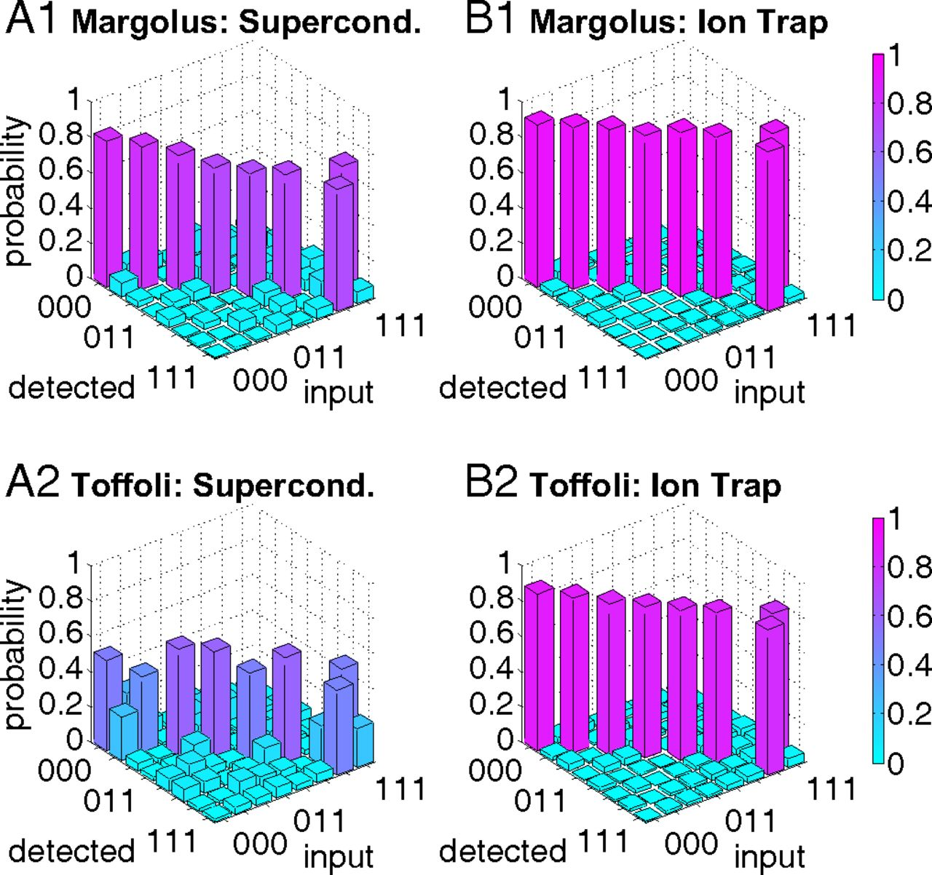

Slide 15
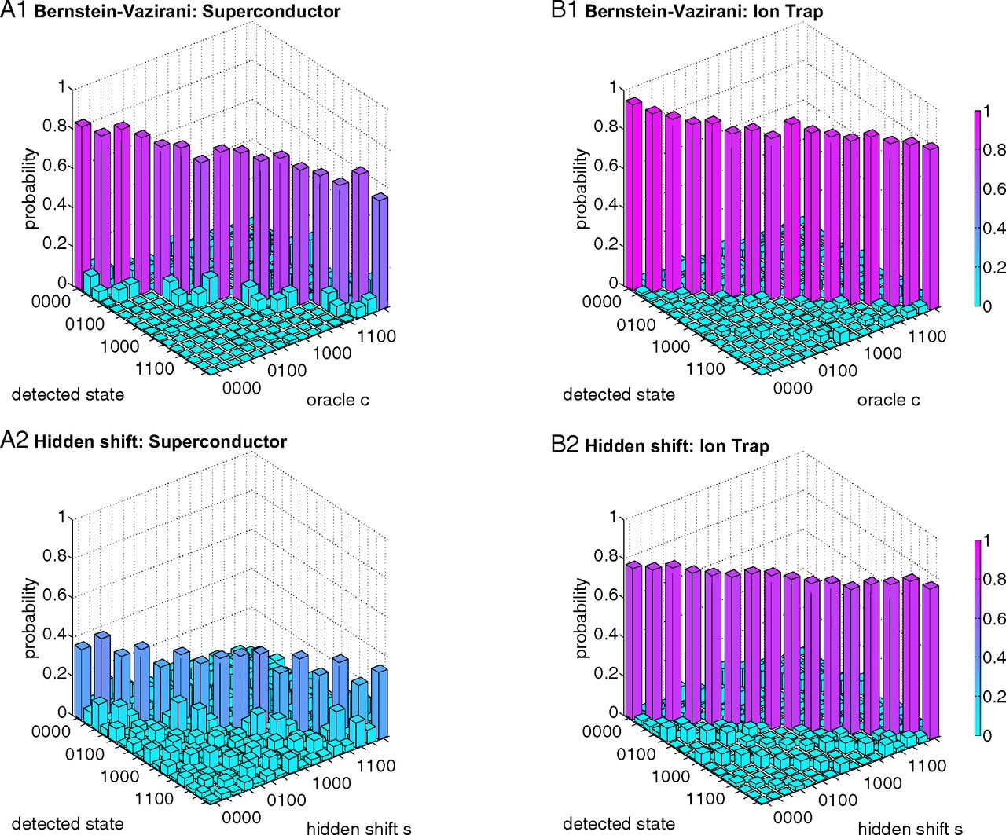

Slide 16
Open Problems
Number of qubits is small
Need scalable architecture
Remove cross talk
Maintaining controllability
Ensuring accuracy
Connectivity is an issue
Automated calibration
Notes:
Quantum Computers is wires to quantum bits
Scalability issues in in IBM-Q is the ability to send wires to the qubits (Control and Biasing)
Microvwa
Another issue is to manage the heat with scale
In Ion Trap the designs hinge on precise laser beams to measure and excite the ions

Slide 17
Thank You

Slide 19
