Slide 1
Quipper : A Scalable Quantum Programming Language
Authors: Alexander S. Green, Peter LeFanu Lumsdaine, Neil J. Ross, Peter Selinger, Benoît Valiron
Slides By: Brody Eastwood

Slide 2
Motivation (as of June 2013)
Algorithms understood
Hardware not understood
Software difficult to write
Often hardware-specific and very low level
Quantum Turing machine
Quantum lambda calculus (van Tonder/Selinger and Valrion)
QCL
IO Monad

Slide 3
Knill’s QRAM Model
Quantum computer is a co-processor with two types of instructions
Unitary (responds with an ACK)
Measure (responds with measurement)
Checks for physical impossibility at either compile or run time
Use gates one-by-one

Slide 4
Techniques used in quantum algorithms

Slide 5
Algorithm Description
All algorithms made of gates
Useful algorithms nearly impossible to describe as gates
Need way of programming at a higher level

Slide 6
Quantum Primitives
QFT
Amplitude Amplification (Grover’s)
Quantum Walks
Phase Estimation
State Distillation
Oracles
Circuits
Useful to be able to use directly

Slide 7
Quipper

Slide 8
Quipper is an embedded language
Haskell is host language
Can be considered a library with a preferred style of writing programs
Uses many features of Haskell
Higher-order operators
Overloaded operators

Slide 9
Extended Circuit Model
Scoped Ancillas
Simplifies reuse of ancillas
Assertive termination
Can be false, compiler assumes it isn’t
Mixed classical/quantum circuits
Useful for oracles

Slide 10
Parameters and Inputs
Many algorithms cycle between circuit generation and circuit runs
Parameters known at circuit generation
Inputs only known during circuit run
Quipper types:
Bool (parameter)
Bit (input)
Qbit (input)

Slide 11
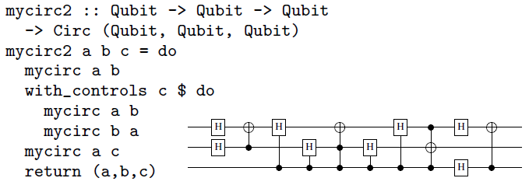
Actual Programming
Procedurally
One-at-a-time but ends up compiled together
Block structure
Like procedurally, but grouped together
Efficiently stored

Slide 12
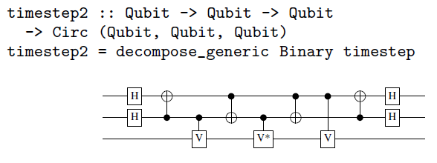
Actual Programming Cont.
Circuit operators
Many stock operations (like decompose_generic) available
Extensible quantum data types
The general type can hold multiple bits

Slide 13
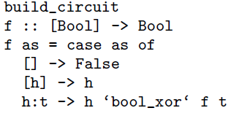
Oracles
Automatic generation of quantum oracles
Write classical template under “build_circuit”
Unpack the template into classical_to_reversible
Quantum oracle gets generated

Slide 14
Algorithms

Slide 15
Triangle Finding
Seven algorithms were made in Quipper
Only Triangle Finding was discussed in this paper (and only partially)
Triangle finding
Used 30189977982990 (over 30 trillion) total gates.
Used 4676 qubits.

Slide 16
The circuits for o8_MUL and o4_POW17

Slide 17
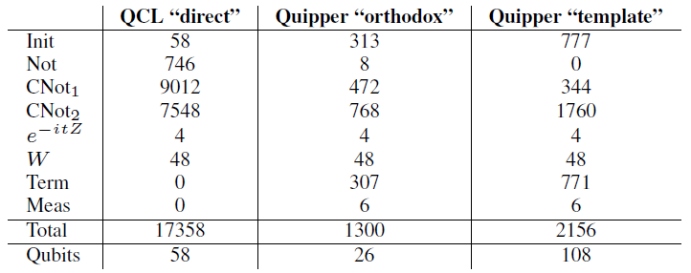
Binary Welded Tree
BWT isn’t discussed in the paper
Quipper measured twice:
Orthodox: Hand-coded oracle
Template: Autogenerated oracle
It is compared to QCL
Has no autogeneration of oracles
Quipper more efficient in gates
Only more efficient in Qubits when oracle coded by hand

Slide 18
Conclusion

Slide 19
Contribution
Quipper itself
First easily scalabe quantum programming language
Opens door for using formal methods of analyze quantum algorithms
Quipper used to program 7 algorithms
11 People
55 man months
Usable to estimate resource utilization
Considered both usable and useful

Slide 20
Discussion
Open problems
No linear type system
Can’t check for non-duplication of quantum data
Not supported by any hardware
Reality ended up moving away from Quipper
Quiskit

Slide 21
Questions?

